Slide 1
Towards Precise Instruction Scheduling
Prepared by: Shereen Subhi

Slide 2
Instructions with a varying latency (e.g load operation) constitute a challenge, given the relatively high frequency of memory reads (load instruction account for roughly 20%-30% of all instructions executed).

Slide 3
Outline
Memory Dependence Speculation
Speculative execution of load instruction
Towards Precise Scheduling

Slide 4
Memory Dependence Speculation
Memory dependence speculation implies to not delay executing a load until all its ambiguous dependences (i.e., a load consumes a value that may be produced by a store preceding it in the total order) are resolved, performance may have improved as the load executed earlier than it would had to wait for its ambiguous dependences to be resolved. However, if a true dependence was violated, the speculation was erroneous (i.e., a mispeculation). In the latter case, the effects of the speculation must be undone.

Slide 5
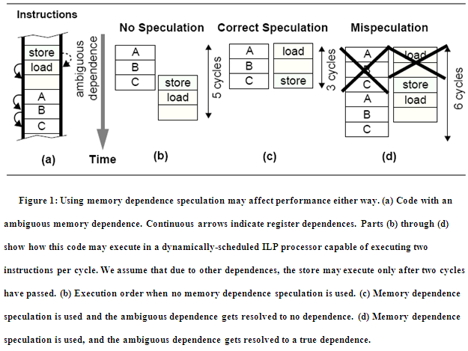

Slide 6
  Age-ordered load queue (LQ) and store queue (SQ)
Mechanism detecting erroneous speculation
When a load executes, its address is checked with all older stores in the SQ. If a match is detected, the youngest store forwards the data to the load (load forwarding). Conversely, when a store executes, it must check the LQ looking for younger loads to the same address that have executed prematurely. When matches are found, the processor needs to re-execute (or replay) premature loads and their dependents.

Slide 7
Speculative execution of load instruction
To reduce the penalty due to data mis-speculations, the processor can predict whether the load will hit or miss in the cache
Early identification of cache misses allows the processor to more accurately schedule instructions that are dependent on loads and to more precisely prefetch data into the cache.

Slide 8
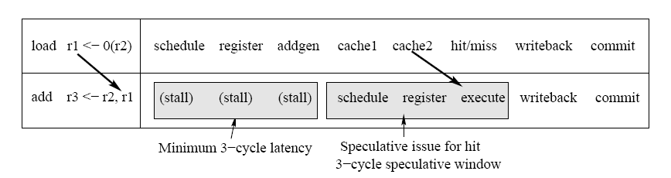
Problem Statement
Example of data speculation for a load instruction

Slide 9
Towards Precise Scheduling
The goal of the scheduler is to be able to determine the access latency for load operations and schedule the dependent instructions accordingly
Once the exact latency of a load operation is found, the arrival time of the source data is stored in the RUU and passed along to the instructions that depend on the load.

Slide 10
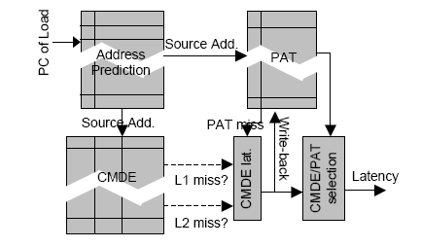
Scheduling scheme

Slide 11
Scheduling Algorithm
The output of the CMDE is hit/miss predictions for level 1 and 2 caches, the output of the PAT is the latency if the address is found in PAT, PAT miss indication, otherwise. PAT miss indication activates the CMDE latency calculation, which sets the latency to one of level 1, level 2 hit latency or memory access latency according to the CMDE output.

Slide 12
  History-Based Prediction
Similar to the load hit/miss prediction technique used in Alpha 21264
Each table entry is a 4-bit saturating counter that is incremented by 2 for each time the load misses and decremented by 1 for each time the load hits. The most significant bit is used to predict hit or miss. If this bit is 1, the load is predicted to miss. If it is 0, the prediction is maybe.

Slide 13
  Cache miss detection engine (CMDE Techniques)
If an address is not found in the PAT, the scheduler assumes that this address is not in-flight and accesses the CMDE structures for the level 1 data cache. If the CMDE structures do not indicate a miss, the delay is estimated to be the level 1 cache hit latency.
If the CMDE structures indicate a miss, the CMDE structures for the level 2 data cache are accessed. Similarly, if the processor has 3rd or 4th level data caches. All CMDE techniques have reliable outputs, if they produce a miss output, the access is guaranteed to miss. Otherwise, they produce a maybe output. In this case the access might miss or hit in the cache.

Slide 14
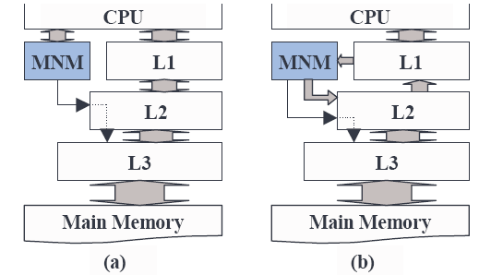
Cache miss detection structures (MNM machine)
Different Mostly No Machine (MNM) positions. In (a) the MNM and L1 cache are accessed in parallel, in (b) MNM is accessed only after the L1 miss.

Slide 15
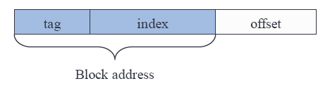
Block address used by MNM
When a block is placed into a cache, all the bytes in that block are placed into the cache. So in all the techniques, block address is used

Slide 16
Partitioned-Address Filter
Instead of using the entire cache line address, the address can be split into m partitions, with each partition using its own array of bits. A cache miss is identified when one or more of the address partitions for the address of a requested line does not belong to the respective address partition of any line in the cache.

Slide 17
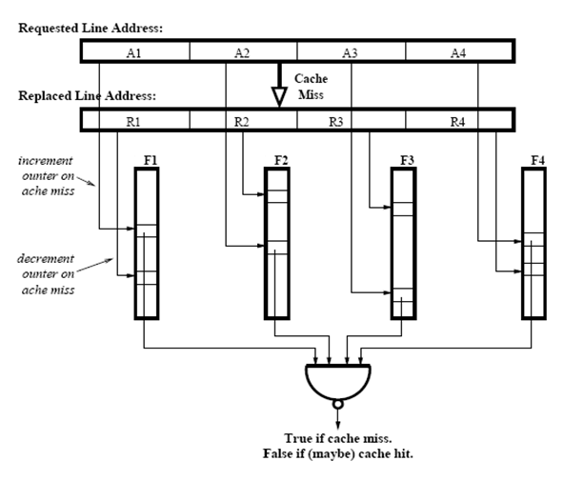
Partitioned-Address Filter for Cache Miss Detection

Slide 18
Partial-Address Filter
The partial-address filter uses the least-significant bits of the line address to index a small array of bits. Each bit indicates whether the partial address matches any corresponding partial address of a line in the cache. The least-significant bits are selected rather than most significant bits to reduce the chance of collisions.

Slide 19
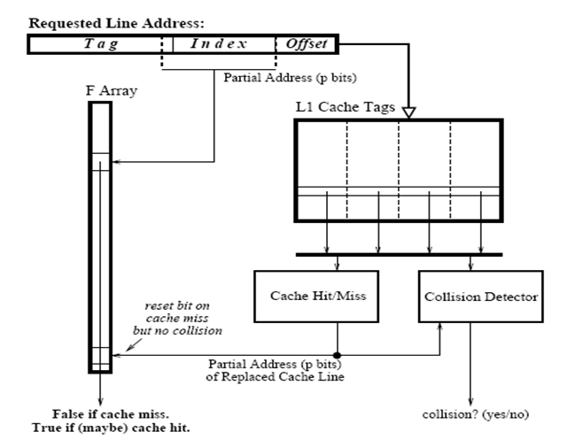
Partial-Address Filter for Cache Miss Detection

Slide 20
Conclusion
Data speculation allows instructions that are dependent on a load to be scheduled before the latency of the load is known.
Scheduler described used to estimate the arrival of cache blocks enabling more precise scheduling of instructions dependent on these loads.

Slide 21
Future Work
An extension of this work to use the generated information about the cache hits and misses to perform prefetching. The processor can start fetching the data for the access instead of waiting until the load instruction reaches the execute stage.

Slide 22
Thank you

