Slide 1
A Study on Cache Replacement Policies
Prepared by :Asma Abdelkarim

Slide 2
Outline
Introduction
MLP-Aware Cache Replacement policies
Dynamic Insertion Policy (DIP)
Other adaptive replacement policies
Shepherd cache
Extending DIP for shared caches in CMPs
PIPP shared caches in CMPs

Slide 3
Introduction
Convention LRU policy is not adequate for last level caches:
Last level caches lack temporal locality
LRU causes cache thrashing for memory-intensive workloads
A miss in a level two cache causes long stalls due to memory access
LRU has bad performance for shared caches in CMPs
New proposed policies: improve performance while maintaining minimum hardware overhead and design changes

Slide 4
MLP-Aware Replacement Policies
Memory Level Parallelism (MLP) is the ability to handle multiple cache misses in parallel.
Reasons for MLP: superscalar processors, non-blocking caches, pre-fetching
MLP is not uniform across memory accesses: some misses occur in isolation and some occur in parallel.
MLP-Aware replacement policies aim to reduce isolated misses ----> reduce long memory stalls

Slide 5
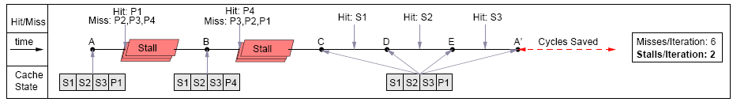
MLP-Aware Replacement Policies
Average memory access time = Hit Time + Miss Rate * Miss Penalty
a) Belady’s Optimal replacement policy
b) MLP-Aware replacemnet policy

Slide 6
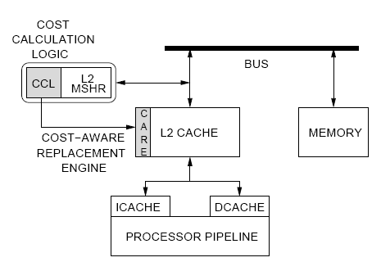
MLP-Aware Replacement Policies
Micro-architecture
Micro-architecture of MLP-Aware cache replacement policies

Slide 7
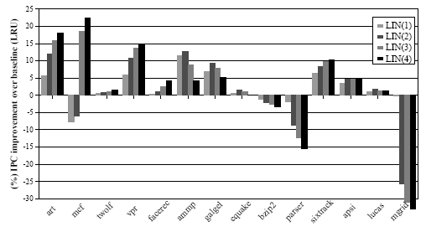
MLP-Aware Replacement Policies
LIN Results
The Linear Policy (LIN) combines both recency and MLP cost.

Slide 8
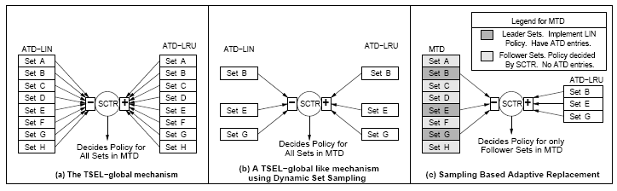
Hybrid MLP-Aware Replacement Policies
Tournament selection between LRU and MLP

Slide 9
Hybrid MLP-Aware Replacement Policies
Results

Slide 10
Dynamic Insertion policy (LIP/BIP)
Large workloads cause 100% miss rate in L2 caches under LRU.
Divide the replacement policy into: victim selection and insertion.

Slide 11
Dynamic Insertion policy (LIP/BIP)
LRU Insertion Policy (LIP):
- Inserts all lines in the LRU position.
- Block is promoted to the MRU position only if it’s re-referenced.
- Near- optimal performance for cyclic access patterns
- Doesn’t adapt to changes in the workload
Bimodal Insertion Policy (BIP) allows new lines to be inserted in the MRU position with low probability (e)

Slide 12
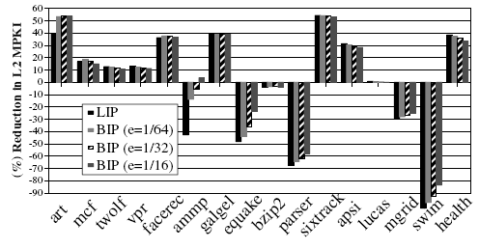
Dynamic Insertion policies
BIP/LIP results

Slide 13
Dynamic Insertion policies (DIP)
Set Dueling
Dynamic Insertion Policy dynamically chooses between LRU and BIP using SET Dueling

Slide 14
Dynamic Insertion policies (DIP)
Results

Slide 15
Dynamic Insertion policies (DIP)
Micro-architecture

Slide 16
Other Adaptive Replacement Policies
Adaptive replacement policies that combine any two conventional replacement policies (LRU, LFU, FIFO, Random) using SBAR.

Slide 17
Shepherd Cache
The cache sets are logically divided into two caches: the shepherd cache and the main cache.
The shepherd cache emulates the operation of Belady’s optimal replacement policy.
Each shepherd cache line has a column of counters that keep track of imminence of other lines.
New lines are inserted in the shepherd cache, lines evicted from the shepherd cache replaces the line with the least imminence, or does self replacement.

Slide 18
Shepherd Cache
Micro-architecture

Slide 19
Shepherd Cache
Results

Slide 20
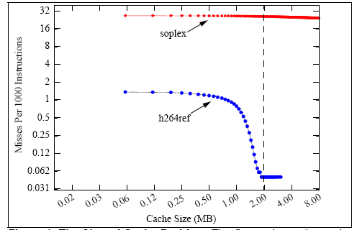
Extending DIP for Shared Caches in CMPs
Thread Un-aware Adaptive Policy
Directly extending DIP to work for shared caches is inefficient: all workloads will be using the same policy.
LRU serves workloads according to the demand not to the benefit: not all workloads benefit from the cache the same.

Slide 21
Extending DIP for Shared Caches in CMPs
Thread Aware Replacement policy (TADIP)

Slide 22
Extending DIP for Shared Caches in CMPs
Results

Slide 23
Double-DIP
Adding Promotion Policies
Another optimization for DIP is including what is called promotion policies.
BIP directly promotes a re-referenced line to the MRU position.
Dynamic Promotion Policy (DPP) uses set dueling to choose among two promotion policies: MRU promotion policy and Single-Step Incremental Promotion Policy (SIPP)
More optimized policy is the Dynamic Promotion with Interpolated Increments Policy (D-PIIP).

Slide 24
Double-DIP
Adding Promotion Policies

Slide 25
Double-DIP
Adding Promotion Policies

Slide 26
Double-DIP
Adding Promotion Policies/ Results

Slide 27
PIPP: Promotion/Insertion Pseudo-Partitioning
PIPP uses way partitioning to decide the amount of partitions specified for each core

Slide 28
PIPP: Promotion/Insertion Pseudo-Partitioning

Slide 29
Conclusion
Recent replacement policies are proposed to improve performance of last level caches both in
uni-processor and multi processor systems.
These policies can be combined with other optimization techniques (e.g. pre-fetching, bypassing….)to further improve the performance of the cache
The performance of the proposed policies can not be accurately compared because of the lack of a unified simulation environment

