Slide 1
Big Data Analysis
Course Introduction
Prof. Gheith Abandah
أ.د. غيث علي عبندة

Slide 2
Outline
Instructor Information
Video: What is Data Science?
Data Science Hierarchy of Needs
Data Science Skills
Textbook and References
Course Objectives and Outcomes
Course Outline
Policies and Grading
Important Dates

Slide 3
Instructor Information
Instructor: Prof. Gheith Abandah
Email: abandah@ju.edu.jo
Office: CPE 406
Home page: http://www.abandah.com/gheith
MS Team: Link
Office hours: Sun – Wed: 12:30 – 1:30

Slide 4
What is Data Science?
YouTube Video from Joma Tech
What REALLY is Data Science? Told by a Data Scientist
https://youtu.be/xC-c7E5PK0Y

Slide 5
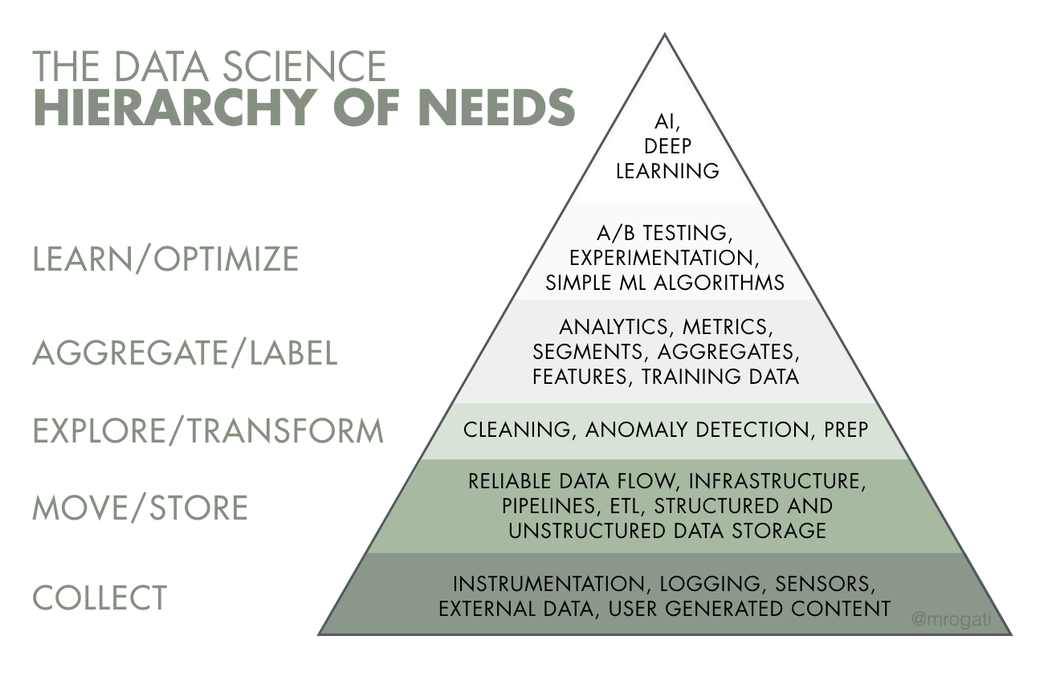
Data Science Hierarchy of Needs

Slide 6
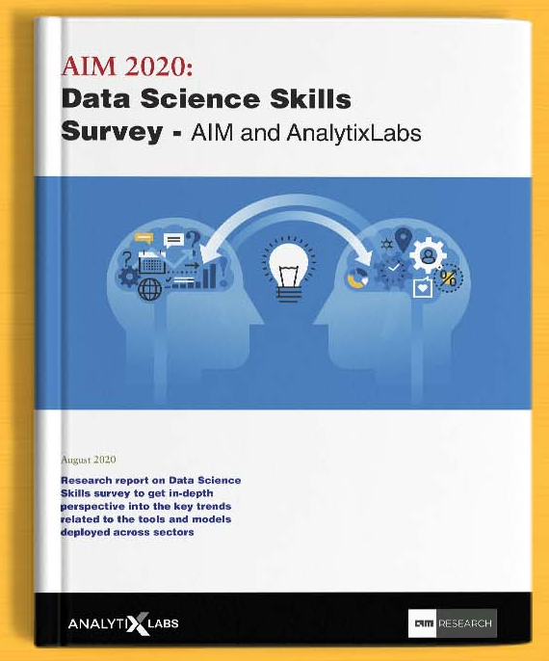
Data Science Skills
Data Science Skills Study 2020
https://analyticsindiamag.com/aim-2020-data-science-skills-survey-aim-and-analytix-labs/
By AIM and AnalytixLabs
Released on 17/8/2020

Slide 7
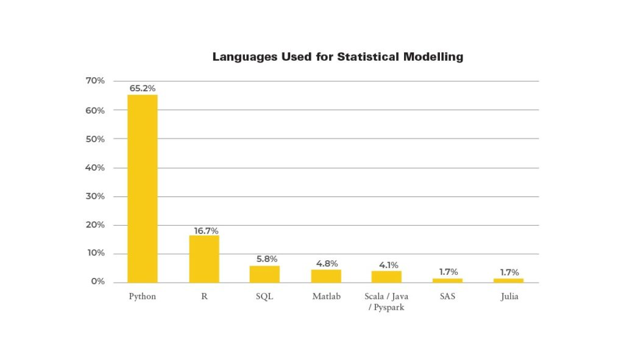

Slide 8
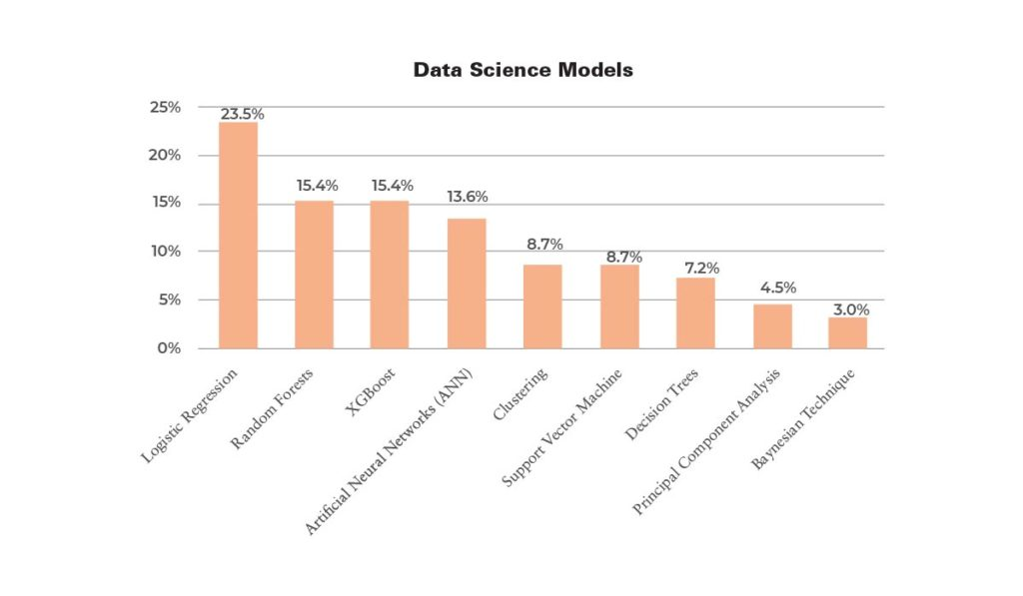

Slide 9
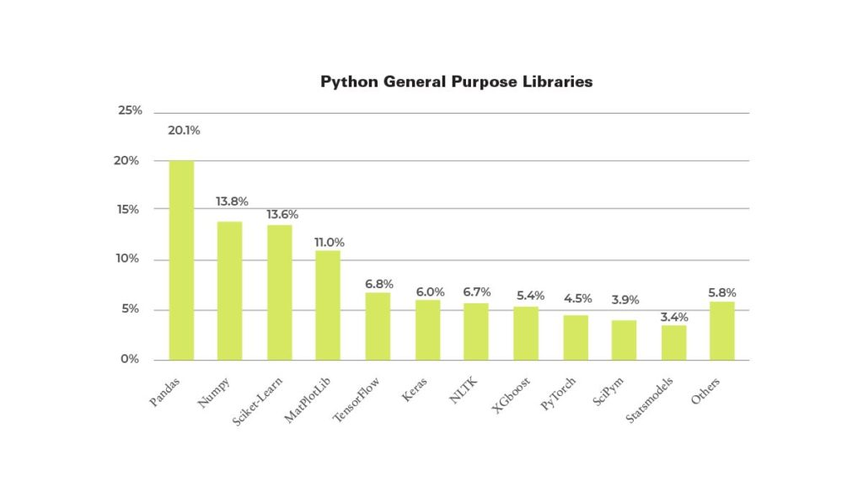
Notes:
NLTK: Natural Language Toolkit
PyTorch by Facebook

Slide 10
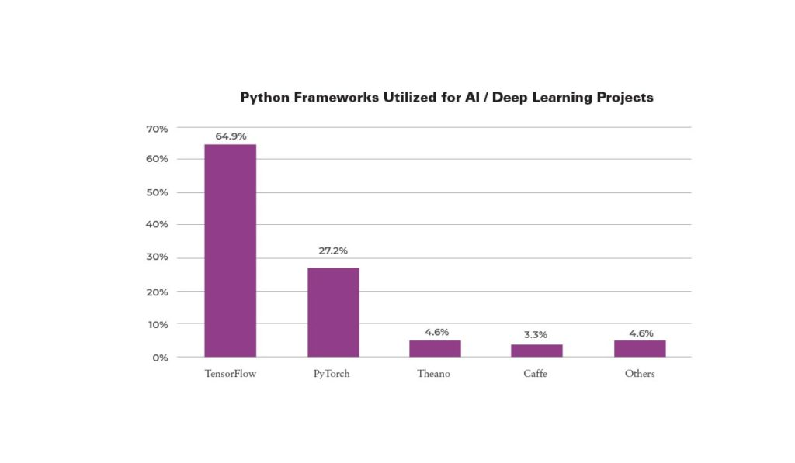

Slide 11
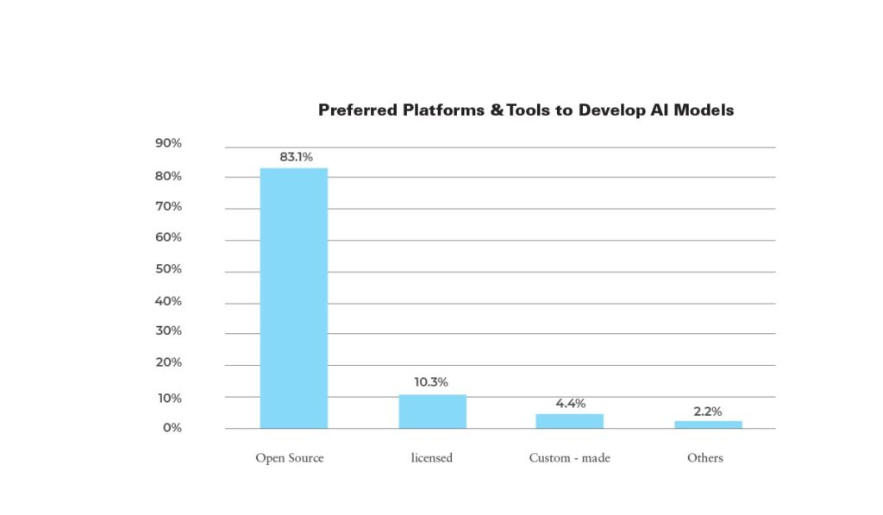

Slide 12
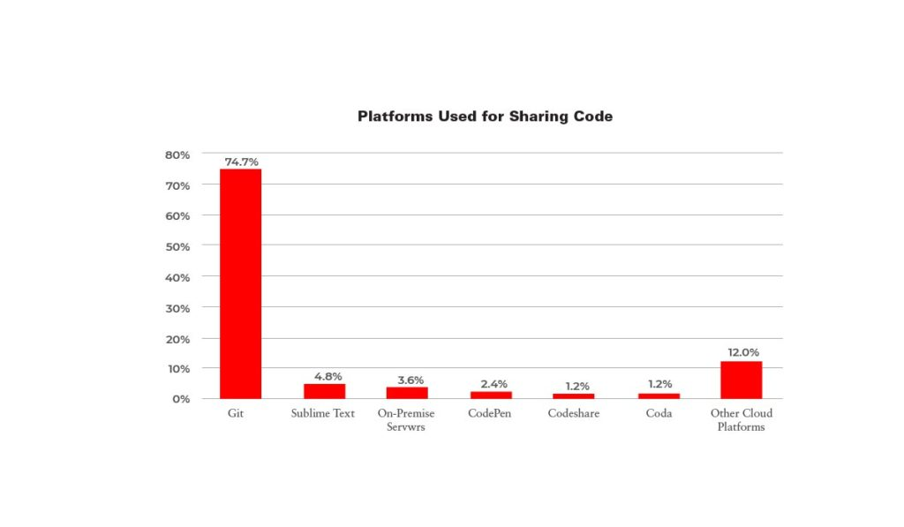

Slide 13
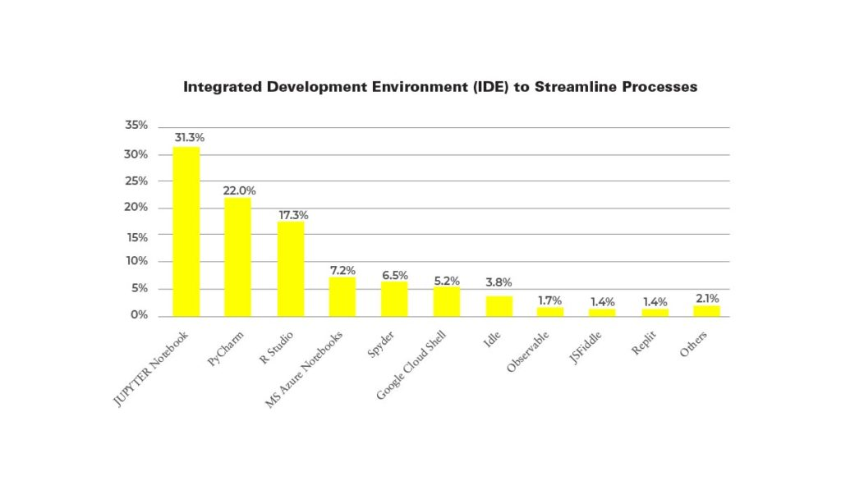

Slide 14
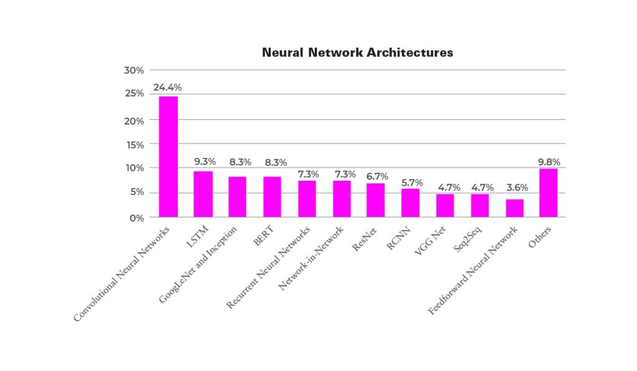

Slide 15
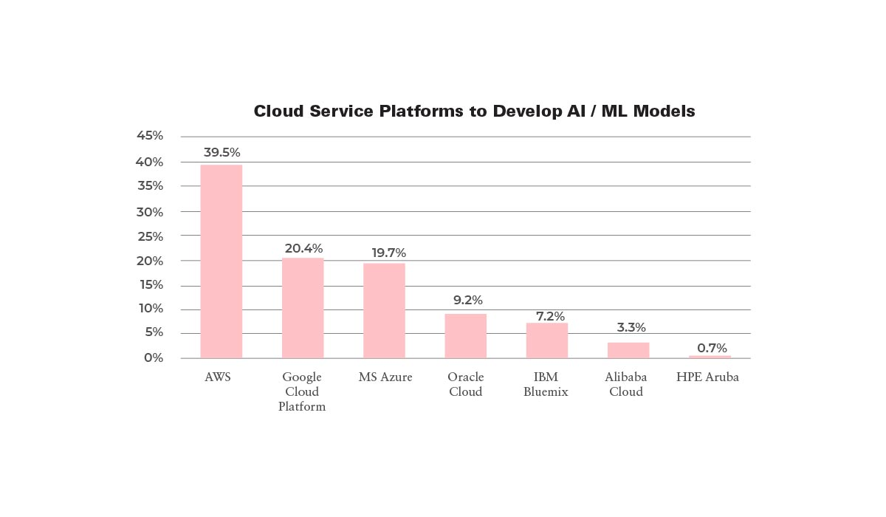

Slide 16
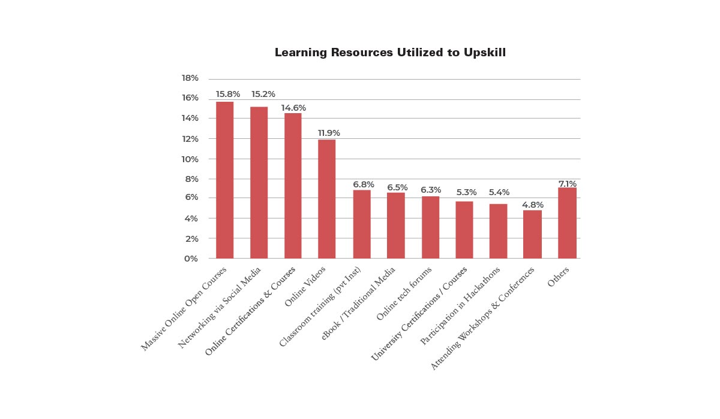

Slide 17
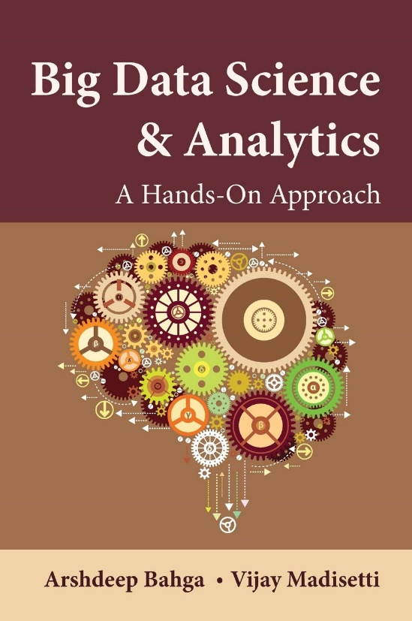
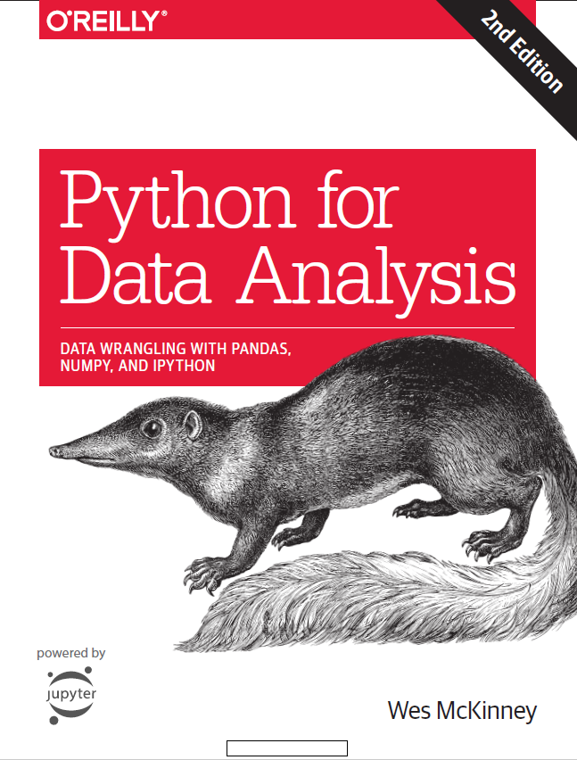
Textbooks
Arshdeep Bahga and Vijay Madisetti, Big Data Analytics: A Hands-On Approach, 2019.
Wes McKinney, Python for Data Analysis: Data Wrangling with Pandas, NumPy, and Ipython, O’Reilly Media, 2nd Edition, 2018.
Course web page: http://www.abandah.com/gheith/?page_id=2759

Slide 18
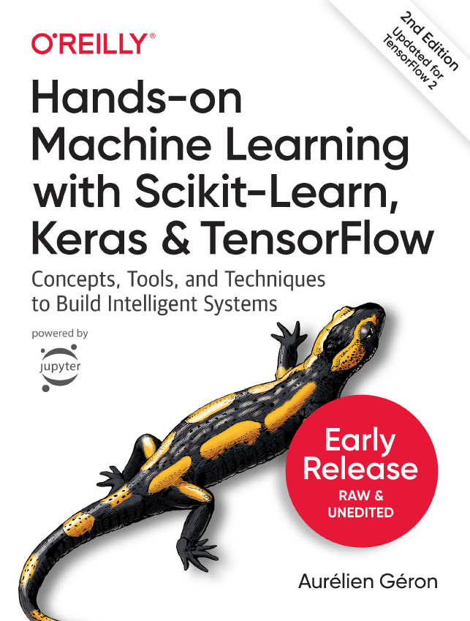
References
Jake VanderPlas, A Whirlwind Tour of Python, O’Reilly Media, 2016.
Joel Gurs, Data Science from Scratch, O’Reilly Media, 2015.
Aurélien Géron, Hands-On Machine Learning with Scikit-Learn, Keras and TensorFlow: Concepts: Tools, and Techniques to Build Intelligent Systems, 2nd Edition, O’Reilly Media, Oct 2019.

Slide 19
Course Objectives
Introduce students to the basic concepts and techniques in big data.
Introduce students to the practical techniques used in data analytics including loading, cleaning, preparation, wrangling, visualization, and analysis.

Slide 20
Course Outcomes
Know the main concepts and techniques used in handling big data and performing data analytics.
Use Python and its specialized libraries to gain insight from data.

Slide 21
Course Outline
No | Topic | Hours | Reference
1.1 | Course Introduction | 1.5 | 3
1.2 | Introduction to Python, Anaconda and PyCharm | 2 | 3
1.3 | Python Basics, IPython and Jupyter Notebooks | 3 | 3
1.4 | Built-in Data Structures, Functions and Files | 3 | 3
1.5 | Object Oriented Programming in Python | 2 | 3
1.6 | NumPy Basics: Arrays and Vectorized Computation | 6 | 3
1.7 | Pandas Data Structures, Essential Functionality & Descriptive Statistics | 6 | 3
2.1 | Introduction to Big Data | 3 | 1
2.2 | Big Data Architectures and Patterns | 3 | 1
2.3 | MapReduce Patterns | 3 | 1

Slide 22
Course Outline
No | Topic | Hours | Reference
3.1 | Data Loading, Storage and File Formats | 6 | 2
3.2 | Data Cleaning and Preparation | 6 | 2
3.3 | Data Wrangling: Join, Combine and Reshape | 3 | 2
3.4 | Plotting and Visualization With Matplotlib and Seaborn | 6 | 2
3.5 | Data Aggregation and Group Operations | 3 | 2
3.6 | Time Series | 3 | 2

Slide 23
Policies
Attendance is required
All submitted work must be yours
Cheating will not be tolerated
Open-book exams
Covid-19 vaccination or valid PCR test is required to join the classes.
Check department announcements at:
  http://www.facebook.com/pages/Computer-Engineering-Department/369639656466107

Slide 24
Grading
Assignments and Quizzes 20%
Midterm Exam 30%
Final Exam 50%

Slide 25
Important Dates
Mon 11 Oct, 2021 | First Lecture
Wed 1 Dec, 2021 | Midterm Exam
Wed 12 Jan, 2022 | Last Lecture
Jan 18 – 30, 2022 | Final Exam Period

