Slide 1
Chapter 03: Modern Architectures
Adapted by Prof. Gheith Abandah

Slide 2
Learning Outcomes
Nowadays, single-threaded CPU performance is stagnating.
Taking full advantage of modern architectures requires not only sophisticated (parallel) algorithm design but also knowledge of features such as the memory system and vector units.
Learn about the memory hierarchy with fast caches located in-between CPU and main memory to mitigate the von Neumann bottleneck.
Write programs making effective use of the available memory system.
Understand Cache Coherency and False Sharing in multi-core CPU systems.
Study the basics of SIMD parallelism and Flynn’s taxonomy.
Learn about the vectorization of algorithms on common CPUs using C/C++ intrinsics.

Slide 3
Outline
Memory Hierarchy
  von Neumann Bottleneck
  Cache Memory
  Optimizing Cache Accesses
  Cache Coherence
  False Sharing
Levels of Parallelism
  Flynn’s Taxonomy
  SIMD Concept
  AoS and SoA
Homework

Slide 4
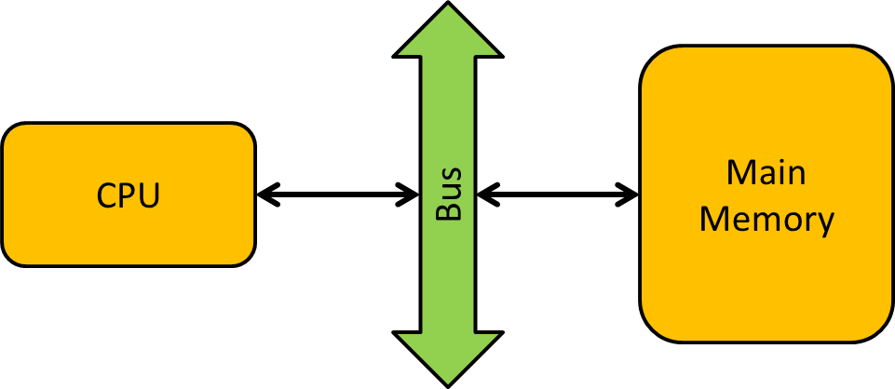
Basic Structure of a Classical von Neumann Architecture
In early computer systems, timings for accessing main memory and for computation were reasonably well balanced.
During the past few decades, computation speed grew at a much faster rate compared to main memory access speed resulting in a significant performance gap.
von Neumann Bottleneck: Discrepancy between CPU compute speed and main memory (DRAM) speed.

Slide 5
Von Neumann Bottleneck – Example
Main
Memory
CPU
Bus
Peak compute performance:
3 GHz × 8 cores × 16 Flop = 384 GFlop/s
Peak transfer rate:
51.2 GB/s
Simplified model in order to establish an upper bound on performance for computing a dot product of two vectors u and v containing n double precision numbers stored in main memory
  i.e. we will never go faster than what the model predicts

Slide 6
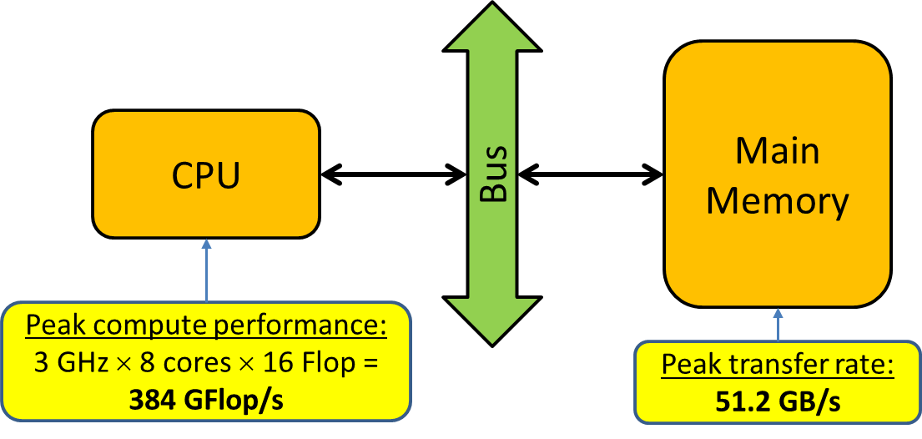
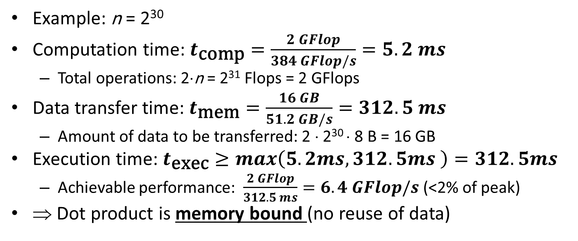
Performance of DOT
// Dot Product
double dotp = 0.0;
for (int i = 0; i<n; i++)
dotp += u[i] * v[i];
Example: n = 2³⁰
Computation time: $t_{\text{comp}}=\frac{2 GFlop}{384 GFlop/s}=5.2 ms$
  Total operations: 2⋅n = 2³¹ Flops = 2 GFlops
Data transfer time: $t_{\text{mem}}=\frac{16 GB}{51.2 GB/s}=312.5 ms$
  Amount of data to be transferred: 2 ⋅ 2³⁰ ⋅ 8 B = 16 GB
Execution time: $t_{\text{exec}}≥max\left(5.2ms,312.5ms \right)=312.5ms$
  Achievable performance: $\frac{2 GFlop}{312.5 ms}=6.4 GFlop/s$ (<2% of peak)
⇒ Dot product is memory bound (no reuse of data)

Slide 7
Outline
Memory Hierarchy
  von Neumann Bottleneck
  Cache Memory
  Optimizing Cache Accesses
  Cache Coherence
  False Sharing
Levels of Parallelism
  Flynn’s Taxonomy
  SIMD Concept
  AoS and SoA
Homework

Slide 8
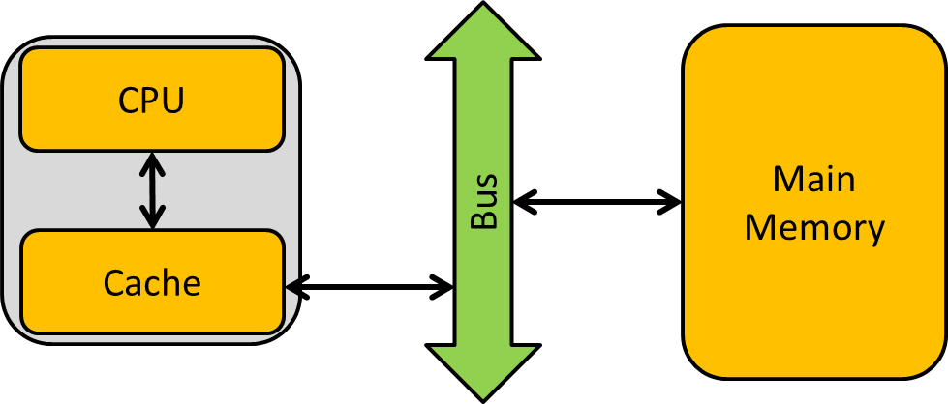
Basic Structure of a CPU with a single Cache
CPUs typically contain a hierarchy of three levels of cache (L1, L2, L3).
  Current CUDA-enabled GPUs contain two levels.
Higher bandwidth and lower latency compared to main memory but much smaller capacity.
Trade-off between capacity and speed
  e.g. L1-cache is small but fast and the L3-cache is relatively big but slow.
Caches could be private for a single core or shared between several cores.

Slide 9
Cache Memory – Example
Peak compute performance:
3 GHz × 8 cores × 16 Flop = 384 GFlop/s
Main
Memory
CPU
Bus
Cache
Capacity: 512 KB
@Register-speed
Peak transfer rate:
51.2 GB/s
Simplified model in order to establish an upper bound on performance for computing a matrix W = U×V each of size n×n stored in main memory
  i.e. we will never go faster than what the model predicts

Slide 10
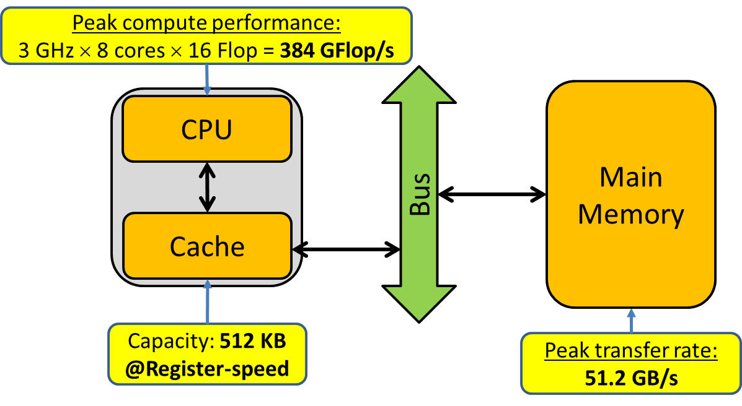
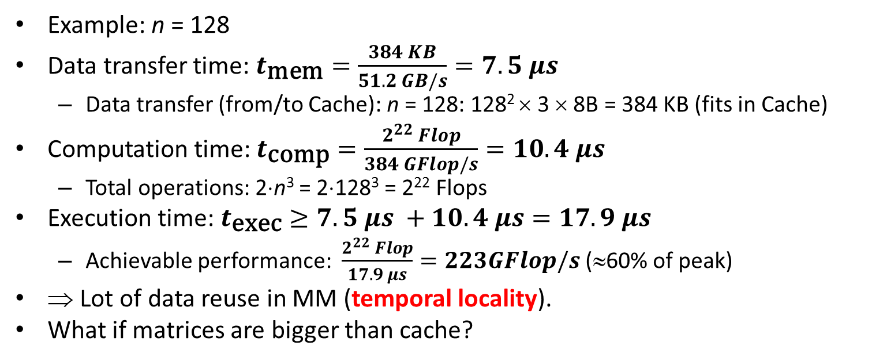
Performance of MM
//Matrix Multiplication
for (int i = 0; i<n; i++)
for (int j = 0; j < n; j++) {
double dotp = 0;
for (int k = 0; k<n; k++)
dotp += U[i][k]*V[k][j];
W[i][j] = dotp;
}
Example: n = 128
Data transfer time: $t_{\text{mem}}=\frac{384 KB}{51.2 GB/s}=7.5 μs$
  Data transfer (from/to Cache): n = 128: 128² × 3 × 8B = 384 KB (fits in Cache)
Computation time: $t_{\text{comp}}=\frac{2^{22} Flop}{384 GFlop/s}=10.4 μs$
  Total operations: 2⋅n³ = 2⋅128³ = 2²² Flops
Execution time: $t_{\text{exec}}≥7.5 μs +10.4 μs=17.9 μs$
  Achievable performance: $\frac{2^{22} Flop}{17.9 μs}=223GFlop/s$ (≈60% of peak)
⇒ Lot of data reuse in MM (temporal locality).
What if matrices are bigger than cache?

Slide 11
Spatial Locality
Which data do we load from main memory?
//maximum of an array (elements stored contiguously)
for (i = 0; i<n; i++)
maximum = max(a[i], maximum);
Cache Line: several items of information as a single memory location.
Instead of requesting only a single value, an entire cache line is loaded with values from neighboring addresses.
Example: Cache line size of 64 B and double precision values
  First iteration: a[0] is requested resulting in a cache miss
  Eight consecutive values a[0], a[1], a[2], a[3], a[4], a[5], a[6], a[7] loaded into one same cache line.
  Next seven iterations will then result in cache hits
  Subsequent request a[8] resulting again in a cache miss, an so on
  Overall, the hit ratio in our example is as high as 87.5%.

Slide 12
Outline
Memory Hierarchy
  von Neumann Bottleneck
  Cache Memory
  Optimizing Cache Accesses
  Cache Coherence
  False Sharing
Levels of Parallelism
  Flynn’s Taxonomy
  SIMD Concept
  AoS and SoA
Homework

Slide 13
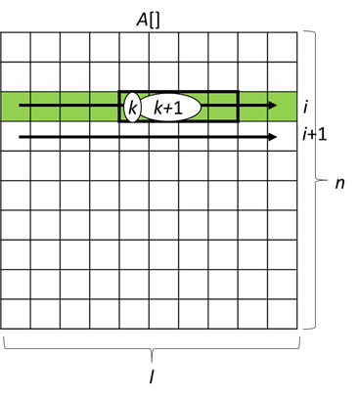
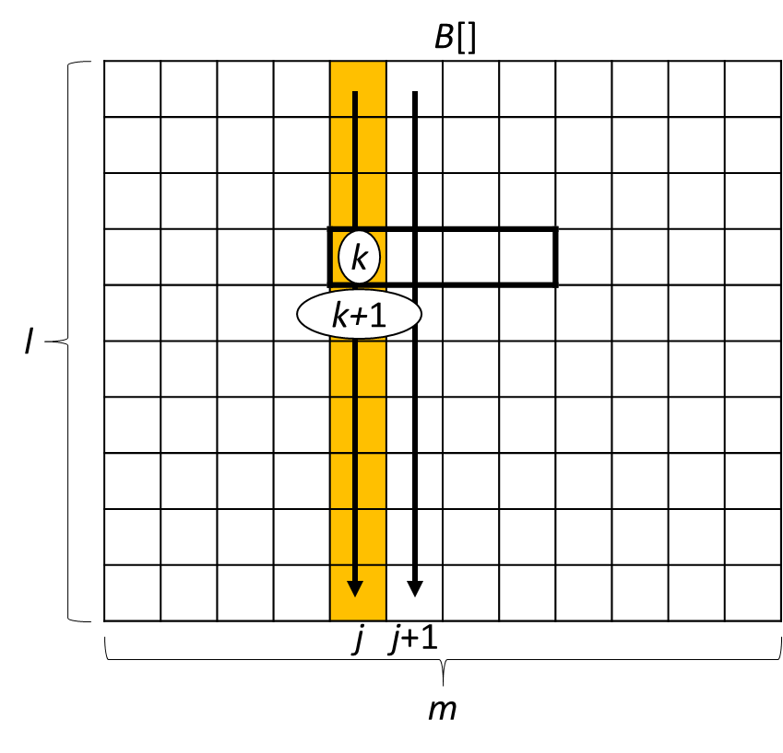
Optimizing Cache Accesses
//Naive Matrix Multiplication
for (int i = 0; i<n; i++)
for (int j = 0; j < m; j++) {
float accum = 0;
for (k = 0; k < l; k++)
accum += A[i*l+k]*B[k*m+j];
C[i*m+j] = accum;
}
Matrix multiplication: A_{n×l}⋅B_{l×m} = C_{n×m}
Stored in linear arrays in row-major order
Access pattern of A contiguously: (i,k) ⇒ (i,k+1)
Accesses pattern of B non-contiguously: (k,j) ⇒ (k+1,j)
  l×sizeof(float) apart in main memory ⇒ not stored in same cache line
  Cache line possibly evicted from L1-cache ⇒ low hit-rate for large l

Slide 14
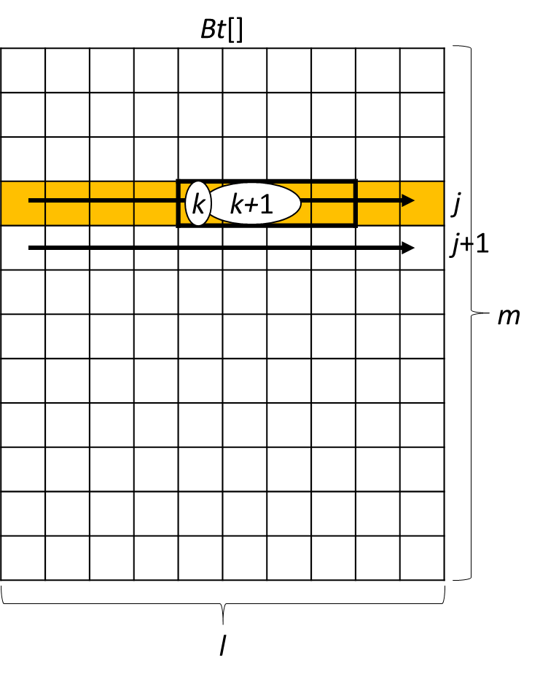
Optimizing Cache Accesses
//Transpose-and-Multiply
for (k=0; k<l; k++)
for (j = 0; j<m; j++)
Bt[j*l+k] = B[k*m+j];
for (i=0; i<n; i++)
for (j=0; j<m; j++) {
float accum = 0;
for (k=0; k<l; k++)
accum += A[i*l+k] * B[j*l+k];
C[i*m + j] = accum;
}
Transpose-and-Multiply:
  Bt_{m×l} = (B_{l×m})^{T}
  A_{n×l}⋅Bt_{m×l} = C_{n×m}
Access pattern of A contiguously: (i,k) ⇒ (i,k+1)
Accesses pattern of Bt contiguously: (j,k) ⇒ (j,k+1)

Slide 15
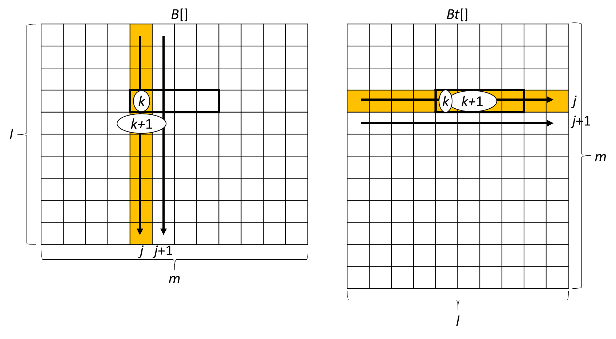
Optimizing Cache Accesses
Execution on an i7-6800K using m = n = l = 2¹³
#elapsed time (naive_mult): 5559.5s
#elapsed time (transpose): 0.8s
#elapsed time (transpose_mult): 497.9s
Speedup: 11.1
Execution on an i7-6800K using m = n = 2¹³, l = 2⁸
#elapsed time (naive_mult): 28.1s
#elapsed time (transpose): 0.01s
#elapsed time (transpose_mult): 12.9s
Speedup: 2.2

Slide 16
Outline
Memory Hierarchy
  von Neumann Bottleneck
  Cache Memory
  Optimizing Cache Accesses
  Cache Coherence
  False Sharing
Levels of Parallelism
  Flynn’s Taxonomy
  SIMD Concept
  AoS and SoA
Homework

Slide 17
Cache Write Policies
When a CPU writes data to cache, the value in cache may be inconsistent with the value in main memory.
Write-through
  Caches handle this by updating the data in main memory at the time it is written to cache.
Write-back
  Caches mark data in the cache as dirty.
  When the cache line is replaced by a new cache line from memory, the dirty line is written to memory.
Write x=12
L1: x,…
L2: …
L3: …
Main memory: …,x ,…

Slide 18
The Cache Coherence Problem – Example
Main Memory
y
2
8
2
y
y
Cache
Cache
4
2
2
8
Core 0
Core 1
y:=y+2;
y:=y+6;
Cache inconsistency: the two caches
store different values for the same variable.

Slide 19
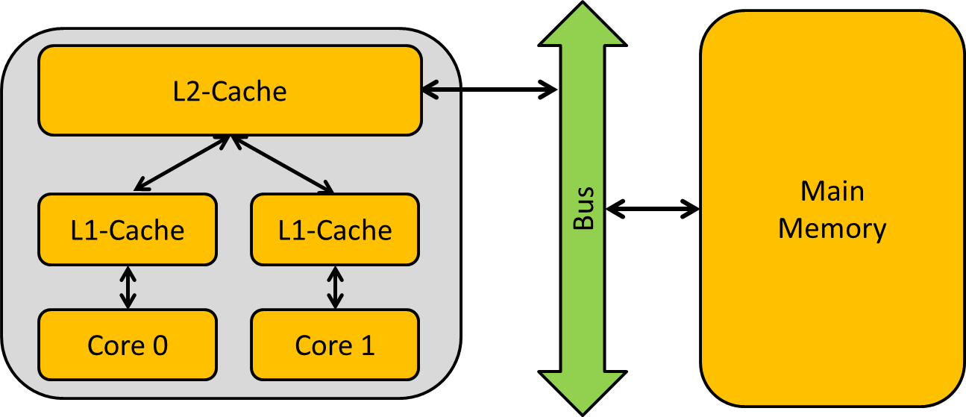
Cache Coherence
Modern multicore CPUs often contain several cache levels.
  Each core has a private (small but fast) first-level cache.
  All cores share a common (larger but slower) lower-level cache.
Possible to have several copies of shared data
  One copy stored in L1-cache of Core 0 & one stored in L1-cache of Core 1
Cache Inconsistency
  If Core 0 now writes to the associated cache line, only the value in the L1-cache of Core 0 is updated but not the value in the L1-cache of Core 1
⇒ Cache coherency protocols are required.

Slide 20
Cache Coherence through Invalidation
1. Assume y is initially not cached.
Main Memory
y
2
8
2
y
y
Cache
Cache
2
2
Core 0
Core 1
y:=y+2;
y:=y+6;

Slide 21
Cache Coherence through Invalidation
2. Core 0 loads and modifies y.
Main Memory
y
2
8
2
y
y
Cache
Cache
4
2
2
Core 0
Core 1
y:=y+2;
y:=y+6;

Slide 22
Cache Coherence through Invalidation
3. Core 1 loads y. The memory is updated.
Main Memory
y
2
8
4
y
y
Cache
Cache
4
2
2
4
Core 0
Core 1
y:=y+2;
y:=y+6;

Slide 23
Cache Coherence through Invalidation
4. Core 1 modifies y. Core 0 cached is invalidated.
Main Memory
y
2
8
4
y
y
Cache
Cache
2
10
Core 0
Core 1
y:=y+2;
y:=y+6;

Slide 24
Outline
Memory Hierarchy
  von Neumann Bottleneck
  Cache Memory
  Optimizing Cache Accesses
  Cache Coherence
  False Sharing
Levels of Parallelism
  Flynn’s Taxonomy
  SIMD Concept
  AoS and SoA
Homework

Slide 25
Matrix-Vector Multiplication
A
a₀₀ | a₀₁ | … | a_{0,n-1}
a₁₀ | a₁₁ | … | a_{1,n-1}
: | : |  | :
a_{m-1,0} | a_{m-1,1} | … | a_{m-1,n-1}
y
y₀
y₁
:
y_{m-1}
x
x₀
:
x_{n-1}
×
=
Thread | Components of y
0 | y[0], y[1]
1 | y[2], y[3]
2 | y[4], y[5]
3 | y[6], y[7]
Thread that has been assigned y[i] will need to execute
y[i] = 0.0;
for (j=0; j<n; j++)
y[i] += A[i][j] * x[j];

Slide 26
False Sharing – Cache Line Ping-Pong
#pragma omp parallel for schedule(static,2)
for (i = 0; i < m; i++) {
y[i] = 0.0;
for (int j = 0; j < n; j++)
y[i] += A[i][j] * x[j];
}
y
y₀
y₁
y₂
y₃
y₄
y₅
y₆
y₇
Cache coherence enforced at “Cache-line level”
For example, for m = 8, all of y is stored in a single cache line.
False Sharing: Every write to y invalidates the line in the other processor’s cache. Most of these updates to y are forcing the threads to access main memory.
Thread 0
Thread 1
Thread 2
Thread 3

Slide 27
Outline
Memory Hierarchy
  von Neumann Bottleneck
  Cache Memory
  Optimizing Cache Accesses
  Cache Coherence
  False Sharing
Levels of Parallelism
  Flynn’s Taxonomy
  SIMD Concept
  AoS and SoA
Homework

Slide 28
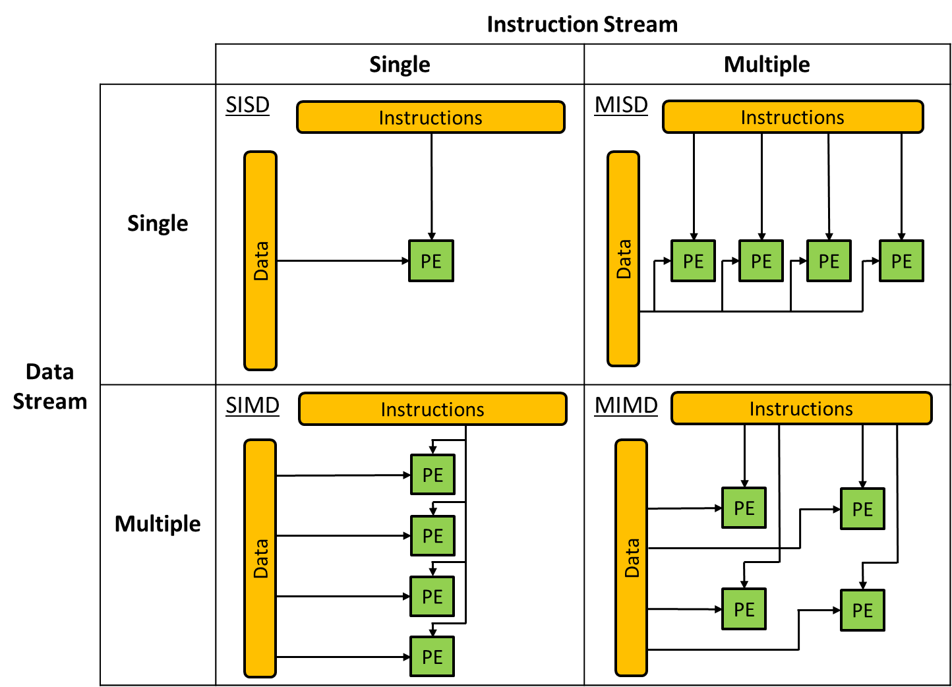
Flynn‘s Taxonomy (1966)

Slide 29
Outline
Memory Hierarchy
  von Neumann Bottleneck
  Cache Memory
  Optimizing Cache Accesses
  Cache Coherence
  False Sharing
Levels of Parallelism
  Flynn’s Taxonomy
  SIMD Concept
  AoS and SoA
Homework

Slide 30
SIMD (Single Instruction, Multiple Data)
//Mapping element-wise subtraction onto SIMD
for (i = 0; i<n; i++) w[i] = u[i]–v[i];
Control Unit
ALU₁
ALU₂
…
ALU_{n}
u[0]−v[0]
u[1]−v[1]
u[n-1]−v[n-1]
What if we don’t have as many ALUs as data items?
  Divide the work and process iteratively

Slide 31
SIMD
//Mapping a Conditional Statement onto SIMD
for (i = 0; i<n; i++)
if (u[i] > 0)
w[i] = u[i]–v[i];
else
w[i] = u[i]+v[i];
All ALUs required to execute the same instruction (synchronously) or idle
Control Unit
u[0]=3.2
v[0]=2.2
u[0]=−1
v[0]=1.3
u[0]=0.0
v[0]=4.9
ALU₁
ALU₂
…
ALU_{n}
u[0]>0.0?
u[1]>0.0?
u[n-1]>0.0?
w[0]=1.0
idle
idle
idle
w[1]=0.3
w[n-1]=4.9
Solution: Each ALU compares its register u to 0 and sets a flag that affects which of the two results is stored (predication).

Slide 32
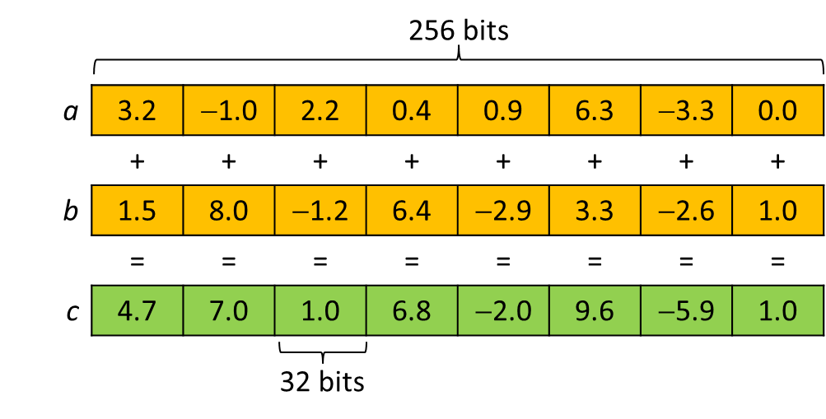
SIMD with AVX2 Registers
//AVX2-Programming with C/C++ Intrinsics
__m256 a, b, c; // declare AVX registers
... // initialize a and b
c = _mm256_add_ps(a, b); // c[0:8] = a[0:8] + b[0:8]
Reference: https://software.intel.com/en-us/cpp-compiler-developer-guide-and-reference

Slide 33

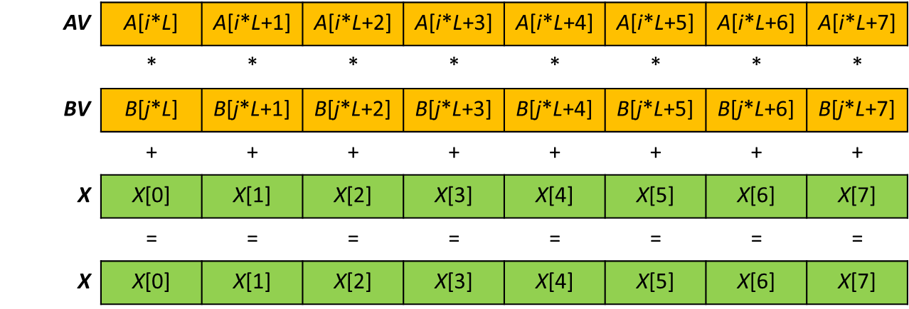
AVX2 Programming: transposed MatMult
_mm256_fmadd_ps(AV,BV,X) intrinsic used in the inner loop of the vectorized transposed matrix multiplication

Slide 34
AVX2 Programming: transposed MatMult
#include <immintrin.h> //AVX intrinsics
//Transpose-and-Multiply with AVX2
void avx2_tmm(float *A, float *B, float *C,
uint64_t M, uint64_t L, uint64_t N) {
for (uint64_t i=0; i<N; i++)
for (uint64_t j=0; j<M; j++) {
__m256 X = _mm256_setzero_ps();
for (uint64_t k=0; k<L; k+=8) {
const __m256 AV = _mm256_load_ps(A+i*L+k);
const __m256 BV = _mm256_load_ps(B+j*L+k);
X = _mm256_fmadd_ps(AV, BV, X);
}
C[i*N+j] = hsum_avx(X); //Add the 8 values
}
}

Slide 35
AVX2 Programming: transpose MatMult
Execution on an i7-6800K using m = 1K, l = 2K, n = 4K
#elapsed time (plain_tmm): 12.29s
#elapsed time (avx2_tmm): 2.13s
Speedup: 5.8
Execution on an i7-6800K using 12 threads with OpenMP and m = 1K, l = 2K, n = 4K
#elapsed time (plain_tmm): 0.32s
Speedup: 6.7 × 5.8

Slide 36
Outline
Memory Hierarchy
  von Neumann Bottleneck
  Cache Memory
  Optimizing Cache Accesses
  Cache Coherence
  False Sharing
Levels of Parallelism
  Flynn’s Taxonomy
  SIMD Concept
  AoS and SoA
Homework

Slide 37
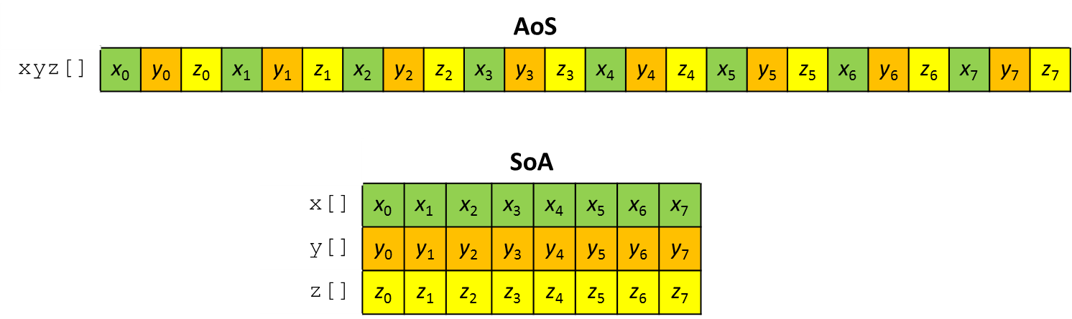
AoS and SoA
AoS (Array of Structures): stores records consecutively in single array.
SoA (Structure of Arrays): uses one array per dimension. Each array only stores the values of the associated element dimension.
Example: We want to use a collection of n real-valued 3D vectors to compare the SIMD-friendliness of AoS and SoA for vector normalization.

Slide 38

Vector Normalization with AoS
//Non-vectorized with plain AOS layout 3D vector normalization
void plain_aos_norm(float * xyz, uint64_t length) {
for (uint64_t i=0; i<3*length; i+=3) {
const float x = xyz[i+0];
const float y = xyz[i+1];
const float z = xyz[i+2];
float irho = 1.0f/std::sqrt(x*x+y*y+z*z);
xyz[i+0] *= irho;
xyz[i+1] *= irho;
xyz[i+2] *= irho;
}
}
Map each $v_{i}=(x_{i},y_{i},z_{i})$ to ${\hat{v}}_{i}=\frac{v_{i}}{\left\|v_{i}\right\|}=\left(\frac{x_{i}}{ρ_{i}},\frac{y_{i}}{ρ_{i}},\frac{z_{i}}{ρ_{i}}\right)$ where $ρ_{i}=\sqrt{x_{i}^{2}+y_{i}^{2}+z_{i}^{2}}$

Slide 39
Vector Normalization with AoS
x
y
z
x
y
z
x²
y²
z²
x²+y²
x²+y²+ z²
Vector registers would not be fully occupied for 256-bit registers.
Summing up the squares requires operations between neighboring lanes resulting in only a single value for the inverse square root calculation.
Scaling to longer vector registers becomes increasingly inefficient.

Slide 40
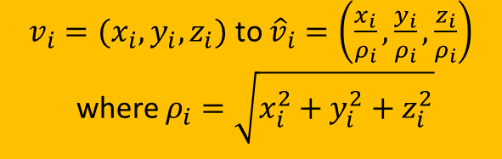
Vector Normalization with SoA
$v_{i}=(x_{i},y_{i},z_{i})$ to ${\hat{v}}_{i}=\left(\frac{x_{i}}{ρ_{i}},\frac{y_{i}}{ρ_{i}},\frac{z_{i}}{ρ_{i}}\right)$
where $ρ_{i}=\sqrt{x_{i}^{2}+y_{i}^{2}+z_{i}^{2}}$
//AVX-Vectorized SOA layout 3D vector normalization
void avx_soa_norm(float *x, float *y, float *z, uint64_t length) {
for (uint64_t i=0; i<length; i+=8) {
__m256 X = _mm256_load_ps(x+i); // aligned loads
__m256 Y = _mm256_load_ps(y+i);
__m256 Z = _mm256_load_ps(z+i);
__m256 R = _mm256_fmadd_ps(X,X, // R <- X*X+Y*Y+Z*Z
_mm256_fmadd_ps(Y,Y, _mm256_mul_ps(Z,Z)));
R = _mm256_rsqrt_ps(R); // R <- 1/sqrt(R)
_mm256_store_ps(x+i, _mm256_mul_ps(X, R)); // aligned stores
_mm256_store_ps(y+i, _mm256_mul_ps(Y, R));
_mm256_store_ps(z+i, _mm256_mul_ps(Z, R));
}
}

Slide 41
Outline
Memory Hierarchy
  von Neumann Bottleneck
  Cache Memory
  Optimizing Cache Accesses
  Cache Coherence
  False Sharing
Levels of Parallelism
  Flynn’s Taxonomy
  SIMD Concept
  AoS and SoA
Homework

Slide 42
Homework 3
From Textbook 1, Section 3.3, solve Exercises:
  1
  2

