Slide 1
Chapter 02: Theoretical Background
Adapted by Prof. Gheith Abandah

Slide 2
Outline
PRAM
Network Topologies
Amdahl’s and Gustafson’s Laws
Foster’s Parallel Algorithm Design Methodology
Homework

Slide 3
Learning Outcomes Today
Understand the PRAM model as an idealized model of shared memory computation
Analyze a few popular PRAM algorithms in terms of their cost and study the design of some cost-optimal PRAM algorithms
Learn about some typical topologies of distributed memory systems and network architectures
Compare their qualities in terms of the graph theoretic concepts degree, bisection width, and diameter
Use Amdahl’s law and Gustafson’s law to derive an upper bound on the achievable speedup of parallel program
Derive both laws as special cases of a more general scaled speedup formulation
Understand and apply Foster’s methodology to parallel program design in order to explore possible parallelization approaches for distributed memory architecture

Slide 4
Outline
PRAM
  PRAM Variants
  Parallel Prefix Using Recursive Doubling
  Cost Optimal Parallel Prefix
  Sparse Array Compaction
Network Topologies
Amdahl’s and Gustafson’s Laws
Foster’s Parallel Algorithm Design Methodology
Homework

Slide 5
Parallel Random Access Machine (PRAM)
P₀
Control
Program
P₁
Memory
Access
Unit
P_{n−1}
Shared Memory M
Processors
n processors P₀,…,P_{n−1} are connected to a global shared memory M
Any memory location is uniformly accessible from any processor in constant time
Communication between processors can be implemented by reading and writing to the globally accessible shared memory.

Slide 6
PRAM
n identical processors P_{i}, i = 0,…,n−1 operate in lock-step
In every step each processor executes an instruction cycle in three phases:
Read phase: Each processor can simultaneously read a single data item from a (distinct) shared memory cell and store it in a local register.
Compute phase: Each processor can perform a fundamental operation on its local data and subsequently stores the result in a register.
Write phase: Each processor can simultaneously write a data item to a shared memory cell, whereby the exclusive write PRAM variant allows writing only distinct cells while concurrent write PRAM variant also allows processors to write to the same location (race conditions).
Uniform complexity analysis: Each step on the RAM takes O(1) time

Slide 7
PRAM Variants
ER
CR
P₀
P₀
P₁
P₁
P₂
P₂
P₃
P₃
P₄
P₄
P₅
P₅
Exclusive Read Exclusive Write (EREW): No two processors are allowed to read or write to the same shared memory cell during any cycle
Concurrent Read Exclusive Write (CREW): Several processors may read data from the same shared memory cell simultaneously. Still, different processors are not allowed to write to the same shared memory cell

Slide 8
PRAM Variants
EW
CW
P₀
P₀
P₁
P₁
P₂
P₂
P₃
P₃
P₄
P₄
P₅
P₅
Concurrent Read Concurrent Write (CRCW): Both simultaneous reads and writes to the same shared memory cell are allowed. In case of a simultaneous write (analogous to a race condition) we further specify which value will actually be stored:
Priority CW: Processors have been assigned distinct priorities and the one with highest priority succeeds writing
Arbitrary CW: A randomly chosen processor succeeds writing its value.
Common CW: If the values are all equal, then this common value is written, otherwise, the memory location is unchanged.
Combining CW: All values to be written are combined into a single value by means of an associative binary operations (e.g. sum, product, minimum, logical AND)

Slide 9
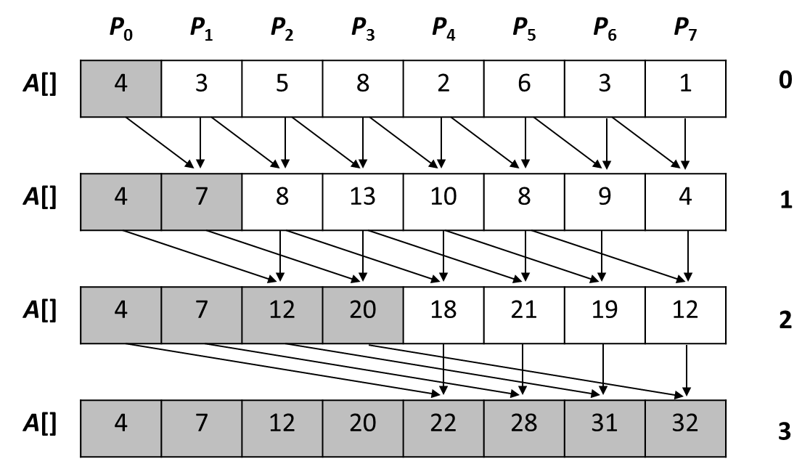
Parallel Prefix on a PRAM using recursive doubling on n Processors
for (j = 0; j<n; j++) do_in_parallel // each processor j
reg_j = A[j]; // copies one value to a local register
for (i = 0; i<ceil(log(n)); i++) do // sequential outer loop
for (j = pow(2, i); j<n; j++) do_in_parallel // each proc. j
reg_j += A[j - pow(2, i)]; // performs computation
A[j] = reg_j; // writes result to shared memory
}
C(n) = T(n,p) × p = O(log n) × n = O(n × log n)
Thus, this algorithm is NOT cost-optimal

Slide 10
Cost-optimal Parallel Prefix on a PRAM
P0
0
1
2
3
P0
0
1
3
6
P1
4
5
6
7
P1
4
9
15
22
P2
8
9
10
11
P2
8
17
27
38
P3
12
13
14
15
P3
12
25
39
54
P0
0
1
3
6
P0
0
1
3
6
P1
4
9
15
28
P1
10
15
21
28
P2
8
17
27
66
P2
36
45
55
66
P3
12
25
39
120
P3
78
91
105
120
Use p = n/log(n) processors
C(n) = T(n,p) × p = O(log n) × n/log(n) = O(n)
Thus, this algorithm is cost-optimal

Slide 11
Cost-optimal Parallel Prefix on an EREW PRAM using p = n/log(n) processors
// Stage 1: each Processor i computes a local prefix sum
// of a subarray of size n/p = log(n) = k
for (i = 0; i<n / k; i++) do_in_parallel
for (j = 1; j<k; j++) do
A[i*k+j] += A[i*k+j-1];
// Stage 2: Prefix summation using only the rightmost value
// of each subarray (O(log(n/k)))
for (i = 0; i<log(n / k); i++) do
for (j = pow(2, i); j<n / k; j++) do_in_parallel
A[j*k-1] += A[(j-pow(2, i))*k-1];
// Stage 3: each Proc i adds the value computed in Step 2 by Proc i-1 to
// each subarray element except for the last one
for (i = 1; i<n / k; i++) do_in_parallel
for (j = 0; j<k - 1; j++) do
A[i*k+j] += A[i*k+j-1];

Slide 12
Sparse Array Compaction on a PRAM
 | P₀ |  |  |  | P₁ |  |  |  | P₂ |  |  |  | P₃
A | 5 | 0 | 8 | 1 | 0 | 0 | 0 | 3 | 0 | 0 | 4 | 0 | 0 | 0 | 1 | 0
tmp | 1 | 0 | 1 | 1 | 0 | 0 | 0 | 1 | 0 | 0 | 1 | 0 | 0 | 0 | 1 | 0
 | parallel prefix summation(tmp)
tmp | 1 | 1 | 2 | 3 | 3 | 3 | 3 | 4 | 4 | 4 | 5 | 5 | 5 | 5 | 6 | 6
A | 5 | 0 | 8 | 1 | 0 | 0 | 0 | 3 | 0 | 0 | 4 | 0 | 0 | 0 | 1 | 0
V | 5 | 8 | 1 | 3 | 4 | 1
Use p = n/log(n) processors
C(n) = T(n,p) × p = O(log n) × n/log(n) = O(n)

Slide 13
Outline
PRAM
Network Topologies
  1D, 2D, Tree, Hypercube
  Shared Memory Interconnects
  Direct and Indirect Networks
Amdahl’s and Gustafson’s Laws
Foster’s Parallel Algorithm Design Methodology
Homework

Slide 14
Linear Array
P0
P1
P2
P3
P4
P5
Assume a linear array with n processors, denoted as L_{n}
The degree of a network is the maximum number of neighbors of any processor
  degree(L_{n}) = 2
The diameter of a network is the length of the longest distance between any two pairs of processors
  diameter(L_{n}) = n−1
The bisection-width of a network is the minimum number of links to be removed to disconnect the network into two halves of equal size
  bw(L_{n}) = 1

Slide 15
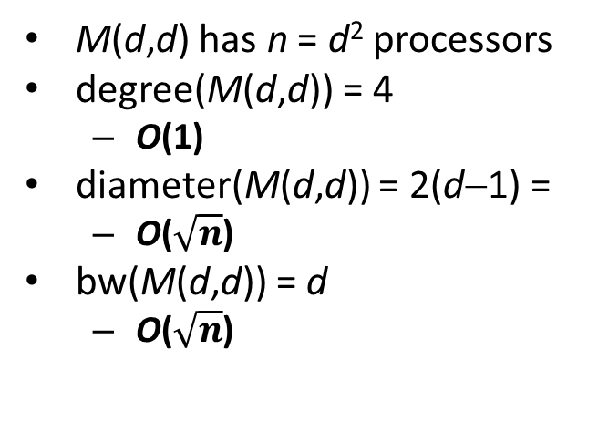
2D Mesh
P_{0,0}
P_{0,1}
P_{0,2}
P_{0,3}
M(d,d) has n = d² processors
degree(M(d,d)) = 4
  O(1)
diameter(M(d,d)) = 2(d−1) =
  O($\sqrt{n}$)
bw(M(d,d)) = d
  O($\sqrt{n}$)
P_{1,0}
P_{1,1}
P_{1,2}
P_{1,3}
P_{2,0}
P_{2,1}
P_{2,2}
P_{2,3}
P_{3,0}
P_{3,1}
P_{3,2}
P_{3,3}

Slide 16
2D Torus
A Torus T(c,d) is a Mesh augmented by wraparound edges at the border of the mesh.
T(c,d) has n = c⋅d processors
degree(T(c,d)) = 4
diameter(T(c,d)) = d/2 + c/2
bw(T(c,d)) = min{2⋅c,2⋅d}
n
m

Slide 17
Binary Tree
P0
P1
P2
d = 3
P3
P4
P5
P6
BT(d) has n = 2^{d}−1 processors
degree(BT(d)) = 3
  O(1)
diameter(BT(d)) = 2(d−1)
  O(log(n))
bw(BT(d)) = 1
  O(1)

Slide 18
Hypercube
The Hypercube, denoted by Q_{d} (d≥1), is the graph that has vertices representing the 2^{d} bit strings of length d. Two vertices are adjacent if and only if the bit strings that they represent differ in exactly one bit position.
Q₃
Q₁
Q₂
110
111
0
1
10
11
101
100
010
011
00
01
000
001

Slide 19
Hypercube
0110
0111
1110
1111
0010
0011
1010
1011
0100
0101
1100
1101
0000
0001
1000
1001
HC(d) = Hypercube of degree d
  Number of processors: n = 2^{d}
  degree(HC(d)) = d = O(log(n))
  diameter(HC(d)) = d = O(log(n))
  bw(HC(d)) = n/2 = O(n)

Slide 20
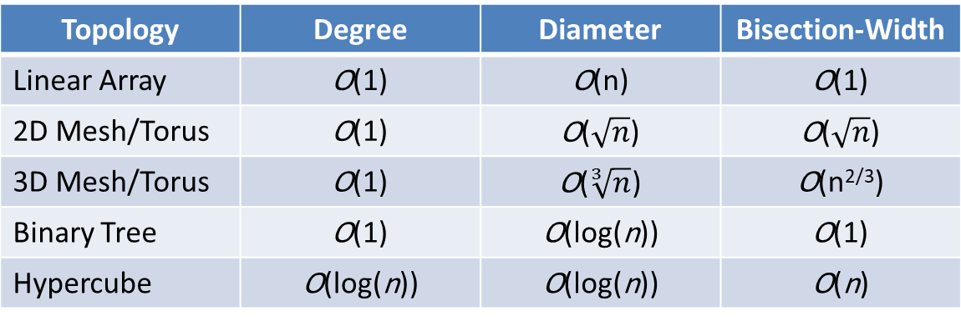
Criteria to Evaluate Network Topologies
Topology | Degree | Diameter | Bisection-Width
Linear Array | O(1) | O(n) | O(1)
2D Mesh/Torus | O(1) | O($\sqrt{n}$) | O($\sqrt{n}$)
3D Mesh/Torus | O(1) | O($\sqrt[3]{n}$) | O(n^{2/3})
Binary Tree | O(1) | O(log(n)) | O(1)
Hypercube | O(log(n)) | O(log(n)) | O(n)
Low Diameter
  In order to support efficient communication between any pair of processors
High Bisection Width:
  A low bisection width can slow down many collective communication operations and thus can severely limit the performance of applications
  However, achieving high bisection width may require non-constant network degree
Constant degree (i.e. independent of network size)
  allows a network to scale to a large number of nodes without the need of adding an excessive number of connections

Slide 21
Shared Memory Interconnects
1. Bus interconnect
  A collection of parallel communication wires together with some hardware that controls access to the bus.
  Communication wires are shared by the devices that are connected to it.
  As the number of devices connected to the bus increases, contention for use of the bus increases, and performance decreases.

Slide 22
Shared Memory Interconnects
2. Switched interconnect
  Uses switches to control the routing of data among the connected devices.
  Crossbar
    Allows simultaneous communication among different devices.
    Faster than buses.
    But the cost of the switches and links is relatively high.

Slide 23
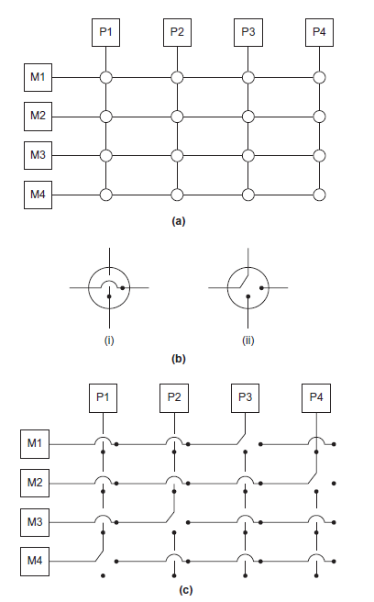
(a) A crossbar switch connecting 4 processors (Pi) and 4 memory modules (Mj)
(b) Configuration of internal switches in a crossbar
(c) Simultaneous memory accesses by the processors

Slide 24
Distributed Memory Interconnects
1. Direct interconnect
  Each switch is directly connected to a processor memory pair, and the switches are connected to each other, e.g., hypercube, fully-connected network.
2. Indirect interconnect
  Switches may not be directly connected to a processor, e.g., crossbar, omega network.

Slide 25
Fully Connected Network
Each switch is directly connected to every other switch.
bisection width = bw(p) = p²/4 = O(p²)
But is impractical. Why?

Slide 26
Indirect Interconnects
Simple examples of indirect networks:
  Crossbar
  Omega network
Often shown with unidirectional links and a collection of processors, each of which has an outgoing and an incoming link, and a switching network.

Slide 27
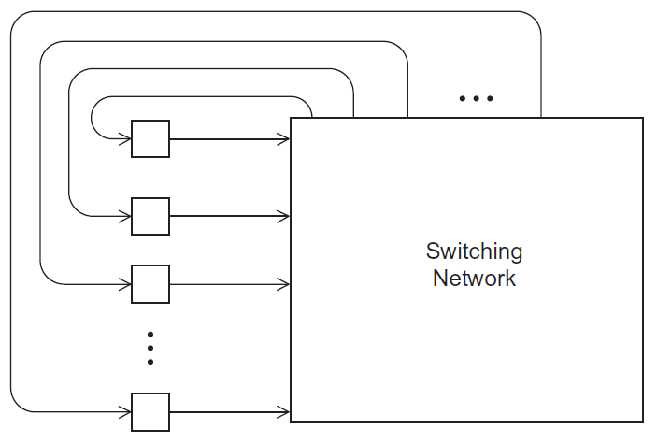
A Generic Indirect Network

Slide 28
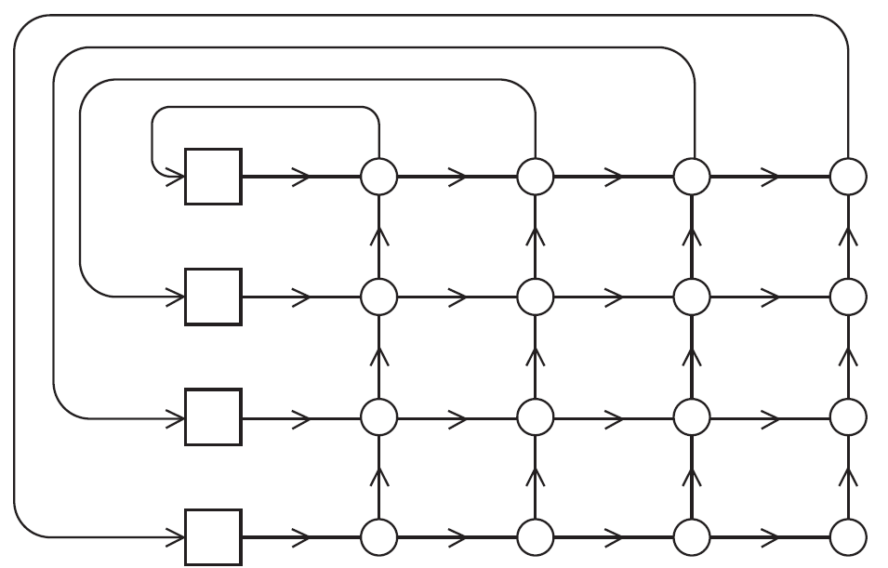
Crossbar Interconnect for Distributed Memory

Slide 29
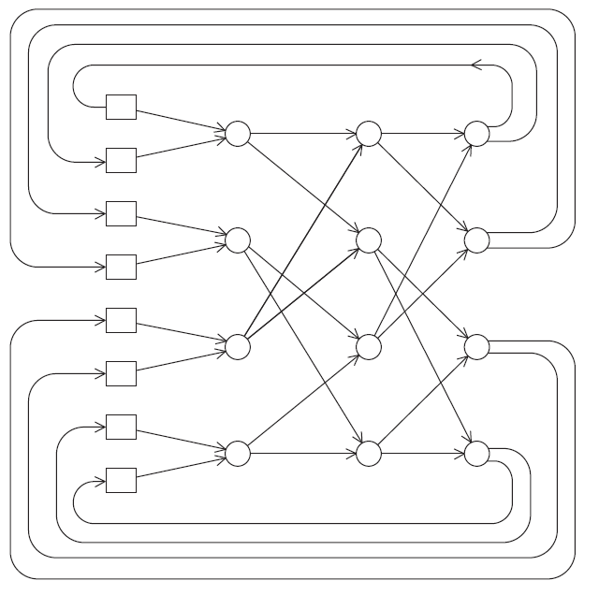
An Omega Network

Slide 30
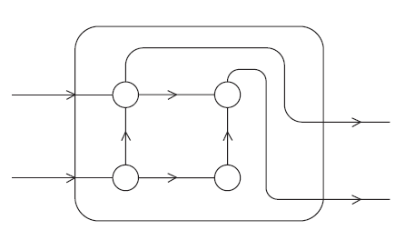
A Switch in an Omega Network

Slide 31
Outline
PRAM
Network Topologies
Amdahl’s and Gustafson’s Laws
  Amdahl’s Law
  Scaled Speedup
  Gustafson’s Law
Foster’s Parallel Algorithm Design Methodology
Homework

Slide 32
Amdahl’s Law
Formula for estimating speedup is named Amdahl's Law
It states that no matter how many processors are used in a parallel run, a program's speedup will be limited by its fraction of sequential code.
That is, almost every program has a fraction of the code that doesn't lend itself to parallelism. This is the fraction of code that will have to be run with just one processor, even in a parallel run.
Gives an upper bound on the speedup that can be achieved

Slide 33
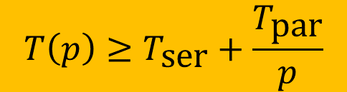

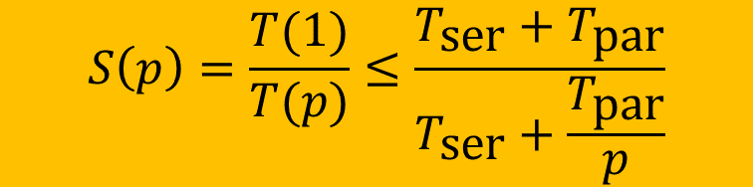
Derivation of Amdahl‘s Law
$$T\left(1\right)=T_{\text{ser}}+T_{\text{par}}$$
part of the program that does not benefit from parallelization
part of the program that does can benefit from parallelization
We now assume that the best possible speedup we can achieve is linear
Then, we derive an upper bound for achievable speedup
$$T\left(p\right)≥T_{\text{ser}}+\frac{T_{\text{par}}}{p}$$
$$S\left(p\right)=\frac{T(1)}{T(p)}≤\frac{{T_{\text{ser}}+T}_{\text{par}}}{T_{\text{ser}}+\frac{T_{\text{par}}}{p}}$$

Slide 34
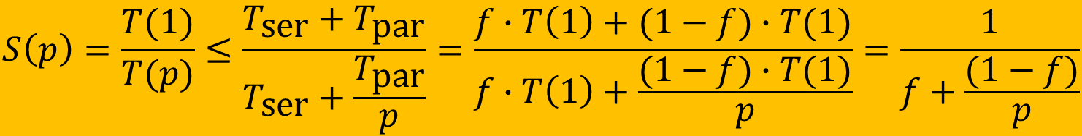
Derivation of Amdahl‘s Law
$$T_{\text{ser}}=f∙T\left(1\right) \text{and} T_{\text{par}}=\left(1−f\right)∙T\left(1\right); (0≤f≤1)$$
Instead of using absolute runtimes (T_{ser} and T_{par}), we now use their fraction f
Substituting this in the previously derived upper bound, results in Amdahl’s Law; i.e. upper bound for the speedup that only depends on f and p
$$S\left(p\right)=\frac{T(1)}{T(p)}≤\frac{{T_{\text{ser}}+T}_{\text{par}}}{T_{\text{ser}}+\frac{T_{\text{par}}}{p}}=\frac{f∙T\left(1\right)+(1−f)∙T(1)}{f∙T\left(1\right)+\frac{(1−f)∙T(1)}{p}}=\frac{1}{f+\frac{(1−f)}{p}}$$

Slide 35
Amdahl’s Law
T(1)
1 processor
f⋅T(1)
(1−f)⋅T(1)
T_{ser}
T_{par}
p
p processors
f⋅T(1)
(1−f)⋅T(1)/p
T(p)

Slide 36
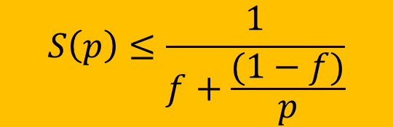
Amdahl’s Law
$$S\left(p\right)≤\frac{1}{f+\frac{(1−f)}{p}}$$
Where the term f stands for the fraction of operations done sequentially with just one processor, and the term (1−f) stands for the fraction of operations that can potentially be parallelized.
The sequential fraction of code, f, is a unit-less measure between 0 and 1.
Amdahl’s Law can be used to predict the performance of parallel programs

Slide 37
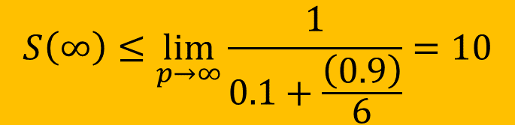
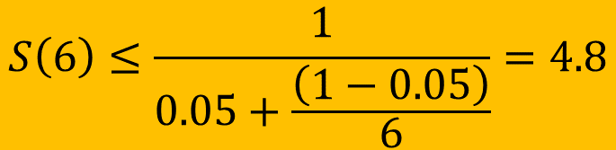
Amdahl’s Law – Example
95% of a program’s execution time occurs inside a loop that can be executed in parallel. What is the maximum speedup we should expect from a parallel version of the program executing on 6 CPUs?
$$S\left(6\right)≤\frac{1}{0.05+\frac{\left(1−0.05\right)}{6}}=4.8$$
10% of a program’s execution time is spent within inherently sequential code. What is the limit to the speedup achievable by a parallel version of the program?
$$S\left(∞\right)≤\lim_{p→∞}{\frac{1}{0.1+\frac{\left(0.9\right)}{6}}}=10$$

Slide 38
Scaled Speedup
Limitation of Amdahl’s law: only applies in situation where the problem size is constant and the number of processors varies (⇒ strong scalability)
However, when using more processors we may also use larger problems sizes (⇒ weak scalability)
  In this case the time spent in the parallelizable part (T_{par}) may grow faster in comparison to T_{ser}
Scaled Speedup: incorporates such scenarios in the calculation of the achievable speedup.
We now derive a more general law which allows for scaling with respect to the problem’s complexity
  Gustafson’s Law is just a special case which can be used to predict the theoretically achievable speedup using multiple processors when the parallelizable part scales linearly with the problem size while serial part remains constant

Slide 39
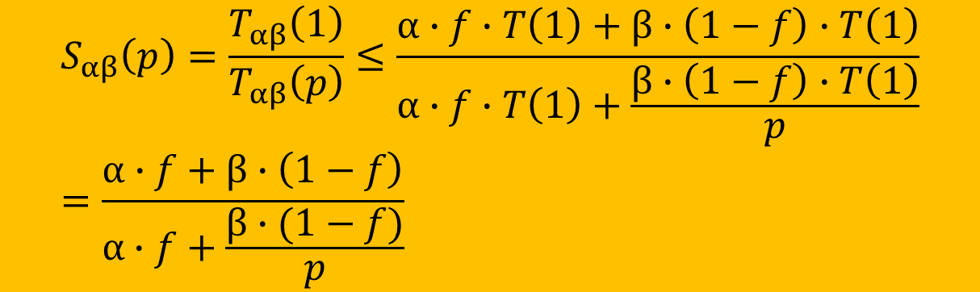
Derivation of Scaled Speedup Law
$$T_{αβ}\left(1\right)= α∙T_{\text{ser}}+{β∙T}_{\text{par}}=α∙f∙T\left(1\right)+β∙(1−f)∙T(1)$$
α: scaling function of the part of the program that does not benefit from
parallelization with respect to the complexity of the problem size
β: scaling function of the part of the program that benefits from parallelization
with respect to the complexity of the problem size
We derive a scaled upper bound for the achievable speedup:
$$S_{αβ}\left(p\right)=\frac{T_{αβ}\left(1\right)}{T_{αβ}\left(p\right)}≤\frac{α∙f∙T\left(1\right)+β∙\left(1−f\right)∙T\left(1\right)}{α∙f∙T\left(1\right)+\frac{β∙\left(1−f\right)∙T\left(1\right)}{p}}=\frac{α∙f+β∙\left(1−f\right)}{α∙f+\frac{β∙(1−f)}{p}}$$

Slide 40
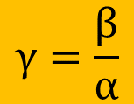
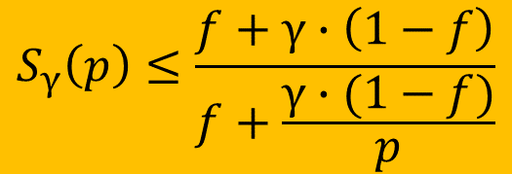
Derivation of Gustafson‘s Law
$$γ=\frac{β}{α}$$
Ratio of the problem complexity scaling between the parallelizable part and the non-parallelizable part.
$$S_{γ}\left(p\right)≤\frac{f+γ∙\left(1−f\right)}{f+\frac{γ∙(1−f)}{p}}$$
Using different functions for γ yields the following special cases:
γ = 1 (i.e. α = β): Amdahl‘s Law
γ = p (e.g. α = 1; β = p): Parallelizable part grows linear in p while the non-parallelizable part remains constant ⇒ Gustafson’s law:
$$S\left(p\right)≤f+p∙\left(1−f\right)=p+f∙(1−p)$$

Slide 41
Gustafson‘s Law
T(1)
1 processor
(non-scaled)
f⋅T(1)
(1−f)⋅T(1)
T_{ser}
T_{par}
p
p processors
(scaled)
f⋅T(1)
(1−f)⋅T(1)
T_{γ=p}(p)
T_{γ=p}(1)
f⋅T(1)
p⋅(1−f)⋅T(1)
1 processor
(scaled)
T_{ser}
p⋅T_{par}

Slide 42
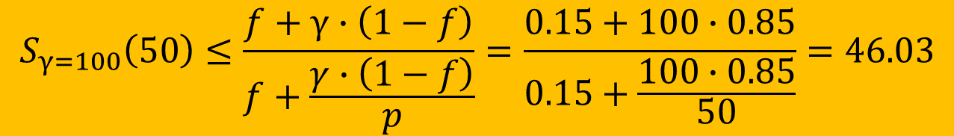
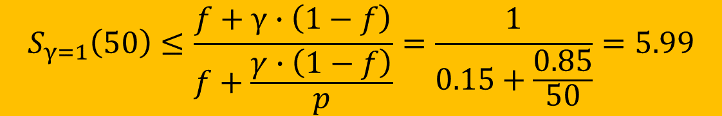
Scaled Speedup – Example
Suppose we have a parallel program that is 15% serial and 85% linearly parallelizable for a given problem size. Assume that the (absolute) serial time does not grow as the problem size is scaled.
  How much speedup can we achieve if we use 50 processors without scaling the problem?
  Suppose we scale up the problem size by a factor of 100. How much speedup could we achieve with 50 processors?
$$S_{γ=1}\left(50\right)≤\frac{f+γ∙\left(1−f\right)}{f+\frac{γ∙\left(1−f\right)}{p}}=\frac{1}{0.15+\frac{0.85}{50}}=5.99$$
$$S_{γ=100}\left(50\right)≤\frac{f+γ∙\left(1−f\right)}{f+\frac{γ∙\left(1−f\right)}{p}}=\frac{0.15+100∙0.85}{0.15+\frac{100∙0.85}{50}}=46.03$$

Slide 43
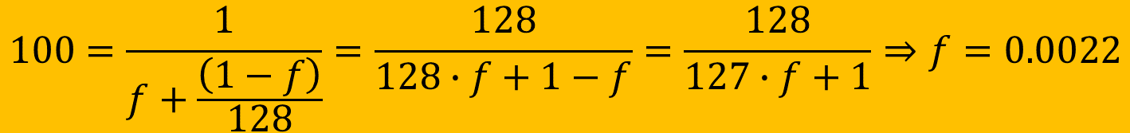
Exercise
Assume that you want to write a program that should achieve a speedup of 100 on 128 processors.
  What is the maximum sequential fraction of the program when this speedup should be achieved under the assumption of strong scalability?
  What is the maximum sequential fraction of the program when this speedup should be achieved under the assumption of weak scalability whereby γ scales linearly?
$$100=\frac{1}{f+\frac{\left(1−f\right)}{128}}=\frac{128}{128∙f+1−f}=\frac{128}{127∙f+1}⇒f=0.0022$$
$$100=128+f⋅\left(1−128\right)=128−127⋅f⇒f=\frac{28}{127}=0.22$$

Slide 44
Functional Dependency of Scaled Speedup S_{γ}(p) parametrized with γ=p^{δ}

Slide 45
Functional Dependency of Scaled Efficiency E_{γ}(p)= S_{γ}(p)/p parametrized with γ=p^{δ}
Iso-efficiency lines: How much must δ increase in order to preserve parallel efficiency for increasing p? or:
How much does the parallelizable part of our problem need grow if we want to keep the same efficiency while using more processing units?

Slide 46
Outline
PRAM
Network Topologies
Amdahl’s and Gustafson’s Laws
Foster’s Parallel Algorithm Design Methodology
Homework

Slide 47
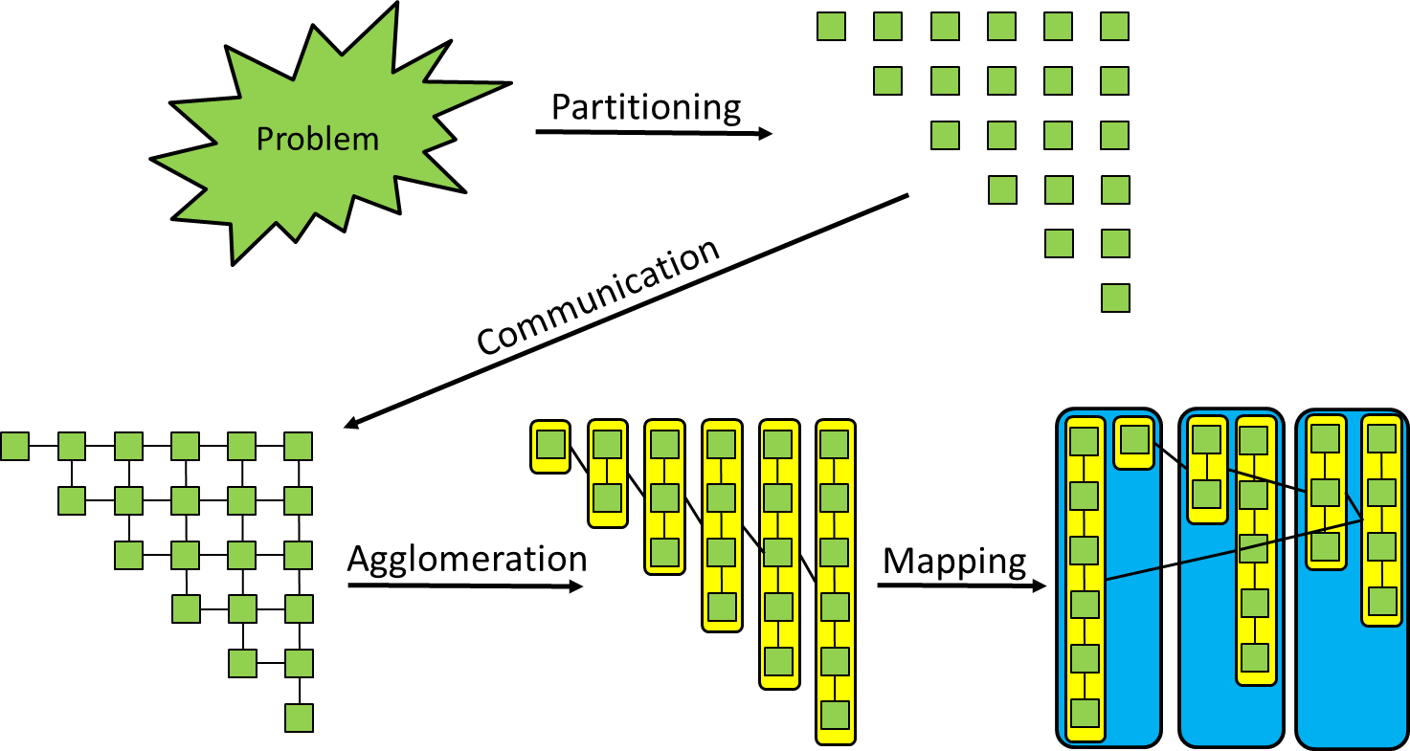
Foster‘s Parallel Algorithm Design Method
PCAM
Partitioning: decompose the problem into a large amount of small (fine-grained) tasks that can be executed in parallel
Communication: determine the required communication between tasks
Agglomeration: combine identified tasks into larger (coarse-grained) tasks in order to reduce communication by improving data locality
Mapping: assign the agglomerated tasks to processes in order to minimize communication, enable concurrency, and balance workload

Slide 48
Example: Jacobi Iteration
Replace each value in the matrix by the average of its four neighbors
Boundaries remain constant
Input Matrix: x[i][j]
xnew[i][j]
−1
−1
−1
−1
−1
−1
−1
−1
−1
−1
−1
−1
3
3
3
3
3
3
3
3
3
3
3
3
2
2
2
2
2
2
2
2
2
2
3
3
3
3
3
3
3
3
3
3
3
3
2.8
2.8
2.8
2.8
2.8
2.8
2.8
2.8
2.8
2.8
2
2
2
2
2
2
2
2
2
2
2
2
2.3
2.3
2.3
2.3
2.3
2.3
2.3
2.3
2.3
2.3
2
2
2
2
2
2
2
2
2
2
2
2
2
2
2
2
2
2
2
2
2
2
2
2
2
2
2
2
2
2
2
2
2
2
1.8
1.8
1.8
1.8
1.8
1.8
1.8
1.8
1.8
1.8
1
1
1
1
1
1
1
1
1
1
1
1
1.3
1.3
1.3
1.3
1.3
1.3
1.3
1.3
1.3
1.3
1
1
1
1
1
1
1
1
1
1
1
1
1
1
1
1
1
1
1
1
1
1
1
1
1
1
1
1
1
1
1
1
1
1
0.8
0.8
0.8
0.8
0.8
0.8
0.8
0.8
0.8
0.8
0
0
0
0
0
0
0
0
0
0
0
0
0.3
0.3
0.3
0.3
0.3
0.3
0.3
0.3
0.3
0.3
0
0
0
0
0
0
0
0
0
0
0
0
−0.3
−0.3
−0.3
−0.3
−0.3
−0.3
−0.3
−0.3
−0.3
−0.3
−1
−1
−1
−1
−1
−1
−1
−1
−1
−1
−1
−1

Slide 49
Jacobi Iteration
Replaces all points of a given 2D matrix by the average of the values around it in every iteration step until convergence:
while (not converged) {
for (int i=1; i<rows-1; i++)
for (int j=1; j<cols-1; j++)
buff[i*cols+j] = 0.25f*(data[(i+1)*cols+j] + data[i*cols+j-1]
+ data[i*cols+j+1] + data[(i-1)*cols+j]);
memcpy(data,buff,rows*cols*sizeof(float));
}
Boundary values are fixed:
x[0][j]
x[n-1][j]
x[i][0]
x[i][n-1]

Slide 50
Example: Jacobi Iteration
x[i][j] after 25 iterations
x[i][j] after 75 iterations
−1
−1
−1
−1
−1
−1
−1
−1
−1
−1
−1
−1
−1
−1
−1
−1
−1
−1
−1
−1
−1
−1
−1
−1
3
1.0
0.2
−0.1
−0.3
−0.3
−0.3
−0.3
−0.1
0.2
1.0
3
3
0.9
0.1
−0.3
−0.4
−0.5
−0.5
−0.4
−0.3
0.1
0.9
3
3
1.6
0.9
0.5
0.4
0.3
0.3
0.4
0.5
0.9
1.6
3
3
1.5
0.7
0.3
0.1
0.0
0.0
0.1
0.3
0.7
1.5
3
2
1.6
1.2
0.9
0.8
0.7
0.7
0.8
0.9
1.2
1.6
2
2
1.5
1.0
0.6
0.4
0.3
0.3
0.4
0.6
1.0
1.5
2
2
1.6
1.3
1.1
1.0
0.9
0.9
1.0
1.1
1.3
1.6
2
2
1.5
1.1
0.8
0.6
0.5
0.5
0.6
0.8
1.1
1.5
2
2
1.5
1.3
1.1
1.0
1.0
1.0
1.0
1.1
1.3
1.5
2
2
1.4
1.0
0.8
0.6
0.5
0.5
0.6
0.8
1.0
1.4
2
1
1.1
1.0
1.0
0.9
0.9
0.9
0.9
1.0
1.0
1.1
1
1
1.0
0.8
0.6
0.5
0.5
0.5
0.5
0.6
0.8
1.0
1
1
0.9
0.8
0.7
0.7
0.7
0.7
0.7
0.7
0.8
0.9
1
1
0.8
0.6
0.4
0.4
0.3
0.3
0.4
0.4
0.6
0.8
1
1
0.6
0.5
0.4
0.3
0.3
0.3
0.3
0.4
0.5
0.6
1
1
0.5
0.3
0.2
0.1
0.1
0.1
0.1
0.2
0.3
0.5
1
0
0.1
0.0
0.0
−0.1
−0.1
−0.1
−0.1
0.0
0.0
0.1
0
0
0.0
−0.1
−0.2
−0.2
−0.3
−0.3
−0.2
−0.2
−0.1
0.0
0
0
−0.3
−0.5
−0.5
−0.5
−0.5
−0.5
−0.5
−0.5
−0.5
−0.3
0
0
−0.4
−0.5
−0.6
−0.6
−0.6
−0.6
−0.6
−0.6
−0.5
−0.4
0
−1
−1
−1
−1
−1
−1
−1
−1
−1
−1
−1
−1
−1
−1
−1
−1
−1
−1
−1
−1
−1
−1
−1
−1

Slide 51
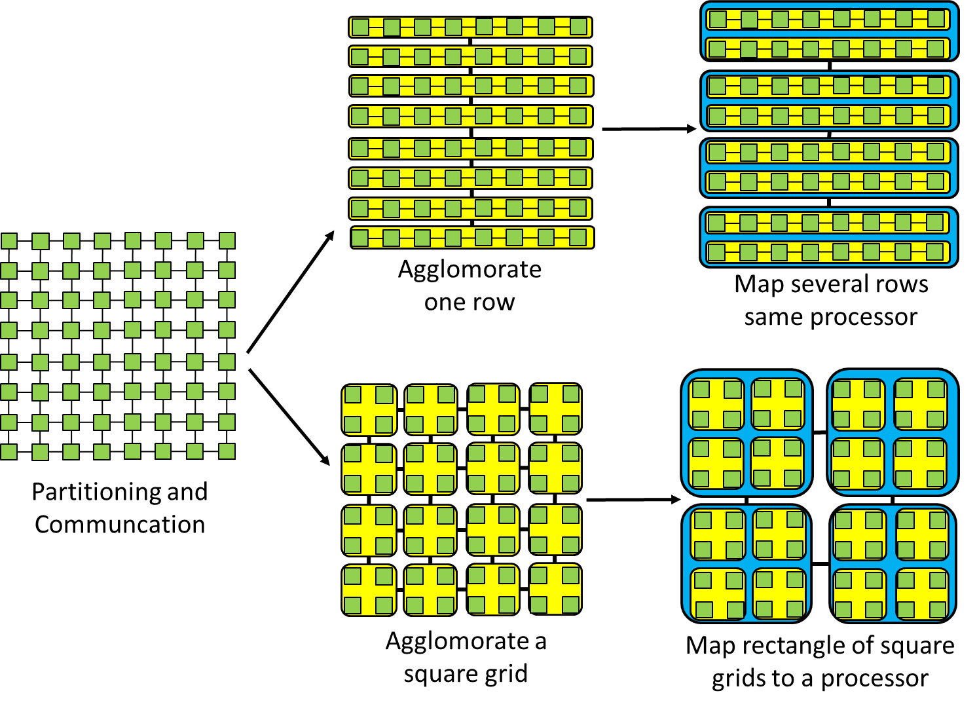

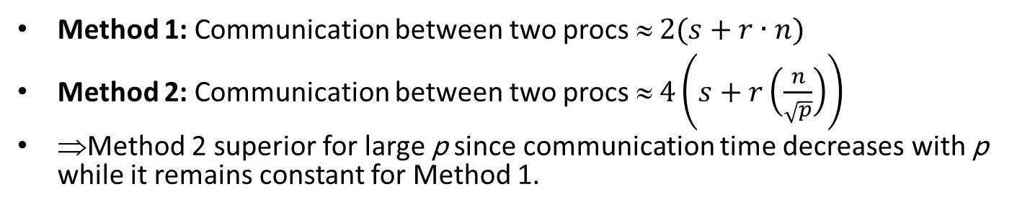
Two Schemes for Jacobi Iteration
Method 1
Latency
$$T_{\text{comm}}\left(n\right)=s+r∙n$$
Inverse of bandwidth
Method 2
Method 1: Communication between two procs ≈ $2(s+r∙n)$
Method 2: Communication between two procs ≈ $4\left(s+r\left(\frac{n}{\sqrt{p}}\right)\right)$
⇒Method 2 superior for large p since communication time decreases with p while it remains constant for Method 1.

Slide 52
Outline
PRAM
Network Topologies
Amdahl’s and Gustafson’s Laws
Foster’s Parallel Algorithm Design Methodology
Homework

Slide 53
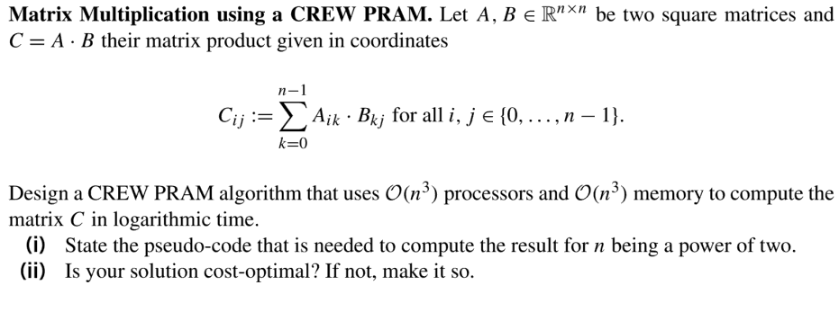
Homework 2
Q1:
Q2: What are degree, diameter and bisection width of a bus, fully connected, switch, omega networks?

