Slide 1
Chapter 01: Introduction
Adapted by Prof. Gheith Abandah

Slide 2
Outline
Introduction
Motivational Example and Its Analysis
Parallelism Basics
HPC Trends and Rankings

Slide 3
What we‘ll be doing
Modern CPUs contain many cores
An even higher degree of parallelism is available multiple CPUs, clusters, and supercomputers.
Thus, the ability to program these types of systems efficiently and effectively is an essential skill
You will learn how to write programs that are explicitly parallel
Using the C++ language for
  Message-Passing Interface (MPI)
  Multithreading
  OpenMP

Slide 4
Learning Outcomes Today
Understand and analyze a parallel algorithm for adding numbers
Learn about the terms Speedup, Efficiency, Scalability, and Compute-to-Computation Ratio
Know the difference between shared-memory and distributed-memory architectures and some corresponding parallel programming languages
Understand important considerations for parallel program design:
  Partitioning, Communication, Synchronization, Load Balancing
Learn about important HPC Trends and Rankings
  Top 500, Green 500, Graph 500

Slide 5
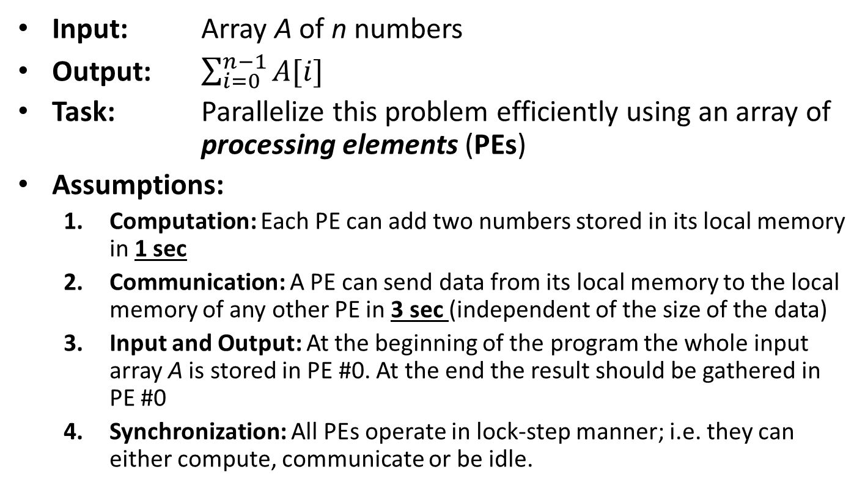
Motivational Example and its Analysis
Input: Array A of n numbers
Output: $\sum_{i=0}^{n−1}{A[i]}$
Task: Parallelize this problem efficiently using an array of processing elements (PEs)
Assumptions:
  Computation: Each PE can add two numbers stored in its local memory in 1 sec
  Communication: A PE can send data from its local memory to the local memory of any other PE in 3 sec (independent of the size of the data)
  Input and Output: At the beginning of the program the whole input array A is stored in PE #0. At the end the result should be gathered in PE #0
  Synchronization: All PEs operate in lock-step manner; i.e. they can either compute, communicate or be idle.

Slide 6

Motivational Example and its Analysis
$$T(n,p)$$
Problem size
#Processors
Establish sequential runtime as a baseline (p = 1):
  For our example: T(1, n) = n−1 sec
What are we interested in?
  Speedup: How much faster can we get with p > 1 processors?
  Efficiency: Is our parallel program efficient?
  Scalability: How does our parallel program behave for varying number of processors (for fixed/varying problem size)?

Slide 7




Motivational Example and its Analysis
PE #0
PE #1
$$\sum_{i=0}^{511}{A[i]}$$
$$\sum_{i=0}^{511}{A[i]}$$
$$\sum_{i=512}^{1023}{A[i]}$$
A[0..511]
A[512..1023]
A[0..1023]
$$\sum_{i=512}^{1023}{A[i]}$$
$$\sum_{i=0}^{1023}{A[i]}$$
Establish runtime for 2 PEs (p = 2) and 1024 numbers (n = 1024):
  T(2, 1024) = 3 + 511 + 3 + 1 = 518 sec
  Speedup: T(1, 1024)/T(2, 1024) = 1023/518 = 1.975
  Efficiency: 1.975/2 = 98.75%

Slide 8




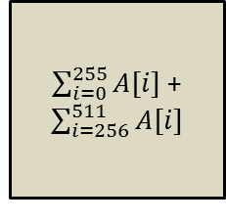


Motivational Example and its Analysis
PE #0
PE #1
$\sum_{i=0}^{255}{A[i]}$ +
$\sum_{i=256}^{511}{A[i]}$
$$\sum_{i=0}^{1023}{A[i]}$$
$\sum_{i=512}^{767}{A[i]}$ +
$\sum_{i=768}^{1023}{A[i]}$
$$\sum_{i=512}^{767}{A[i]}$$
$$\sum_{i=0}^{255}{A[i]}$$
A[512..1023]
A[0..255]
A[512..767]
A[0..1023]
A[0..511]
PE #2
PE #3
$$\sum_{i=256}^{511}{A[i]}$$
$$\sum_{i=768}^{1023}{A[i]}$$
A[256..511]
A[768..1023]
T(4, 1024) = 3×2 + 255 + 3×2 + 2 = 269 seconds
Speedup: T(1, 1024)/T(4, 1024) = 1023/269 = 3.803
Efficiency: 3.803/4 = 95.07%

Slide 9















Motivational Example and its Analysis
PE #0
PE #1
PE #4
PE #5
$$\sum_{i=0}^{1023}{A[i]}$$
$$\sum_{i=0}^{255}{A[i]}$$
A[512..639]
$$\sum_{i=128}^{255}{A[i]}$$
$$\sum_{i=640}^{767}{A[i]}$$
A[512..1023]
A[640..767]
$$\sum_{i=0}^{127}{A[i]}$$
$$\sum_{i=512}^{1023}{A[i]}$$
A[128..255]
$$\sum_{i=0}^{511}{A[i]}$$
$$\sum_{i=512}^{767}{A[i]}$$
A[0..127]
$$\sum_{i=512}^{639}{A[i]}$$
A[0..255]
A[512..767]
A[0..1023]
A[0..511]
PE #2
PE #3
PE #6
PE #7
A[896..1023]
A[256..383]
A[384..511]
$$\sum_{i=896}^{1023}{A[i]}$$
$$\sum_{i=256}^{511}{A[i]}$$
$$\sum_{i=768}^{1023}{A[i]}$$
$$\sum_{i=384}^{511}{A[i]}$$
A[256..511]
A[768..1023]
$$\sum_{i=256}^{383}{A[i]}$$
A[768..895]
$$\sum_{i=768}^{895}{A[i]}$$
T(8, 1024) = 3×3 + 127 + 3×3 + 3 = 148 seconds
Speedup: T(1, 1024)/T(8, 1024) = 1023/148 = 6.91
Efficiency: 6.91/8 = 86%

Slide 10
Motivational Example and its Analysis
Timing analysis using p = 2^{q} PEs and n = 2^{k} input numbers:
  Data distribution: 3⋅q
  Computing local sums: n/p − 1 = 2^{k−q} − 1
  Collection partial results: 3⋅q
  Adding partial results: q
T(p, n) = T(2^{q}, 2^{k}) = 3q + 2^{k-q} − 1 + 3q + q = 2^{k-q} − 1 + 7q

Slide 11
Strong Scalability Analysis for n = 1024

Slide 12
Weak Scalability Analysis for n = 1024×p

Slide 13
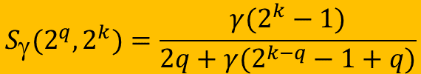
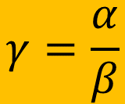
The General Case and the Compute-to-Communication Ratio
Time needed to perform a single addition
$$γ=\frac{α}{β}$$
Time to communciate a stack of numbers
T_{α,β}(2^{q}, 2^{k}) = βq + α(2^{k-q} − 1) + βq + αq = 2βq + α(2^{k-q}− 1+q)
$$S_{γ}(2^{q},2^{k})=\frac{γ(2^{k}−1)}{2q+γ(2^{k−q}−1+q)}$$
Diagram shows: F(γ,q) := S_{γ}(2^{q},2¹⁰)

Slide 14
Outline
Introduction
Motivational Example and Its Analysis
Parallelism Basics
  Distributed Memory Systems
  Shared Memory Systems
  Parallel Program Design
HPC Trends and Rankings

Slide 15
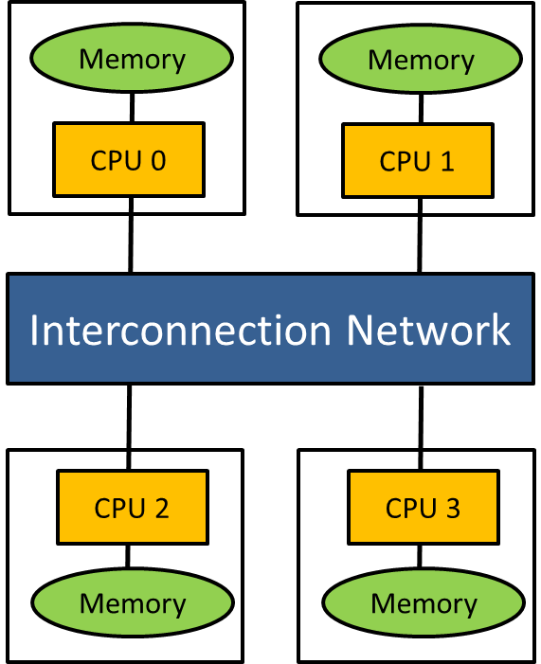
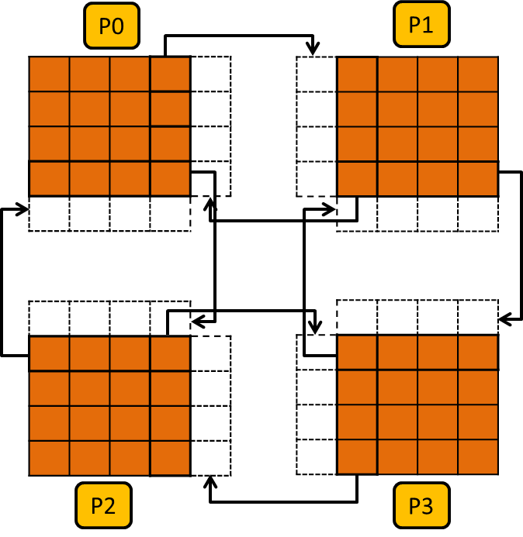
Distributed Memory Systems
Each node has its own, private memory. Processors communicate explicitly by sending messages across a network
  Most popular language: MPI (e.g. MPI_Send, MPI_Recv, MPI_Bcast, MPI_Reduce)
  Or Partitioned Global Address Space (PGAS) languages (e.g. UPC++)
Example: Compute Clusters
  Collection of commodity systems such as CPUs connected by an interconnection network (e.g . Infiniband)

Slide 16
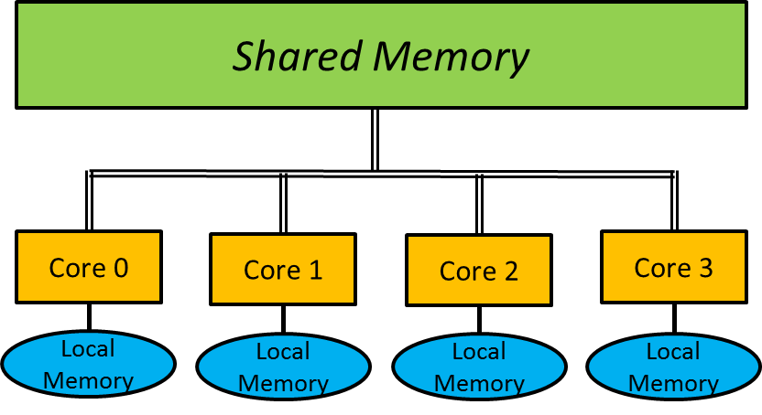
Shared Memory Systems
All cores can access a common memory space through a shared bus or crossbar switch
  e.g. multi-core CPU-based workstations in which all cores share main memory
In addition to the shared main memory each core can also contain a smaller local memory (e.g. L1-cache) in order to reduce expensive accesses to main memory (von-Neumann bottleneck)
  Modern multi-core CPU systems support cache coherence
  ccNUMA: cache coherent non-uniform access architectures
Popular languages: C++11 multithreading, OpenMP, CUDA

Slide 17
Shared Memory Systems
Parallelism created by starting threads running concurrently on the system
Exchange of data implemented by threads reading from and writing to shared memory locations.
Race condition: occurs when two threads access a shared variable simultaneously
  Corresponding programming techniques: mutexes, condition variables, atomics
Thread creation more lightweight and faster compared to process creation:
  CreateProcess(): 12.76 ms
  CreateThread(): 0.038 ms
A[]: | 2.1 | 3.4 | 0.1 | 2.2 | ? | -1.4 | 2.0 | -1.9 | 0.4
Thread 0 | Thread 1
a[4] = 3.1 | a[4] = 2.9

Slide 18
Parallel Program Design
Partitioning:
  Given problem needs to be decomposed into pieces; e.g. data parallelism, task parallelism, model parallelism
Communication:
  Chosen partitioning scheme determines the amount and types of required communication
Synchronization:
  In order to cooperate in an appropriate way, threads or processes may need to be synchronized
Load Balancing:
  Work needs to be equally divided among threads or processes in order to balance the load and minimize idle times
⇒ Foster‘s Design methodology (see Chapter 2)

Slide 19
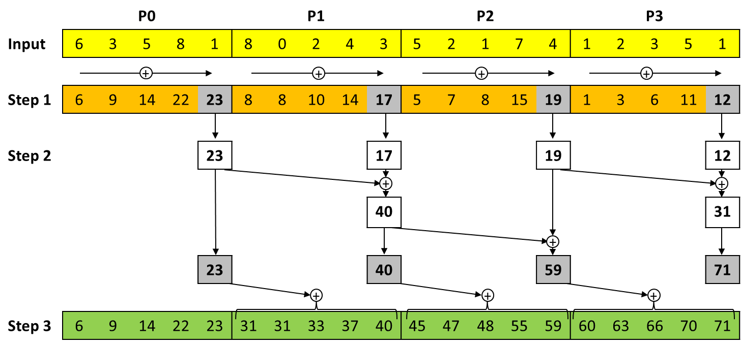
Discovering Parallelism (Prefix Sum)
Loop-carried data dependency
for (i=1; i<n; i++) A[i]=A[i]+A[i-1];
Step 1: local summation within each processor
Step 2: Prefix sum computation using only the rightmost value of each local array
Step 3: Addition of the value computed in Step2 from the left neighbor to each local array element

Slide 20
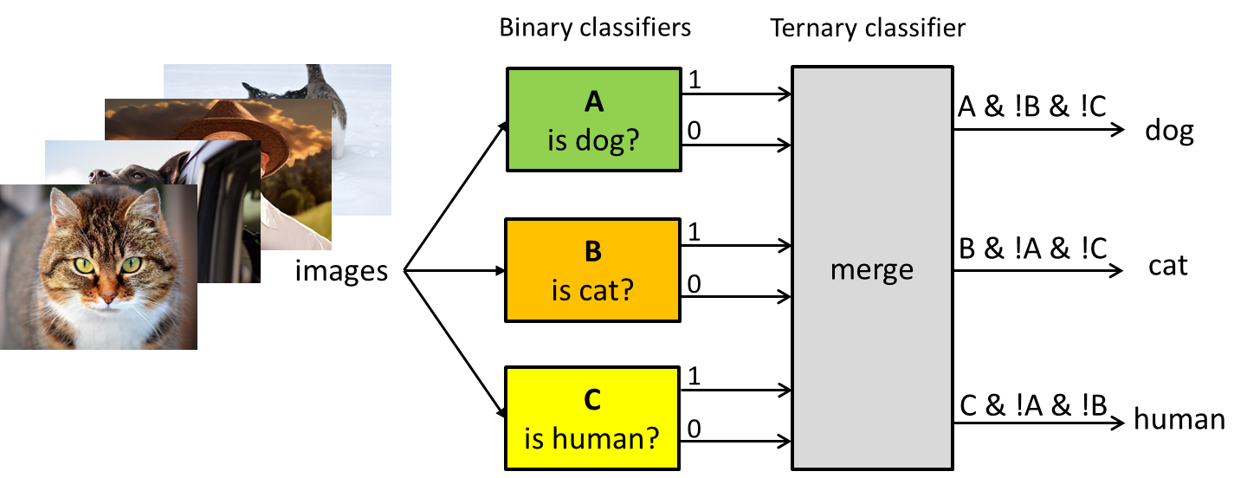
Partitioning Strategies
Task parallelism
  Different binary classifier assigned to a different process (P0, P1, P2)
  Every process classifies each image using the assigned classifier.
  Binary classification results for each image are send to P0 and merged
  Limited parallelism and possible load imbalance
Data parallelism
  Input images could be divided into a number of batches.
  Once a process has completed the classification of its assigned batch, a scheduler dynamically assigns a new batch

Slide 21
Model Parallelism for Deep Learning
GPU 0
GPU 1
GPU 2
GPU 3

Slide 22
Outline
Introduction
Motivational Example and Its Analysis
Parallelism Basics
HPC Trends and Rankings

Slide 23
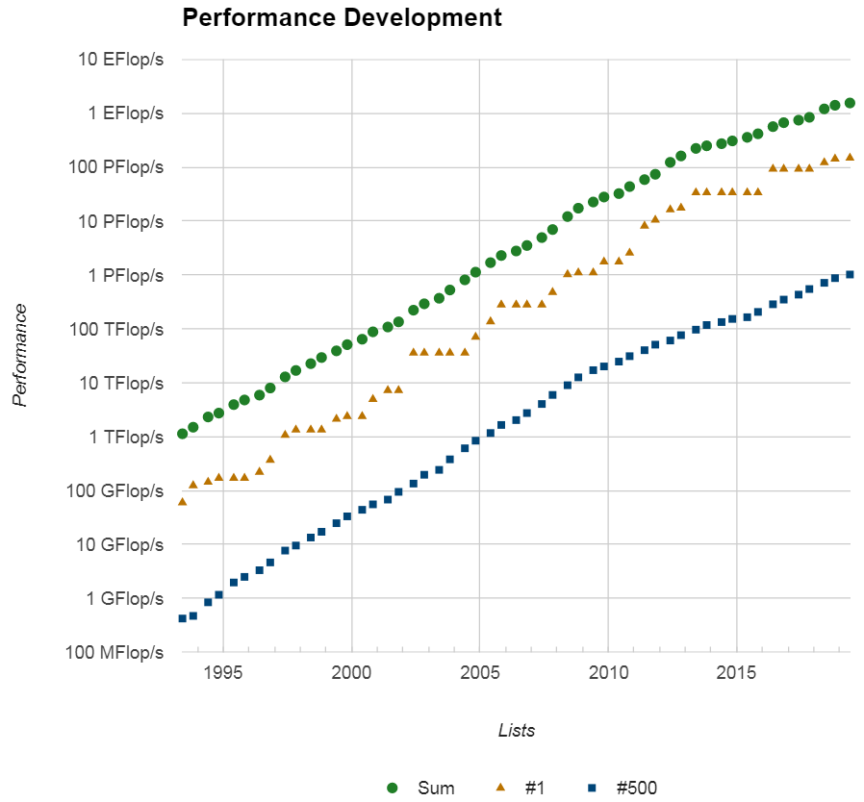
TOP500 Trends
Supercomputers ranked according to their maximally achieved LINPACK performance (top500.org)
  Measures the performance for solving a dense system of linear equations (A⋅x=b) in terms of Flop/s
  Top-ranked system in 2019: Summit contains over 2.4 million cores and achieves 149 PFlop/s, 14.7 Gflops/W (2nd rank), 10 MW
Green500: Flop/s-per-Watt of achieved LINPACK performance

Slide 24
Heterogeneous HPC system and associated programming languages
Node 0
Node 1
Node 2
Node k−1
Cluster
Interconnection Network
MPI,
UPC
OpenMP, Pthreads, CUDA
CPU
CPU
Node
CPU
CPU
Core
Core
Socket
Core
Core
Core
Core
Accelerators
Accelerator board
Accelerator board

Slide 25
Homework 1
Q1: Another well-known HPC ranking is the Graph500 project. Study the website www.graph500.org and answer the following questions:
  What is the utilized benchmark and how is performance measured?
  What is the measured performance and the specification of the top-ranked system?
  What are some of the advantages and disadvantages compared to the TOP500?

Slide 26
Homework 1
Q2: How does our parallel prefix computation work on a shared memory system, input array size n = 2^{k} and p processors? Define its terms of speedup, cost, and efficiency.
Q3: State the difference between weak and strong scalability.
Q4: What is the difference between a shared memory and a distributed memory parallel computer?
Q5: Name and describe a few parallel programming languages

