Slide 1
Feature Selection
Dr. Gheith Abandah

Slide 2
Definition
Feature selection is typically a search problem for finding an optimal or suboptimal subset of m features out of original M features.
Benefits:
For excluding irrelevant and redundant features,
it allows reducing system complexity and processing time,
and often improves the recognition accuracy.
For large number of features, exhaustive search for best subset out of 2^{M} possible subsets is infeasible.

Slide 3
Feature Set

Slide 4
Selection Algorithms
Generally be classified according to the criterion function used in searching for good features.
Wrapper algorithm: the performance of the classifier is used to evaluate the feature subsets.
Filter algorithm: some feature evaluation function is used rather than optimizing the classifier’s performance.
Wrapper methods are usually slower than filter methods but offer better performance.

Slide 5
Best Individual Features
Select best individual features. A feature evaluation function is used to rank individual features, then the highest ranked m features are selected.
Although these methods can exclude irrelevant features, they often include redundant features.
“The m best features are not the best m features”

Slide 6
Best Individual Features
Examples:
Scatter criterion
Symmetric uncertainty

Slide 7
Scatter Criterion

Slide 8
Scatter Criterion

Slide 9
Scatter Criterion

Slide 10
Symmetric Uncertainty

Slide 11
Symmetric Uncertainty

Slide 12
Search Algorithms
Sequential < O(M²)
Forward selection, e.g.,
Fast correlation-based filter (FCBF)
Minimal-redundancy-maximal-relevance (mRMR)
Backward selection
Bidirectional
Random
Genetic algorithm, e.g.,
Multi-objective genetic algorithms (MOGA)

Slide 13
Fast Correlation-Based Filter

Slide 14
Fast Correlation-Based Filter

Slide 15
Minimal-Redundancy-Maximal-Relevance

Slide 16
Minimal-Redundancy-Maximal-Relevance

Slide 17
Minimal-Redundancy-Maximal-Relevance

Slide 18
Non-dominated Sorting Genetic Algorithm
Use NSGA to search for optimal set of solutions with two objectives:
Minimize the number of features used in classification.
Minimize the classification error.

Slide 19
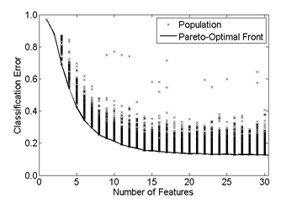
Pareto-Optimal Front

Slide 20
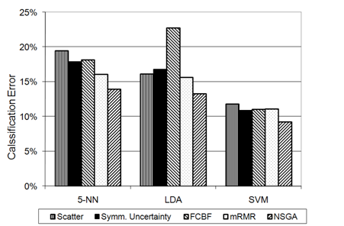
Classification Accuracy

Slide 21
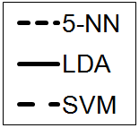
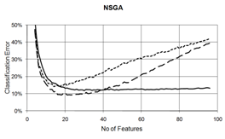
Classification Accuracy

