Slide 1
Appendix D: Multi-Cycle Datapath and Control
Dr. Iyad F. Jafar
Adapted from Dr. Gheith Abandah slides
http://www.abandah.com/gheith/Courses/CPE335_S08/index.html

Slide 2
Outline
Introduction
Multi-cycle Datapath
Multi-cycle Control
Performance Evaluation

Slide 3
Introduction
The single-cycle datapath is straightforward, but...
Hardware duplication
It has to use one ALU and two 32-bit adders
It has separate Instruction and Data memories
Cycle time is determined by worst-case path! Time is wasted for instructions that finish earlier!!
Can we do any better?
Break the instruction execution into steps
Each step finishes in one shorter cycle
Since instructions differ in number of steps, so will the number of cycles! Thus, time is different!
Multi-Cycle implementation!

Slide 4
Multi-Cycle Datapath
Instruction execution is done over multiple steps such that
Each step takes one cycle
The amount of work done per cycle is balanced
Restrict each cycle to use one major functional unit
Expected benefits
Time to execute different instructions will be different (Better Performance!)
The cycle time is smaller (faster clock rate!)
Allows functional units to be used more than once per instruction as long as they are used in different cycles
One memory is needed!
One ALU is needed!

Slide 5
Multi-Cycle Datapath
Requirements
Keep in mind that we have one ALU, Memory, and PC
Thus,
Add/expand multiplexors at the inputs of major units that are used differently across instructions
Add intermediate registers to hold values between cycles !!
Define additional control signals and redesign the control unit

Slide 6
Multi-Cycle Datapath
Requirements - ALU
Operations
Compute PC+4
Compute the Branch Address
Compare two registers
Perform ALU operations
Compute memory address
Thus, the first ALU input could be
R[rs] (R-type)
PC (PC = PC + 4)
➔ Add a MUX and define the ALUScrA signal
The second ALU input could be
R[rt] (R-type)
A constant value of 4 (to compute PC + 4)
Sign-extended immediate (to compute address of LW and SW)
Sign-extended immediate x 4 (compute branch address for BEQ)
Expand the MUX at the second ALU input and make the ALUSrcB signal two bits
The values read from register file will be used in the next cycle
➔ Add the A and B registers
The ALU result (R-type result or memory address) will be used in the following cycle
➔ Add the ALUOut register

Slide 7
Multi-Cycle Datapath
Requirements - PC
PC input could be
PC + 4 (sequential execution)
Branch address
Jump address
➔ The PCSrc signal
The PC is not written on every cycle
Define the PCWrite singal (for ALU, Jump, and Memory)
The PCWriteCond singal (BEQ)

Slide 8
Multi-Cycle Datapath
Requirements – Memory
Memory input could be
Memory address from PC
Memory address from ALU
➔ Add MUX at the address port of the memory and define the IorD signal
Memory output could be
Instruction
Data
Add the IR register to hold the instruction
Add the MDR register to hold the data loaded from memory (Load)
The IR is not written on every cycle
Define the IRWrite signal

Slide 9
Multi-Cycle Datapath
PCWriteCond
PCWrite
PCSource
IorD
ALUOp
MemRead
Control
ALUSrcB
MemWrite
ALUSrcA
MemtoReg
RegWrite
IRWrite
RegDst
PC[31-28]
4
opcode
26
Address Field
Shift
left 2
28
2
0
1
PC
0
Address
Memory
rs
Read Addr 1
0
IR
Read
Data 1
A
1
rt
Read Addr 2
1
zero
Read Data
0
Register
File
rd
Write Addr
ALU
ALUOut
Write Data
1
Read
Data 2
B
0
1
Write Data
4
1
MDR
0
2
Sign
Extend
Shift
left 2
3
Offset
32
ALU
control
func
32
Notes:
Why the branch instruction finish in three cycles? Why the branch address is taken from the ALUOut register not from the ALU output?
→ The branch address is computed in the decode cycle and stored in the ALU register. In the next cycle, the ALU is used to compare the two registers, thus the output is not the branch address. However, at the end of the execute cycle, the branch address is already at the input of the PC and it will not be overwritten until the rising edge arrives.

Slide 10
Multi-Cycle Control Signals
Signal Name | Effect when Deasserted (0) | Effect when Asserted (1)
RegDst | The destination register number comes from the rt field | The destination register number comes from the rd field
RegWrite | None | Write is enabled to selected destination register
ALUSrcA | The first ALU operand is the PC | The first ALU operand is register A
MemRead | None | Content of memory address is placed on Memory data out
MemWrtite | None | Memory location specified by the address is replaced by the value on Write data input
MemtoReg | The value fed to register file is from ALUOut | The value fed to register file is from memory
IorD | PC is used as an address to memory unit | ALUOut is used to supply the address to the memory unit
IRWrite | None | The output of memory is written into IR
PCWrite | None | PC is written; the source is controlled by PCSource
PCWriteCond | None | PC is written if Zero output from ALU is also active

Slide 11
Multi-Cycle Control Signals
Signal | Value | Effect
ALUOp | 00 | ALU performs add operation
 | 01 | ALU performs subtract operation
 | 10 | The funct field of the instruction determines the ALU operation
ALUSrcB | 00 | The second input to the ALU comes from register B
 | 01 | The second input to the ALU is 4 (to increment PC)
 | 10 | The second input to the ALU is the sign extended offset , lower 16 bits of IR.
 | 11 | The second input to the ALU is the sign extended , lower 16 bits of the IR shifted left by two bits
PCSource | 00 | Output of ALU (PC +4) is sent to the PC for writing
 | 01 | The content of ALUOut are sent to the PC for writing (Branch address)
 | 10 | The jump address is sent to the PC for writing

Slide 12
Instruction Execution
The execution of instructions is broken into multiple cycles
In each cycle, only one major unit is allowed to be used
The major units are
The ALU
The Memory
The Register File
Keep in mind that not all instructions use all the major functional units
In general we may need up to five cycles
Cycle 1
Cycle 2
Cycle 3
Cycle 4
Cycle 5
Fetch
Decode
Execute
Memory
WB

Slide 13
Instruction Execution
Cycle 1 – Fetch
Same for all instructions
Operations
Send the PC to fetch instruction from memory and store in IR
IR ⬅ Mem[PC]
Update the PC
PC ⬅ PC + 4
Control Signals
IorD = 0 (Select the PC as an address)
MemRead = 1 (Reading from memory)
IRWrite = 1 (Update PC)
ALUSrcA = 0 (Select PC as first input to ALU)
ALUSrcB = 01 (Select 4 as second input to ALU)
ALUOp = 00 (Addition)
PCWrite = 1 (Update PC)
PCSrc = 00 (Select PC+4)

Slide 14
Instruction Execution
Cycle 2 – Decode
Operations
Read two registers based on the rs and rt fields and store them in the A and B registers
A ⬅ Reg[IR[25:21] ]
B ⬅ Reg[IR[20:16]]
Use the ALU to compute the branch address
ALUOut ⬅ PC + (sign-extend(IR[15:0]) <<2)
Is it always a branch instruction???
Control Signals
ALUSrcA = 0 (Select PC+4)
ALUSrcB = 11 (Select the sign-extended offsetx4)
ALUOp = 00 (Add operation)

Slide 15
Instruction Execution
Cycle 3 – Execute & Branch and Jump Completion
The instruction is known!
Different operations depending on the instruction
Operations
Memory Access Instructions (Load or Store)
Use the ALU to compute the memory address
ALUOut ⬅ A + sign-extend(IR[15:0])
Control Signals
ALUSrcA = 1 (Select A register)
ALUSrcB = 10 (Select the sign-extended offset)
ALUOp = 00 (Addition operation)

Slide 16
Instruction Execution
Cycle 3 – Execute & Branch and Jump Completion
Operations
ALU instructions
Perform the ALU operation according to the ALUop and Func between registers A and B
ALUOut ⬅ A op B
Control Signals
ALUSrcA = 1 (Select A register)
ALUSrcB = 00 (Select B register)
ALUOp = 10 (ALUoperation)

Slide 17
Instruction Execution
Cycle 3 – Execute & Branch and Jump Completion
Operations
Branch Equal Instruction
Compare the two registers
if (A == B) then PC ⬅ ALUOut
Control Signals
ALUSrcA = 1 (Select A register)
ALUSrcB = 00 (Select B register)
ALUOp = 01 (Subtract)
PCWriteCond = 1 (Branch instruction)
PCSrc = 01 (Select branch address)

Slide 18
Instruction Execution
Cycle 3 – Execute & Branch and Jump Completion
Operations
Jump Instruction
Generate the jump address
PC ⬅ {PC[31:28], (IR[25:0],2’b00)}
Control Signals
PCSrc = 10 (Select jump address)
PCWrite = 1 (Write the PC)
Notes:
Why not to finish the jump instruction in the second cycle??!

Slide 19
Instruction Execution
Cycle 4 – Memory Read or R-type and Store Completion
Different operations depending on the instruction
Operations
Load instruction
Use the computed address (found in ALUOut) , read from memory and store value in MDR
MDR ⬅ Memory[ALUOut]
Control Signals
IorD = 1 (Address is for data)
MemRead = 1 (Read from memory)
Store instruction
Use the computed address to store the value in register B into memory
Memory[ALUOut] ⬅ B
Control Signals
IorD = 1 (Address is for data)
MemWrite = 1 (Write to memory)

Slide 20
Instruction Execution
Cycle 4 – Memory Read or R-type and Store Completion
Operations
ALU instructions
Write the results (ALUOut) into the register filer
Reg[IR[15:11]] ⬅ ALUOut
Control Signals
MemToReg = 0 (Data is from ALUOut)
RegDest = 1 (Destination is rd)
RegWrite = 1 (Write to register)

Slide 21
Instruction Execution
Cycle 5 – Memory Read Completion
Needed for Load instructions only
Operations
ALU instructions
Store the value loaded from memory and found in the MDR register in the register file based on the rt field of the instruction
Reg[IR[20:16]] ⬅ MDR
Control Signals
MemToReg = 1 (Data is from MDR)
RegDest = 0 (Destination is rt)
RegWrite = 1 (Write to register)

Slide 22
Instruction Execution
In the proposed multi-cycle implementation, we may need up to five cycles to execute the supported instructions
Instruction Class | Clock Cycles Required
Load | 5
Store | 4
Branch | 3
Arithmetic-logical | 4
Jump | 3

Slide 23
Multi-Cycle Control
(1) FSM Implementation
The control of single-cycle is simple! All control signals are generated in the same cycle!
However, this is not true for the multi-cycle approach:
The instruction execution is broken to multiple cycles
Generating control signals is not determined by the opcode only! It depends on the current cycle as well!
In order to determine what to do in the next cycle, we need to know what was done in the previous cycle!
Memorize ! Finite state machine (Sequential circuit)!
FSM
A set of states (current state stored in State Register)
Next state function (determined by current state and the input)
Output function (determined by current state and the input)
Datapath
control
points
Combinational
control logic
. . .
. . .
. . .
State Reg
Next State
Inst
Opcode

Slide 24
Multi-Cycle Control
Need to build the state diagram
Add a state whenever different operations are to be performed
For the supported instructions, we need 10 different states (next slide)
The first two states are the same for all instructions
Once the state diagram is obtained, build the state table, derive combinational logic responsible for computing next state and outputs

Slide 25
Multi-cycle
State
Diagram
(9) Branch
Completion
(8) Jump
Completion
ALUSrcA = 1
ALUSrcB = 00
ALUOp = 01
PCWriteCond = 1
PCSrc = 01
PCWrite = 1
PCSrc = 10
(0) Fetch
Op = J
(7) R-Type
Completion
MemRead = 1
ALUSrcA = 0
IorD = 0
IRWrite = 1
ALUSrcB = 01
ALUOp = 00
PCWrite = 1
PCSrc = 00
(1) Decode
Op = BEQ
(6) Execute
START
ALUSrcA = 0
ALUSrcB = 11
ALUOp = 00
ALUSrcA = 1
ALUSrcB = 00
ALUOp = 10
RegDst = 1
RegWrite = 1
MemtoReg = 0
Op = R-type
Op = LW
(5) SW
Completion
Op = SW
MemWrite = 1
IorD = 1
(2) Memory
Address
Computation
Op = SW
ALUSrcA = 1
ALUSrcB = 10
ALUOp = 00
(3) Memory Access
(4) LW
Completion
Op = LW
RegDst = 0
RegWrite = 1
MemtoReg = 1
MemRead = 1
IorD = 1

Slide 26
Multi-Cycle Control
(2) ROM Implementation
FSM design
10 inputs
20 outputs
TT size = 2¹⁰x20
ROM
Can be used to implement the truth table above
Each location stores the control signals values and the next state
Each location is addressable by the opcode and next state value
2¹⁰x20
ROM
Control Logic
PCWrite
PCWriteCond
IorD
MemRead
MemWrite
IRWrite
MemToReg
PCSrc
ALUOp
Data
ALUSrcB
ALUSrcA
RegWrite
RegDst
NS3
NS2
NS1
Address
NS0
Op5
Op4
Op2
S2
Op3
Op1
S3
S1
S0
Op0
Opcode
State Register

Slide 27
Multi-Cycle Control
(3) Microprogramming
ROM implementation is vulnerable to bugs and expensive especially for complex CPU.
Size increase as the number and complexity of instructions (states) increases
Use Microprogramming
Some sort of a programming language!
The next state might not be sequential
Generate the next state outside the ROM
Each state is a micro instruction and the signals are specified symbolically
Use labels for sequencing

Slide 28
Multi-Cycle Control
(3) Microprogramming
10x17
ROM
Control Logic
PCWrite
PCWriteCond
IorD
MemRead
MemWrite
IRWrite
MemToReg
Data
PCSrc
ALUOp
ALUSrcB
ALUSrcA
RegWrite
Address
RegDst
1
AddCtrl
State
Address Select Logic
Opcode

Slide 29
Multi-Cycle Control
(3) Microprogramming
Inside the address select logic
To ROM
1
State
MUX
3 2 1 0
AddCtrl
0
Dispatch ROM 2
Dispatch ROM 1
Opcode

Slide 30
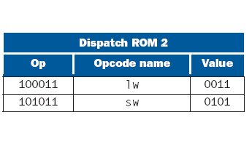
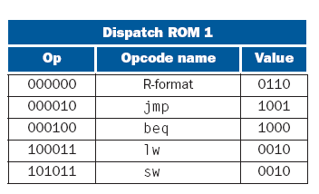
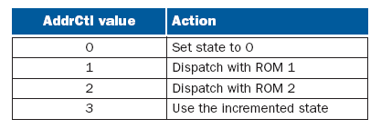
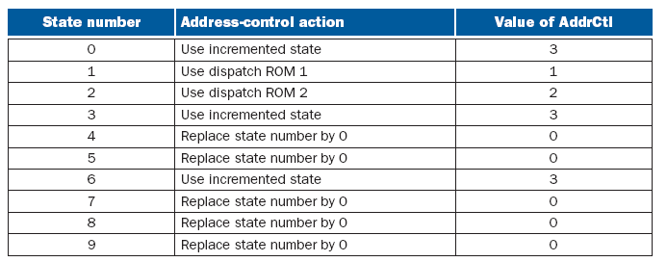
Multi-Cycle Control
(3) Microprogramming
Inside the address select logic

Slide 31
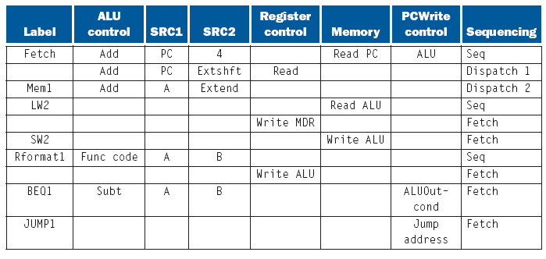
Multi-Cycle Control
(3) Microprogramming
Notes:
The microassembler converts the microcode into actual signal values
The sequencing field is used along with the opcode to determine the next state

Slide 32
Multi-Cycle Performance
Example 1. Compare the performance of the multi-cycle and single-cycle implementations for the SPECINT2000 program which has the following instruction mix: 25% loads, 10% stores, 11% branches, 2% jumps, 52% ALU.
Time_{SC} = IC x CPI_{SC} x CC_{SC}
= IC x 1 x CC_{SC} = IC_{SC} x CC_{SC}
TimeMC = IC x CPI_{MC} x CC_{MC}
CPI_{MC} = 0.25x5 + 0.1x4 + 0.11x3 + 0.02 x 3 + 0.52 x 4 = 4.12
CC_{MC} = 1/5 * CC_{SC} (Is that true!!)
Speedup = Time_{SC} / Time_{MC} = 5 / 4.12 = 1.21 !
Multi-cycle is cost effective as well, as long as the time for different processing units are balanced!

Slide 33
Multi-Cycle Performance
Single-Cycle
Multi-Cycle
This is true as long as the delay of all functional units is balanced!
Cycle 1
Cycle 2
LW
SW
waste
LW
SW
Instr

Slide 34
Multi-Cycle Performance
Example 2. Redo example 1 without assuming that the cycle time for multi-cycle is 1/5 that of single cycle. Assume the delay times of different units as given in the table.
Time_{SC} = IC x CPI_{SC} x CC_{SC}
= IC x 1 x 600 = 600 IC
TimeMC = IC x CPI_{MC} x CC_{MC}
CPI_{MC} = 0.25x5 + 0.1x4 + 0.11x3 + 0.02 x 3 + 0.52 x 4 = 4.12
CC_{MC} = 200 (should match the time of the slowest functional unit)
TimeMC = IC x 4.12x 200 = 824 IC
Speedup = Time_{SC} / TimeMC = 600 / 824= 0.782 !
Unit | Time (ps)
Memory | 200
ALU and adders | 100
Register File | 50

