Slide 1
DISTRIBUTED SYSTEMS Principles and Paradigms Second Edition ANDREW S. TANENBAUM MAARTEN VAN STEEN Chapter 4 Communication Modified by Dr. Gheith Abandah

Slide 2
Outline
Fundamentals
Remote procedure call
Message-oriented communication
Stream-oriented communication
Multicast communication

Slide 3
Stream-oriented Communication
Support for continuous media
Streams and QoS
Stream synchronization

Slide 4
Continuous Media
All communication facilities discussed so far are essentially based on a discrete, that is time-independent exchange of information
Continuous media: Characterized by the fact that values are time dependent:
Audio
Video
Animations
Sensor data (temperature, pressure, etc.)

Slide 5
Data Stream (1)
Definition: A (continuous) data stream is a connection-oriented communication facility that supports isochronous data transmission.
Some common stream characteristics:
Streams are unidirectional
There is generally a single source, and one or more sinks
Often, either the sink and/or source is a wrapper around hardware (e.g., camera, CD device, TV monitor)
Simple stream: a single flow of data, e.g., audio or video
Complex stream: multiple data flows, e.g., stereo audio or combination audio/video

Slide 6
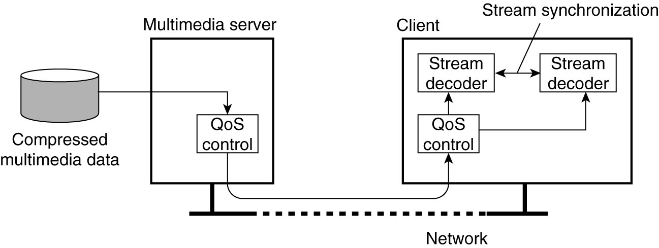
Data Stream (2)
A general architecture for streaming stored multimedia data over a network.

Slide 7
Streams and QoS
Streams are all about timely delivery of data. How do you specify this Quality of Service (QoS)? Basics:
The required bit rate at which data should be transported.
The maximum delay until a session has been set up (i.e., when an application can start sending data)
The maximum end-to-end delay (i.e., how long it will take until a data unit makes it to a recipient).
The maximum delay variance, or jitter.
The maximum round-trip delay.

Slide 8
Enforcing QoS (1)
There are various network-level tools, such as differentiated services by which certain packets can be prioritized.
Use buffers to reduce jitter:

Slide 9
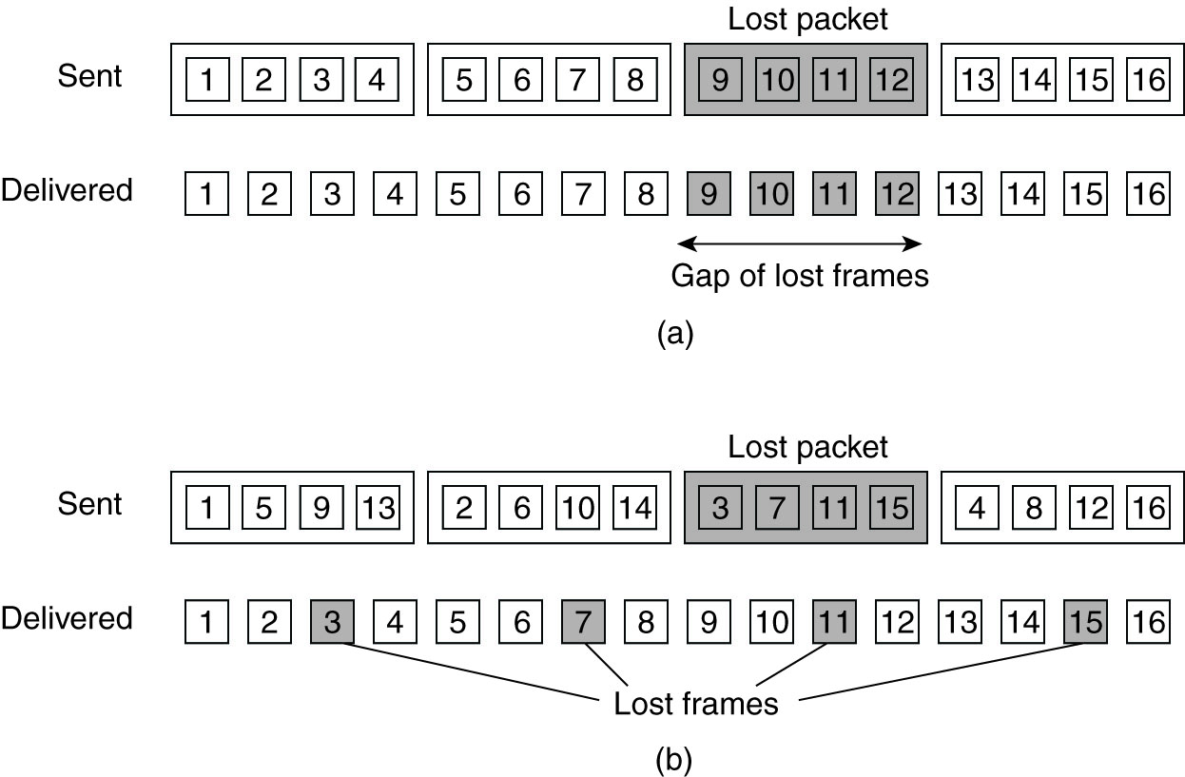
Enforcing QoS (2)
Error correction: k out of n is enough.
Use frame interleaving to reduce he effect of packet loss in (a) non interleaved tx and (b) interleaved

Slide 10
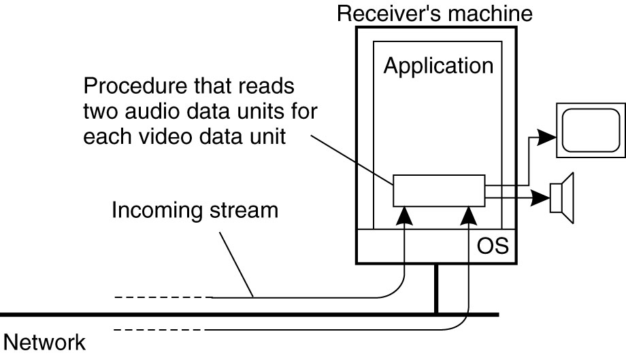
Stream Synchronization (1)
1. The principle of explicit synchronization of complex stream on the level of data units.

Slide 11
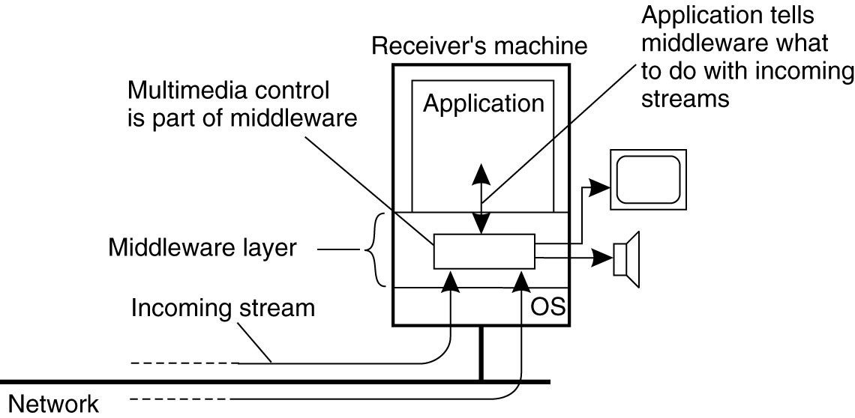
Stream Synchronization (2)
2. The principle of synchronization as supported by high-level interfaces.

Slide 12
Stream Synchronization (3)
Multiplex all substreams into a single stream, and demultiplex at the receiver. Synchronization is handled at multiplexing/demultiplexing point (MPEG).

Slide 13
Multicast Communication
Application-level multicasting
Epidemic algorithms

Slide 14
Application-level Multicasting (ALM)
Essence: Organize nodes of a distributed system into an overlay network and use that network to disseminate data.
Chord-based tree building
Initiator generates a multicast identifier mid.
Lookup succ(mid), the node responsible for mid.
Request is routed to succ(mid), which will become the root.
If P wants to join, it sends a join request to the root.
When request arrives at Q:
Q has not seen a join request before → it becomes forwarder; P becomes child of Q. Join request continues to be forwarded.
Q knows about tree → P becomes child of Q. No need to forward join request anymore.

Slide 15
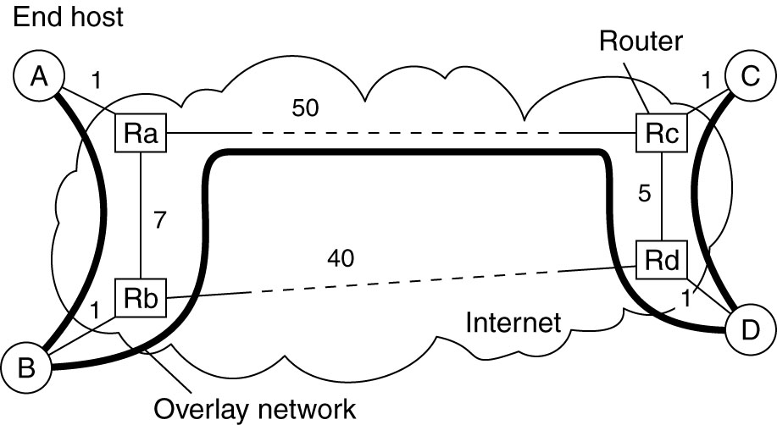
ALM Costs
Link stress: How often does an ALM message cross the same physical link? Example: message from A to D needs to cross (Ra;Rb) twice.
Stretch: Ratio in delay between ALM-level path and network-level path. Example: messages B to C follow path of length 71 at ALM, but 47 at network level → stretch = 71/47.
Tree optimization algorithms by switching parents

Slide 16
Epidemic Algorithms
General background
Update models
Anti-entropy
Gossiping
Removing objects

Slide 17
General Background
Basic idea: Assume there are no write–write conflicts:
Update operations are performed at a single server
A replica passes updated state to only a few neighbors
Update propagation is lazy, i.e., not immediate
Eventually, each update should reach every replica
Two forms of epidemics
Anti-entropy: Each replica regularly chooses another replica at random, and exchanges state differences, leading to identical states at both afterwards
Gossiping: A replica which has just been updated (i.e., has been contaminated), tells a number of other replicas about its update (contaminating them as well).

Slide 18
Anti-entropy
Principle operations
A node P selects another node Q from the system at random.
Push: P only sends its updates to Q
Pull: P only retrieves updates from Q
Push-Pull: P and Q exchange mutual updates (after which they hold the same information).
Observation
For push-pull it takes O(log(N)) rounds to disseminate updates to all N nodes (round = when every node has taken the initiative to start an exchange).

Slide 19
Gossiping (1)
Basic model
A server S having an update to report, contacts other servers. If a server is contacted to which the update has already propagated, S stops contacting other servers with probability 1/k.
Note
If we really have to ensure that all servers are eventually updated, gossiping alone is not enough

Slide 20
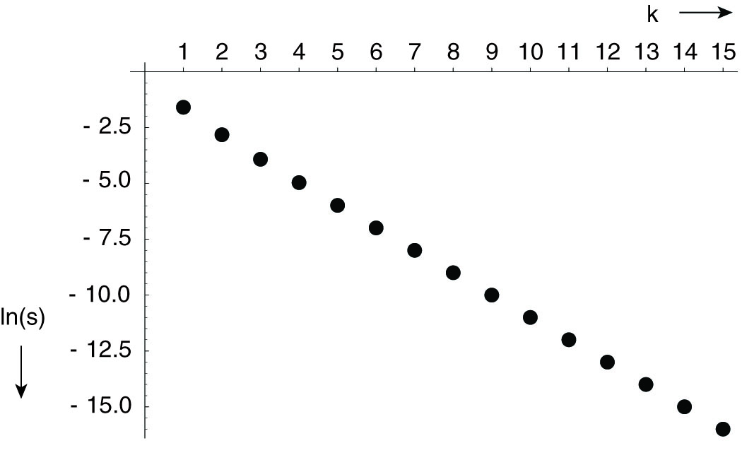
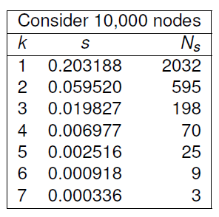
Gossiping (2)
The relation between the fraction s of update-ignorant nodes and the parameter k in pure gossiping. The graph displays ln(s) as a function of k.

Slide 21
Deleting values
Fundamental problem
We cannot remove an old value from a server and expect the removal to propagate. Instead, mere removal will be undone in due time using epidemic algorithms
Solution
Removal has to be registered as a special update by inserting a death certificate

