Slide 1
DISTRIBUTED SYSTEMS Principles and Paradigms Second Edition ANDREW S. TANENBAUM MAARTEN VAN STEEN Chapter 4/B Communication Modified by Dr. Gheith Abandah

Slide 2
Outline
Fundamentals
Remote procedure call
Message-oriented communication
Stream-oriented communication
Multicast communication

Slide 3
Message-oriented Communication
Transient Messaging
Message-Queuing Systems
Message Brokers
Example: IBM WebSphere

Slide 4
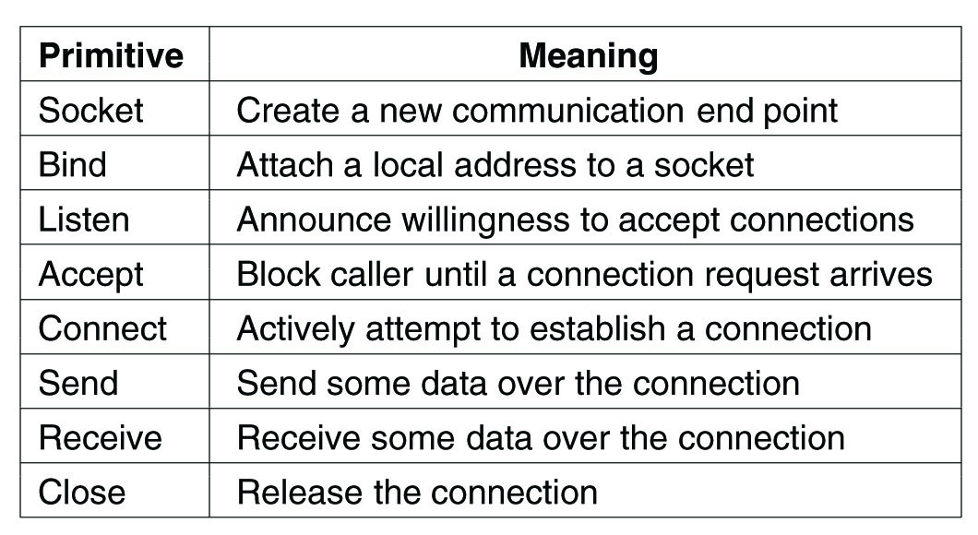
Transient Messaging: Berkeley Sockets (1)
Client server
Buffers
IP+Port
The socket primitives for TCP/IP

Slide 5
Transient Messaging: Berkeley Sockets (2)
Connection-oriented communication pattern using sockets.

Slide 6
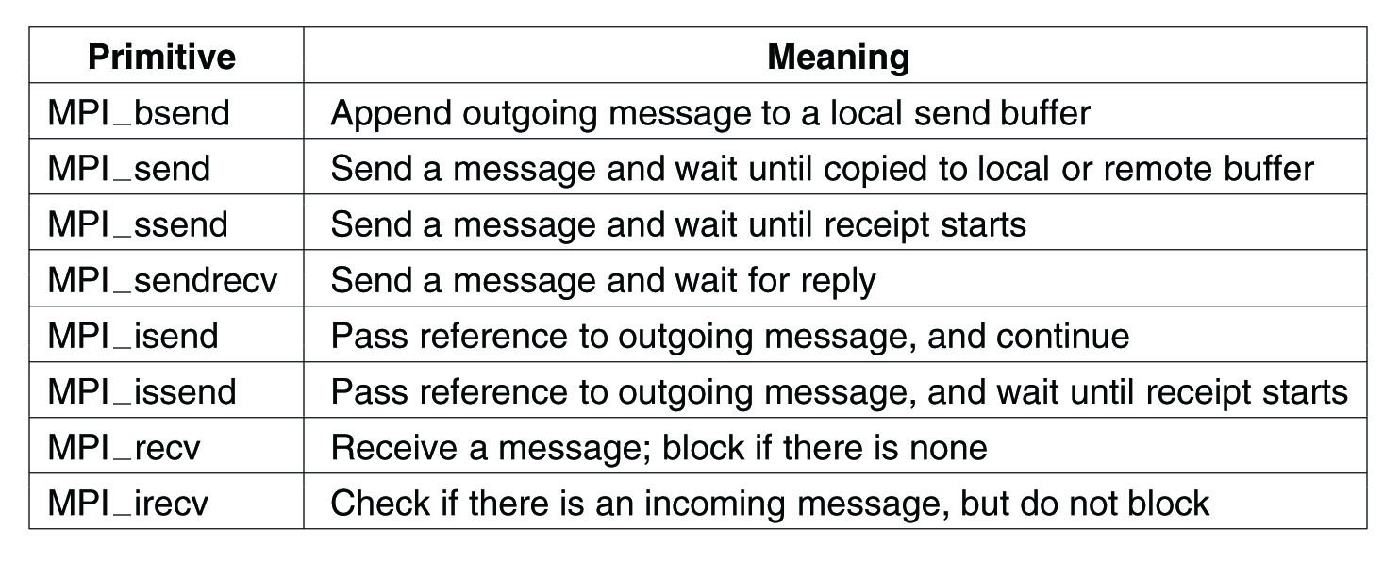
The Message-Passing Interface (MPI)
Some of the most intuitive message-passing primitives of MPI.

Slide 7
Message-Queuing Systems (1)
Message-oriented middleware: Asynchronous persistent communication through support of middleware-level queues. Queues correspond to buffers at communication servers.
Basic interface to a queue in a message-queuing system.

Slide 8
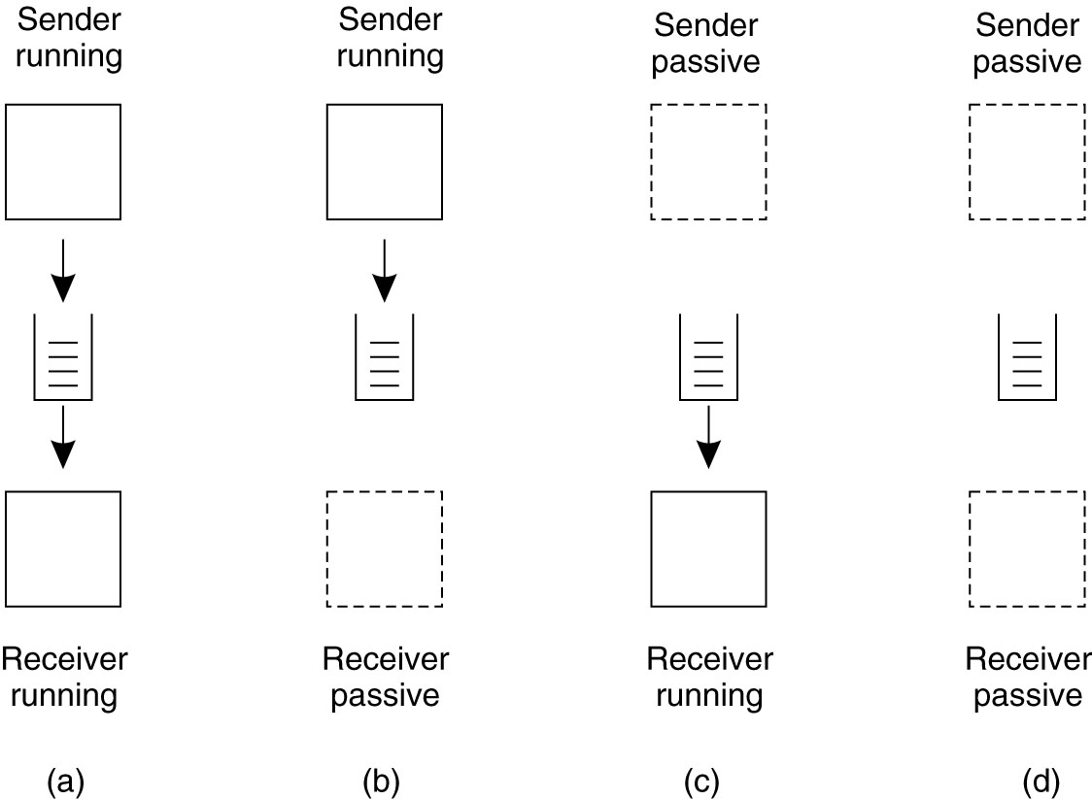
Message-Queuing Systems (2)
Four combinations for loosely-coupled communications using queues.

Slide 9
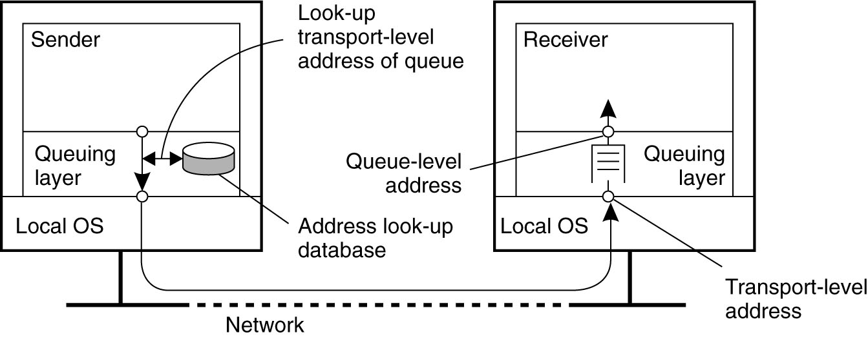
General Architecture of a Message-Queuing System (1)
Addr
IP
The relationship between queue-level addressing and network-level addressing.

Slide 10
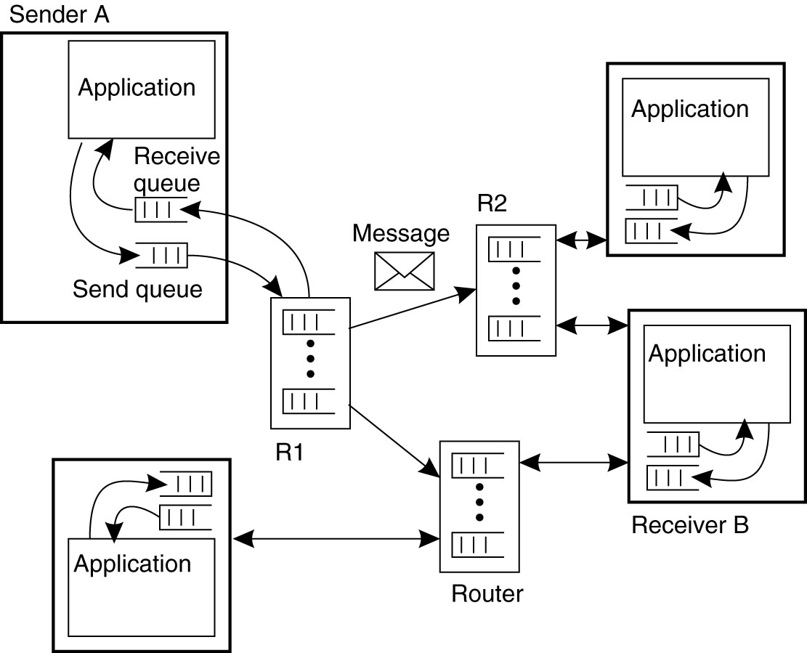
General Architecture of a Message-Queuing System (2)
The general organization
of a message-queuing
system with routers,
often with dynamic
routing.

Slide 11
Message Brokers (1)
Message queuing systems assume a common messaging protocol: all applications agree on message format (i.e., structure and data representation)
Message broker: Centralized component that takes care of application heterogeneity in an MQ system:
Transforms incoming messages to target format
Very often acts as an application gateway
May provide subject-based routing capabilities → Enterprise Application Integration (publish/subscribe)

Slide 12
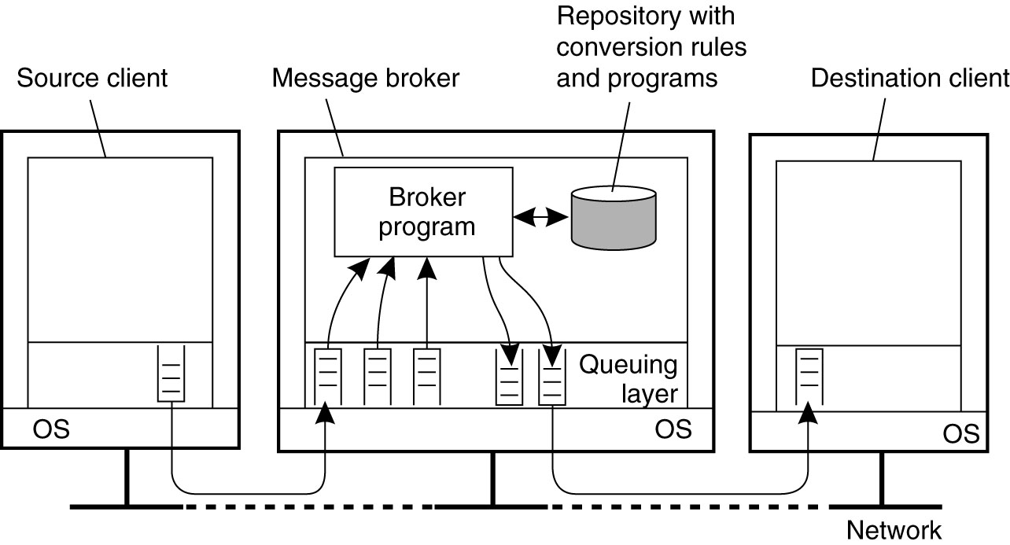
Message Brokers (2)
The general organization of a message broker
in a message-queuing system.

Slide 13
IBM’s WebSphere MQ (1)
Basic concepts
Application-specific messages are put into, and removed from queues
Queues reside under the regime of a queue manager
Processes can put messages only in local queues, or through an RPC mechanism

Slide 14
IBM’s WebSphere MQ (2)
Message transfer
Messages are transferred between queues
Message transfer between queues at different processes, requires a channel
At each endpoint of channel is a message channel agent (MCA)
Message channel agents are responsible for:
Setting up channels using lower-level network communication facilities (e.g., TCP/IP)
(Un)wrapping messages from/in transport-level packets
Sending/receiving packets

Slide 15
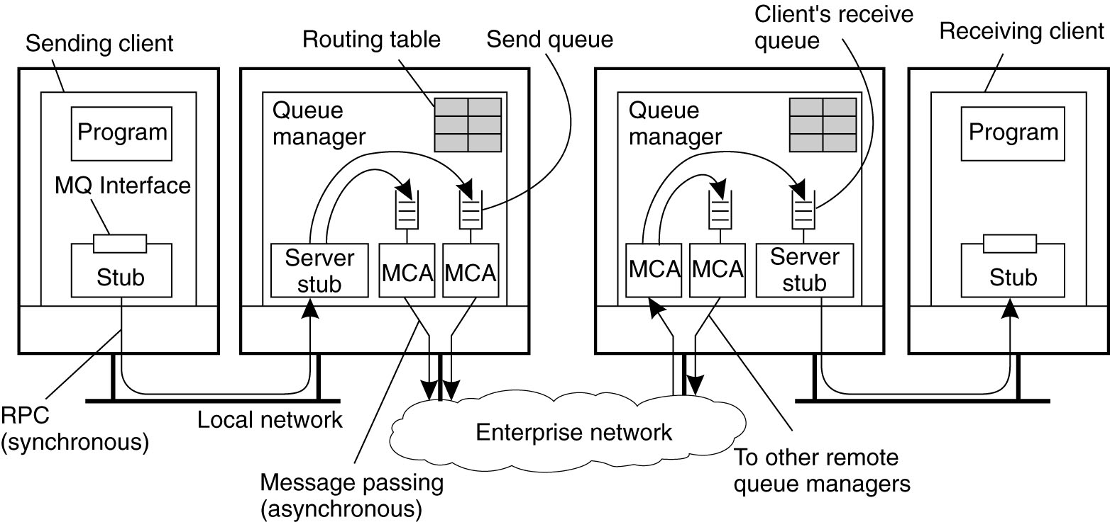
IBM’s WebSphere MQ (3)
Channels are inherently unidirectional
Automatically start MCAs when messages arrive, stop after time-out
Any network of queue managers can be created
Routes are set up manually (system administration)

Slide 16
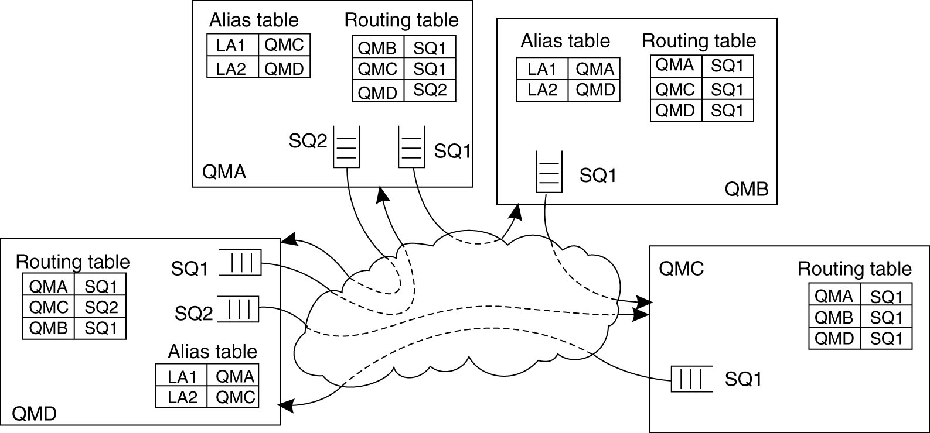
IBM’s WebSphere MQ (4)
Routing: By using logical names, in combination with name resolution to local queues, it is possible to put a message in a remote queue. Addr. Pair: (destQM, SendQ)

Slide 17
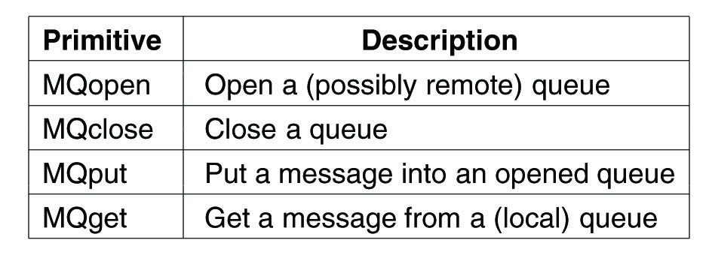
IBM’s WebSphere MQ (5)
Primitives available in the message-queuing interface.

