Slide 1
DISTRIBUTED SYSTEMS Principles and Paradigms Second Edition ANDREW S. TANENBAUM MAARTEN VAN STEEN Chapter 4 Communication Modified by Dr. Gheith Abandah

Slide 2
Outline
Fundamentals
Remote procedure call
Message-oriented communication
Stream-oriented communication
Multicast communication

Slide 3
Fundamentals
Basic networking model
Low-level layers
Transport layer
Application layer
Middleware layer
Types of communication

Slide 4
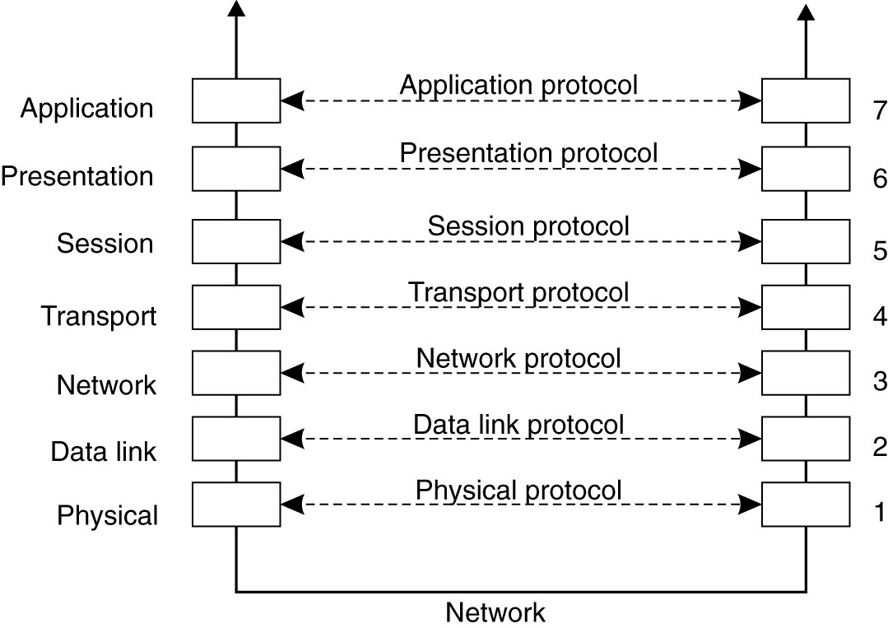
Basic Networking Model (1)
Drawbacks: Focus on message-passing only. Often unneeded or unwanted functionality.

Slide 5
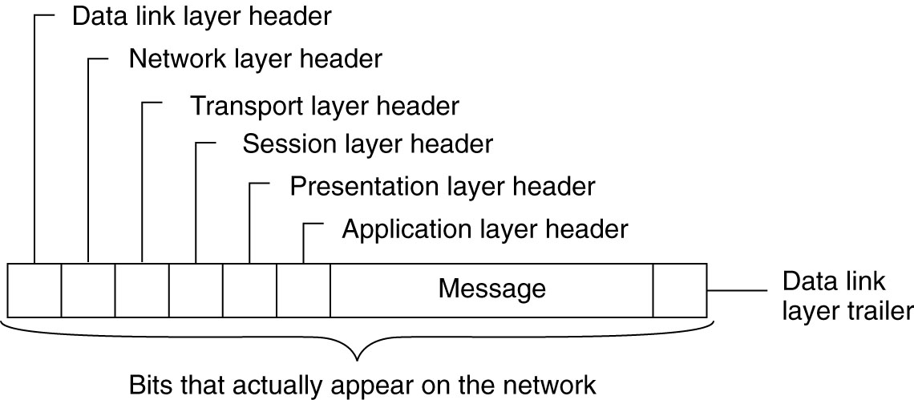
Basic Networking Model (2)
A typical message as it appears on the network

Slide 6
Low-level Layers
Recap
Physical layer: contains the speciﬁcation and implementation of bits, and their transmission between sender and receiver
Data link layer: prescribes the transmission of a series of bits into a frame to allow for error and ﬂow control
Network layer: describes how packets in a network of computers are to be routed, e.g., Internet Protocol
Observation
For many distributed systems, the lowest-level interface is that of the network layer.

Slide 7
Transport Layer
Important
The transport layer provides the actual communication facilities for most distributed systems.
Standard Internet protocols
TCP: connection-oriented, reliable, stream-oriented communication
UDP: unreliable (best-effort) datagram communication

Slide 8
Middleware Layer (1)
Observation
Middleware is invented to provide common services and protocols that can be used by many different applications
A rich set of communication protocols
(Un)marshaling of data, necessary for integrated systems
Naming protocols to allow easy sharing of resources
Security protocols for secure communication
Scaling mechanisms such as for replication and caching
Note
What remains are truly application-speciﬁc protocols.

Slide 9
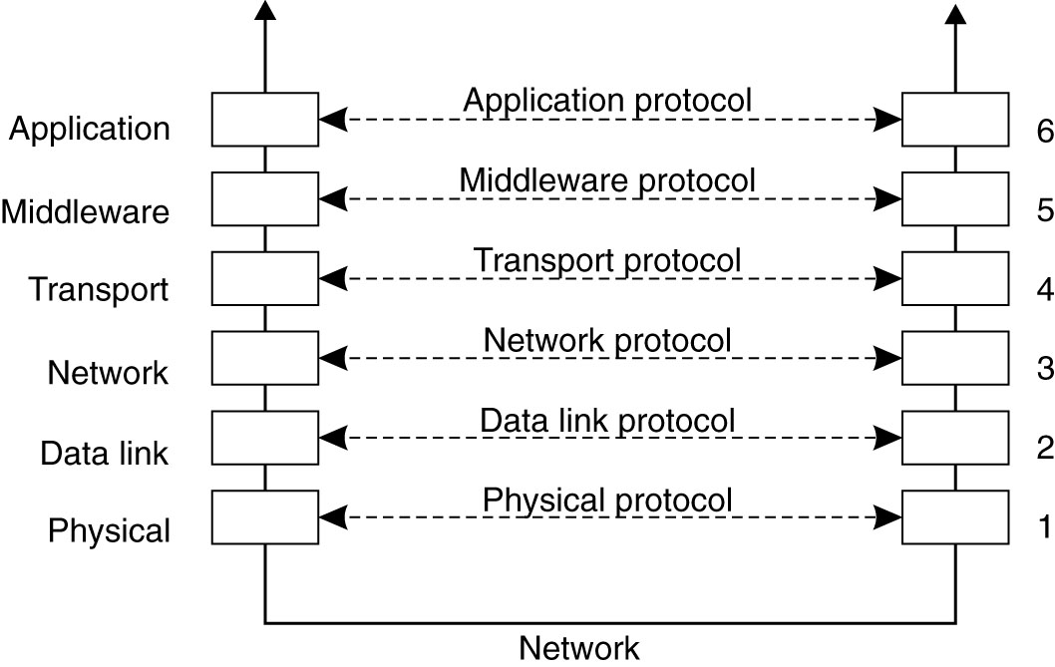
Middleware Layer (2)
An adapted reference model for networked communication.

Slide 10
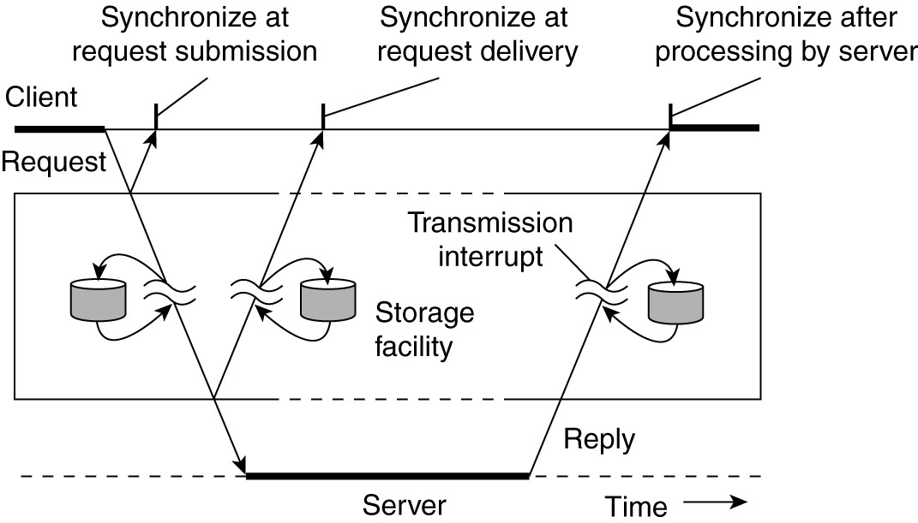
Types of Communication (1)
Transient communication: Comm. server discards message when it cannot be delivered at the next server, or at the receiver.
Persistent communication: A message is stored at a communication server as long as it takes to deliver it.

Slide 11
Types of Communication (2)
Places for synchronization
At request submission
At request delivery
After request processing

Slide 12
Types of Communication (3)
Some observations
Client/Server computing is generally based on a model of transient synchronous communication:
Client and server have to be active at time of comm.
Client issues request and blocks until it receives reply
Server essentially waits only for incoming requests, and subsequently processes them
Drawbacks synchronous communication
Client cannot do any other work while waiting for reply
Failures have to be handled immediately: the client is waiting
The model may simply not be appropriate (mail, news)

Slide 13
Types of Communication (4)
Message-oriented middleware
Aims at high-level persistent asynchronous communication:
Processes send each other messages, which are queued
Sender need not wait for immediate reply, but can do other things
Middleware often ensures fault tolerance

Slide 14
Remote Procedure Call (RPC)
Basic RPC operation
Parameter passing
Synchronous RPC
Example: DCE RPC

Slide 15
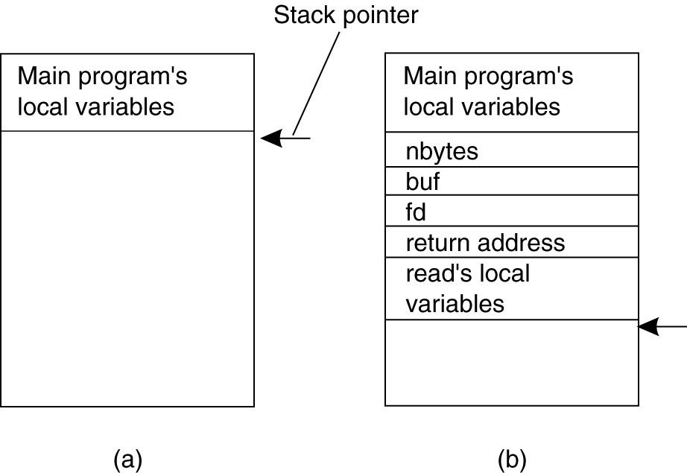
Conventional Procedure Call
Parameter passing in a local procedure call: (a) The stack before the call to read. (b) The stack while the called procedure is active.

Slide 16
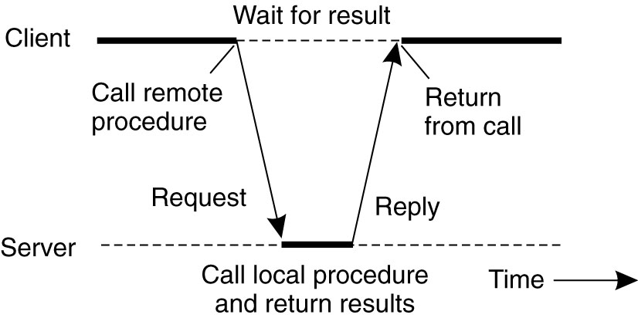
Basic RPC Operation (1)
Observations
Application developers are familiar with simple procedure model
Well-engineered procedures operate in isolation (black box)
There is no fundamental reason not to execute procedures on separate machine
Conclusion
Communication between caller & callee can be hidden by using procedure-call mechanism.

Slide 17
Basic RPC Operation (2)
A remote procedure call occurs in the following
steps:
The client procedure calls the client stub in the normal way.
The client stub builds a message and calls the local operating system.
The client’s OS sends the message to the remote OS.
The remote OS gives the message to the server stub.
The server stub unpacks the parameters and calls the server. Continued …

Slide 18
Basic RPC Operation (3)
A remote procedure call occurs in the following
steps (continued):
The server does the work and returns the result to the stub.
The server stub packs it in a message and calls its local OS.
The server’s OS sends the message to the client’s OS.
The client’s OS gives the message to the client stub.
The stub unpacks the result and returns to the client.

Slide 19
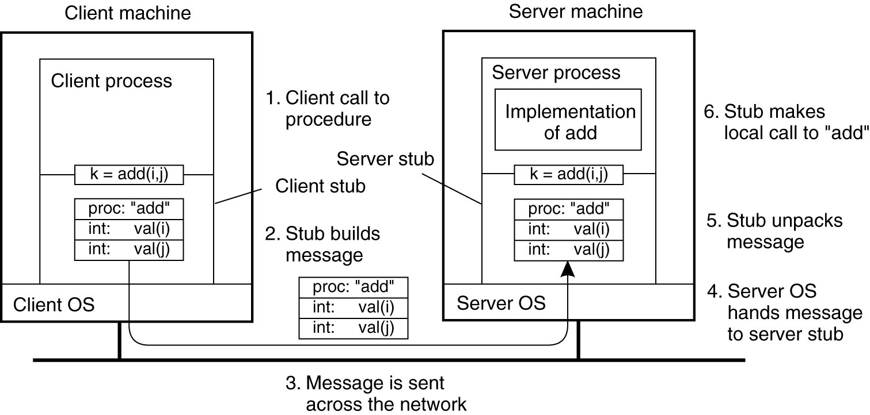
Basic RPC Operation (4)
The steps involved in a doing a remote computation through RPC.

Slide 20
RPC: Parameter Passing (1)
Parameter marshaling
There’s more than just wrapping parameters into a message:
Client and server machines may have different data
representations (think of byte ordering)
Wrapping a parameter means transforming a value into a sequence of bytes
Client and server have to agree on the same encoding:
How are basic data values represented (integers, ﬂoats, characters)
How are complex data values represented (arrays, unions)
Client and server need to properly interpret messages, transforming them into machine-dependent representations.

Slide 21
RPC: Parameter Passing (2)
RPC parameter passing: some assumptions
Copy in/copy out semantics: while procedure is executed, nothing can be assumed about parameter values.
All data that is to be operated on is passed by parameters. Excludes passing references to (global) data.
Conclusion
Full access transparency cannot be realized.
Observation
A remote reference mechanism enhances access transparency:
Remote reference offers uniﬁed access to remote data
Remote references can be passed as parameter in RPCs

Slide 22
Passing Value Parameters (1)
The little numbers in boxes indicate the address of each byte.
Example: The original message on the Pentium (little endian)
5, JILL

Slide 23
Passing Value Parameters (2)
The message as received on the SPARC (big endian)

Slide 24
Passing Value Parameters (3)
The message after inverting the two words
5, LLIJ

Slide 25
Parameter Specification and Stub Generation
(a) A procedure. (b) The corresponding message prescribed by the RPC protocol.
IDL: Interface Definition Language is used to compile the code into client and server stubs.

Slide 26
Asynchronous RPC (1)
The interaction between client and server in a traditional Synchronous RPC

Slide 27
Asynchronous RPC (2)
The interaction using asynchronous RPC.

Slide 28
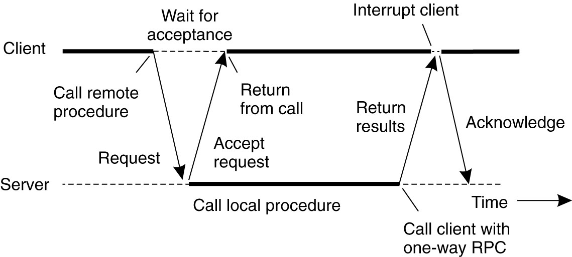
Asynchronous RPC (3)
Deferred synchronous: A client and server interacting through two asynchronous RPCs.
Variation: Client can also do a (non)blocking poll at the server to see whether results are available.

Slide 29
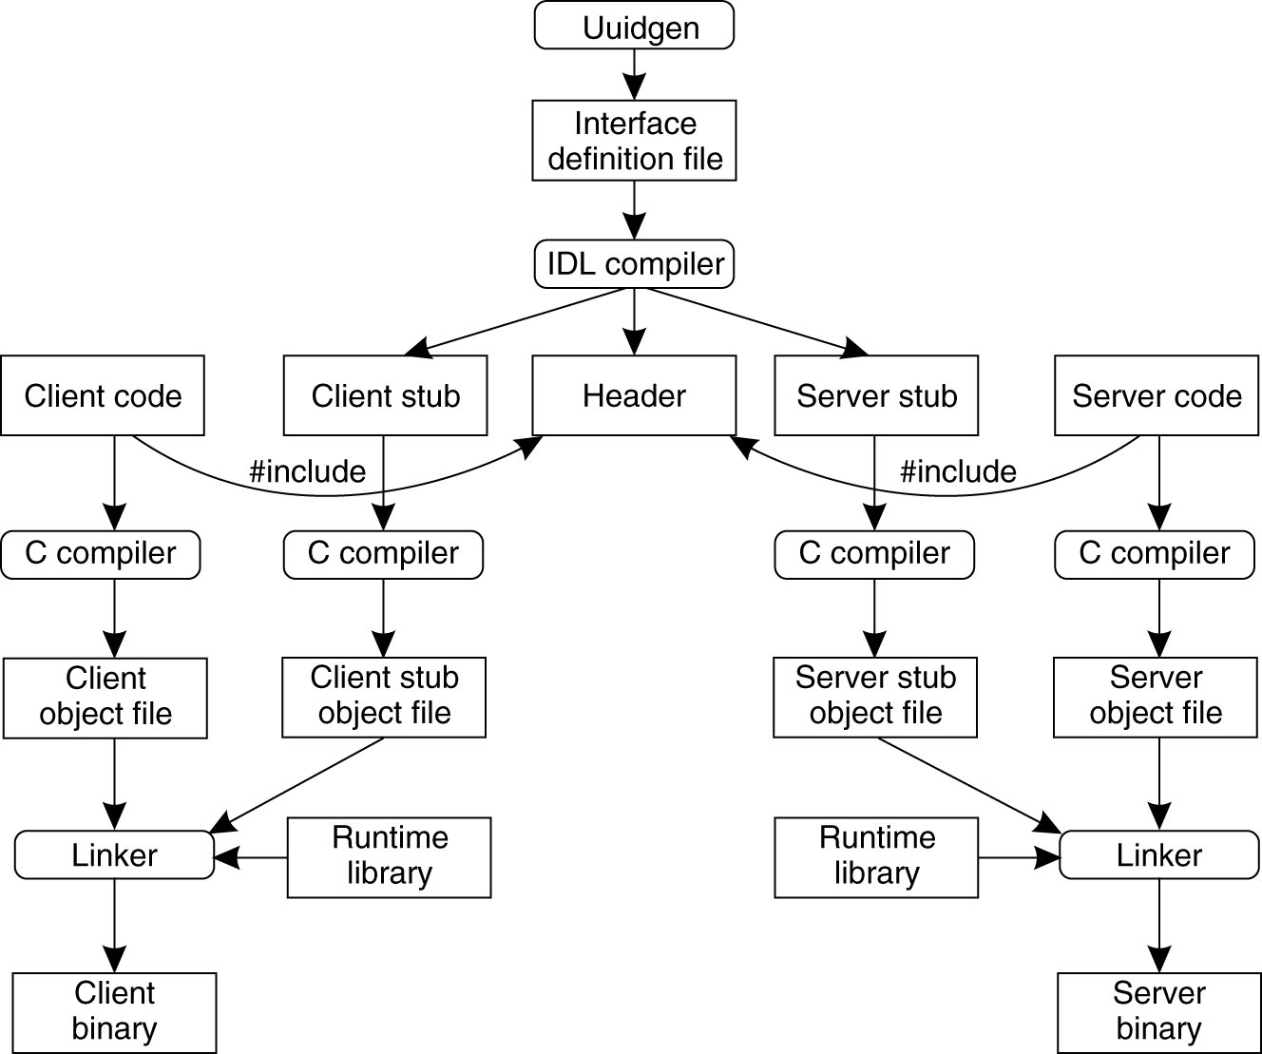
Example: DCE RPC (1)
The steps in writing a client and a server in Distributed Computing Environment DCE RPC.

Slide 30
Example: DCE RPC (2)
Three files output by the IDL compiler:
A header file (e.g., interface.h, in C terms).
The client stub.
The server stub.

Slide 31
Binding a Client to a Server in DCE RPC (1)
Registration of a server makes it possible for a client to locate the server and bind to it.
Server location is done in two steps:
Locate the server’s machine.
Locate the server on that machine.

Slide 32
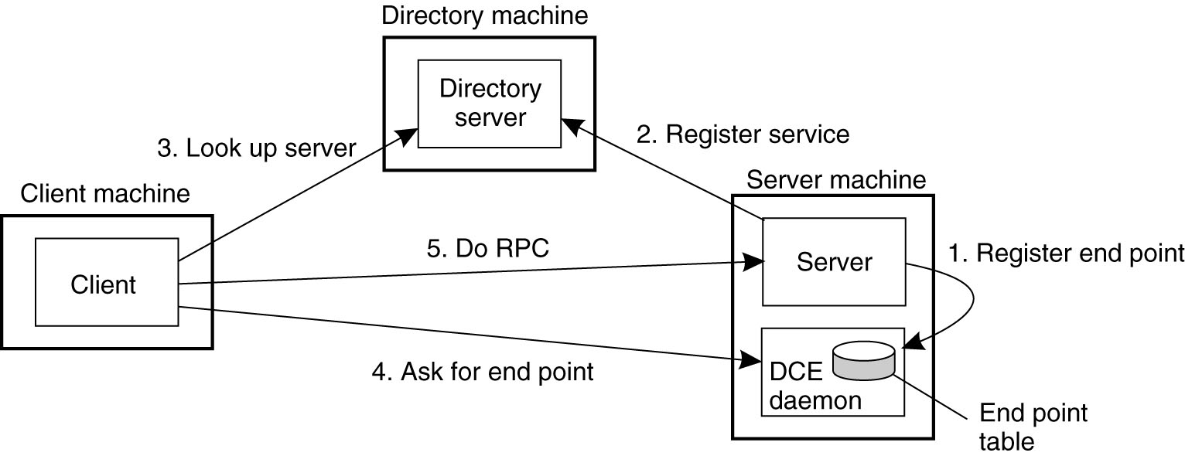
Binding a Client to a Server in DCE RPC (2)
Client-to-server binding in DCE.

