Slide 1
Computer Architecture
A Quantitative Approach, Fifth Edition
Chapter 5
Multiprocessors and
Thread-Level Parallelism

Slide 2
Introduction
Introduction
Thread-Level parallelism
  Have multiple program counters
  Uses MIMD model
  Targeted for tightly-coupled shared-memory multiprocessors
For n processors, need n threads
Amount of computation assigned to each thread = grain size
  Threads can be used for data-level parallelism, but the overheads may outweigh the benefit

Slide 3
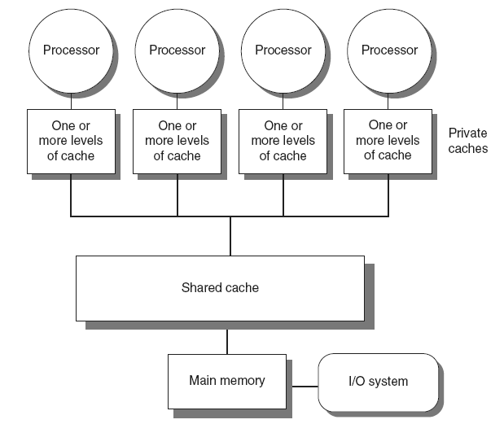
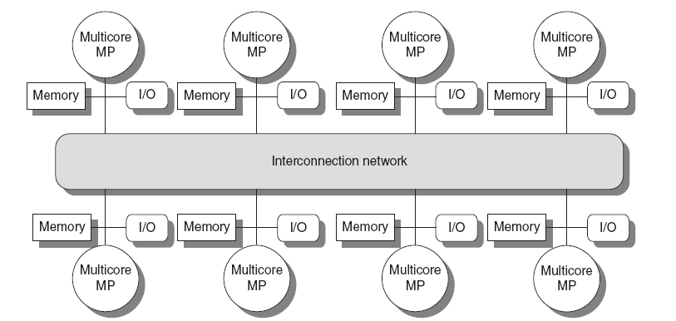
Types
Introduction
Symmetric multiprocessors (SMP)
  Small number of cores
  Share single memory with uniform memory latency
Distributed shared memory (DSM)
  Memory distributed among processors
  Non-uniform memory access/latency (NUMA)
  Processors connected via direct (switched) and non-direct (multi-hop) interconnection networks

Slide 4
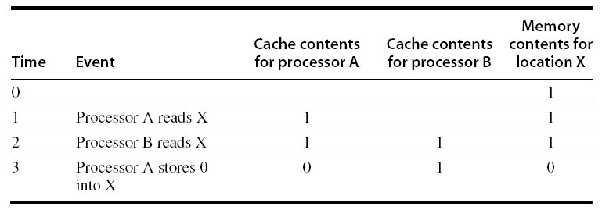
Cache Coherence
Processors may see different values through their caches:
Centralized Shared-Memory Architectures

Slide 5
Cache Coherence
Coherence
  All reads by any processor must return the most recently written value
  Writes to the same location by any two processors are seen in the same order by all processors
Consistency
  When a written value will be returned by a read
  If a processor writes location A followed by location B, any processor that sees the new value of B must also see the new value of A
Centralized Shared-Memory Architectures

Slide 6
Enforcing Coherence
Coherent caches provide:
  Migration: movement of data
  Replication: multiple copies of data
Cache coherence protocols
  Directory based
    Sharing status of each block kept in one location
  Snooping
    Each core tracks sharing status of each block
Centralized Shared-Memory Architectures

Slide 7
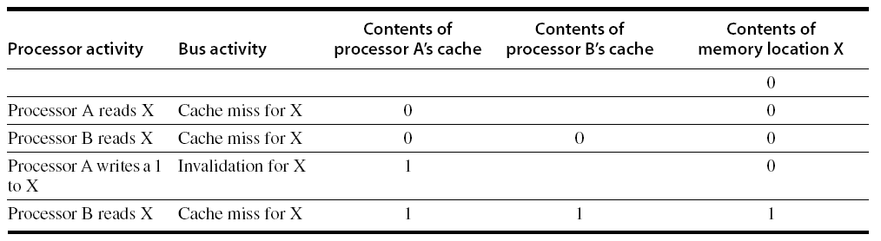
Snoopy Coherence Protocols
Write invalidate
  On write, invalidate all other copies
  Use bus itself to serialize
    Write cannot complete until bus access is obtained
Write update
  On write, update all copies
Centralized Shared-Memory Architectures

Slide 8
Snoopy Coherence Protocols
Locating an item when a read miss occurs
  In write-back cache, the updated value must be sent to the requesting processor
Cache lines marked as shared or exclusive/modified
  Only writes to shared lines need an invalidate broadcast
    After this, the line is marked as exclusive
Centralized Shared-Memory Architectures

Slide 9
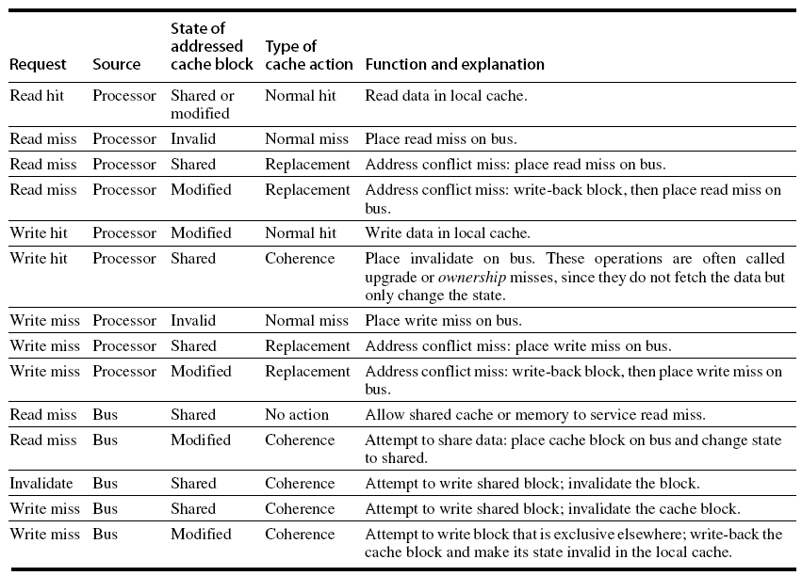
Snoopy Coherence Protocols
Centralized Shared-Memory Architectures

Slide 10
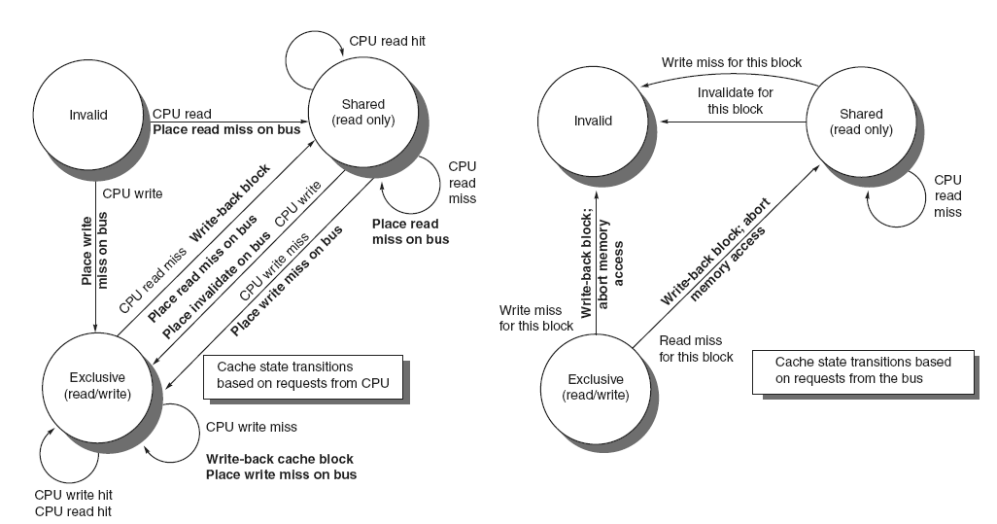
Snoopy Coherence Protocols
Centralized Shared-Memory Architectures

Slide 11
Snoopy Coherence Protocols
Complications for the basic MSI protocol:
  Operations are not atomic
    E.g. detect miss, acquire bus, receive a response
    Creates possibility of deadlock and races
    One solution: processor that sends invalidate can hold bus until other processors receive the invalidate
Extensions:
  Add exclusive state to indicate clean block in only one cache (MESI protocol)
    Prevents needing to write invalidate on a write
  Owned state
Centralized Shared-Memory Architectures

Slide 12
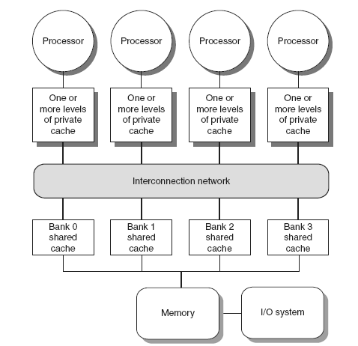
Coherence Protocols: Extensions
Shared memory bus and snooping bandwidth is bottleneck for scaling symmetric multiprocessors
  Duplicating tags
  Place directory in outermost cache
  Use crossbars or point-to-point networks with banked memory
Centralized Shared-Memory Architectures

Slide 13
Coherence Protocols
AMD Opteron:
  Memory directly connected to each multicore chip in NUMA-like organization
  Implement coherence protocol using point-to-point links
  Use explicit acknowledgements to order operations
Centralized Shared-Memory Architectures

Slide 14
Performance
Coherence influences cache miss rate
  Coherence misses
    True sharing misses
      Write to shared block (transmission of invalidation)
      Read an invalidated block
    False sharing misses
      Read an unmodified word in an invalidated block
Performance of Symmetric Shared-Memory Multiprocessors

Slide 15
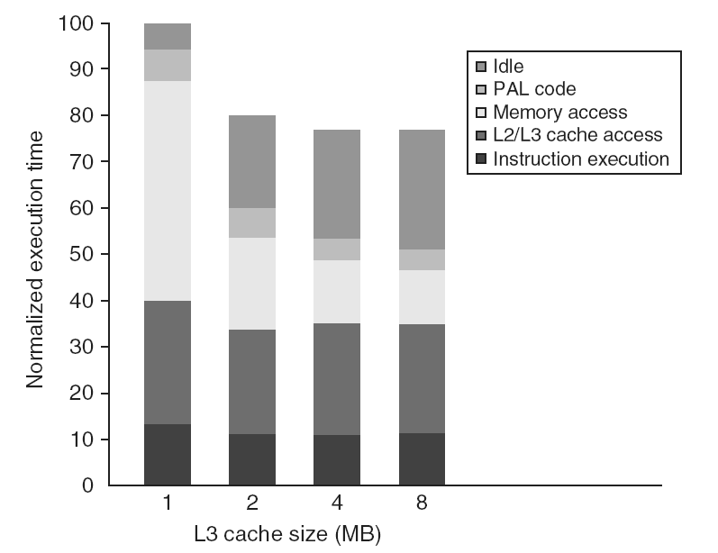
Performance Study: Commercial Workload
Performance of Symmetric Shared-Memory Multiprocessors

Slide 16
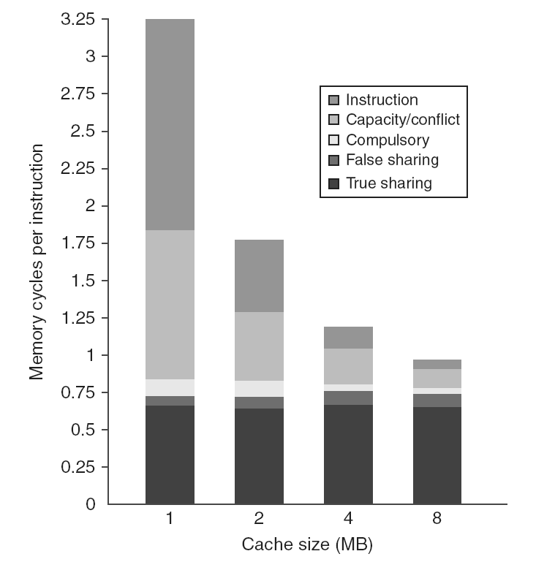
Performance Study: Commercial Workload
Performance of Symmetric Shared-Memory Multiprocessors

Slide 17
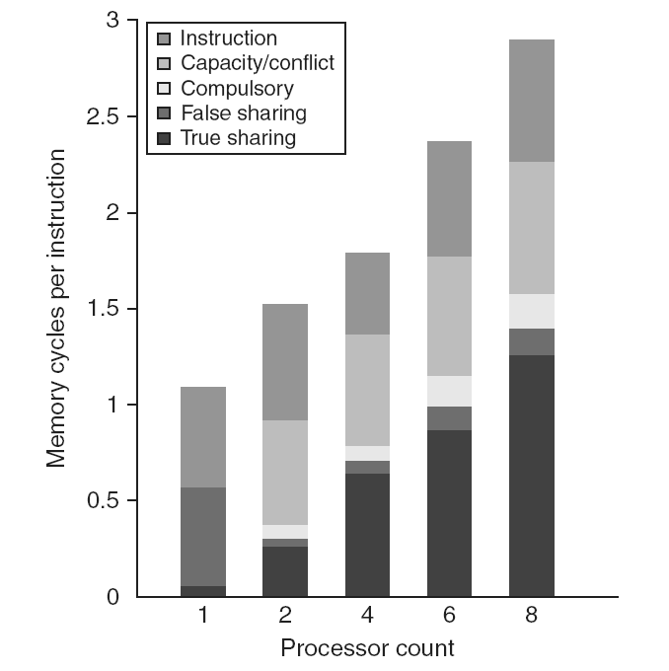
Performance Study: Commercial Workload
Performance of Symmetric Shared-Memory Multiprocessors

Slide 18
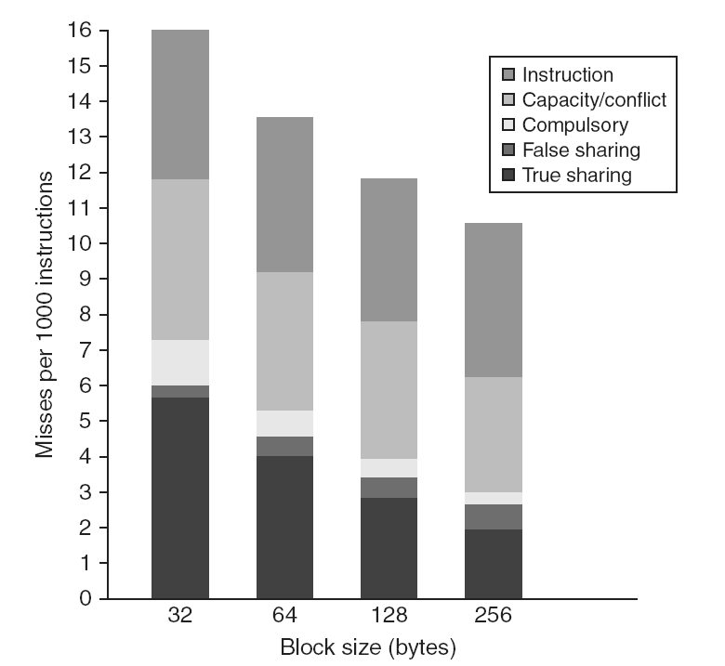
Performance Study: Commercial Workload
Performance of Symmetric Shared-Memory Multiprocessors

Slide 19
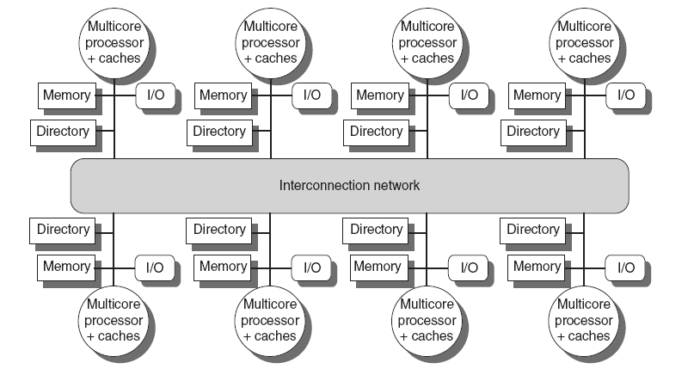
Directory Protocols
Directory keeps track of every block
  Which caches have each block
  Dirty status of each block
Implement in shared L3 cache
  Keep bit vector of size = # cores for each block in L3
  Not scalable beyond shared L3
Implement in a distributed fashion:
Distributed Shared Memory and Directory-Based Coherence

Slide 20
Directory Protocols
For each block, maintain state:
  Shared
    One or more nodes have the block cached, value in memory is up-to-date
    Set of node IDs
  Uncached
  Modified
    Exactly one node has a copy of the cache block, value in memory is out-of-date
    Owner node ID
Directory maintains block states and sends invalidation messages
Distributed Shared Memory and Directory-Based Coherence

Slide 21
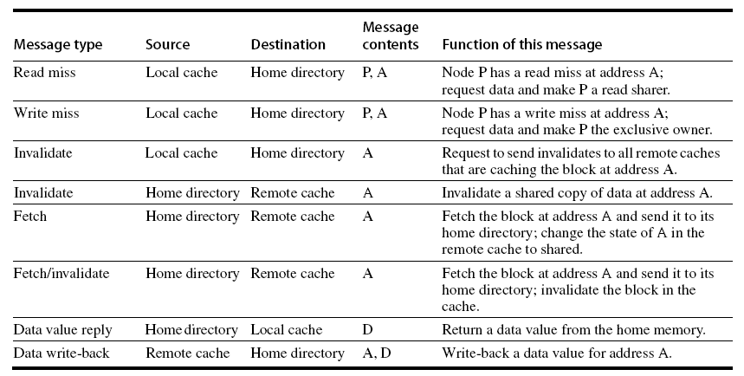
Messages
Distributed Shared Memory and Directory-Based Coherence

Slide 22
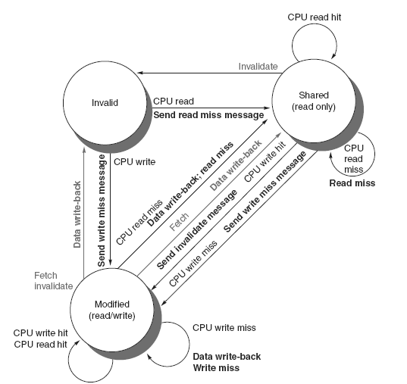
Directory Protocols
Distributed Shared Memory and Directory-Based Coherence

Slide 23
Directory Protocols
For uncached block:
  Read miss
    Requesting node is sent the requested data and is made the only sharing node, block is now shared
  Write miss
    The requesting node is sent the requested data and becomes the sharing node, block is now exclusive
For shared block:
  Read miss
    The requesting node is sent the requested data from memory, node is added to sharing set
  Write miss
    The requesting node is sent the value, all nodes in the sharing set are sent invalidate messages, sharing set only contains requesting node, block is now exclusive
Distributed Shared Memory and Directory-Based Coherence

Slide 24
Directory Protocols
For exclusive block:
  Read miss
    The owner is sent a data fetch message, block becomes shared, owner sends data to the directory, data written back to memory, sharers set contains old owner and requestor
  Data write back
    Block becomes uncached, sharer set is empty
  Write miss
    Message is sent to old owner to invalidate and send the value to the directory, requestor becomes new owner, block remains exclusive
Distributed Shared Memory and Directory-Based Coherence

Slide 25
Synchronization
Synchronization
Basic building blocks:
  Atomic exchange
    Swaps register with memory location
  Test-and-set
    Sets under condition
  Fetch-and-increment
    Reads original value from memory and increments it in memory
  Requires memory read and write in uninterruptable instruction
  load linked/store conditional
    If the contents of the memory location specified by the load linked are changed before the store conditional to the same address, the store conditional fails

Slide 26
Implementing Locks
Synchronization
Spin lock
  If no coherence:
DADDUI R2,R0,#1
lockit: EXCH R2,0(R1) ;atomic exchange
BNEZ R2,lockit ;already locked?
  If coherence:
lockit: LD R2,0(R1) ;load of lock
BNEZ R2,lockit ;not available-spin
DADDUI R2,R0,#1 ;load locked value
EXCH R2,0(R1) ;swap
BNEZ R2,lockit ;branch if lock wasn’t 0

Slide 27
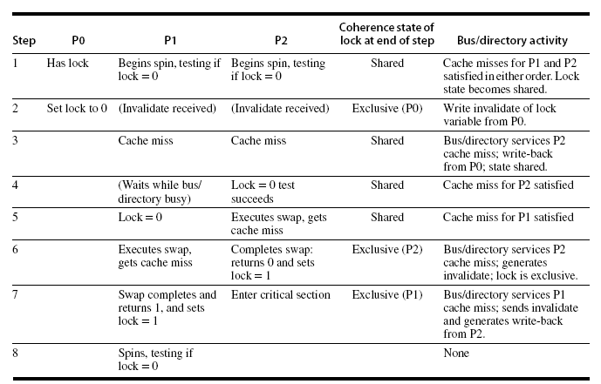
Implementing Locks
Synchronization
Advantage of this scheme: reduces memory traffic

Slide 28
Models of Memory Consistency
Processor 1:
A=0
…
A=1
if (B==0) …
Processor 2:
B=0
…
B=1
if (A==0) …
Should be impossible for both if-statements to be evaluated as true
  Delayed write invalidate?
Sequential consistency:
  Result of execution should be the same as long as:
    Accesses on each processor were kept in order
    Accesses on different processors were arbitrarily interleaved
Models of Memory Consistency: An Introduction

Slide 29
Implementing Locks
To implement, delay completion of all memory accesses until all invalidations caused by the access are completed
  Reduces performance!
Alternatives:
  Program-enforced synchronization to force write on processor to occur before read on the other processor
    Requires synchronization object for A and another for B
      “Unlock” after write
      “Lock” after read
Models of Memory Consistency: An Introduction

Slide 30
Relaxed Consistency Models
Rules:
  X → Y
    Operation X must complete before operation Y is done
    Sequential consistency requires:
      R → W, R → R, W → R, W → W
  Relax W → R
    “Total store ordering”
  Relax W → W
    “Partial store order”
  Relax R → W and R → R
    “Weak ordering” and “release consistency”
Models of Memory Consistency: An Introduction

Slide 31
Relaxed Consistency Models
Consistency model is multiprocessor specific
Programmers will often implement explicit synchronization
Speculation gives much of the performance advantage of relaxed models with sequential consistency
  Basic idea: if an invalidation arrives for a result that has not been committed, use speculation recovery
Models of Memory Consistency: An Introduction

